Slide 1
Medicine Reconciliation Catherine Wilson – Pharmacist Helen Muller - Technician

Slide 2
Medicine reconciliation
Medicine reconciliation is an evidence-based process, which has been demonstrated to significantly reduce medication errors caused by incomplete or insufficient documentation of medicine related information.
It is the process of collecting, comparing and communicating the most accurate list of all medications, allergies and adverse drug reactions (ADRs) for a patient
Any discrepancies are then documented and reconciled.
A key to its success lies in accurate communication of medicine related information between healthcare practitioners.

Slide 3
Why do it?
There are often changes to a patient's medicines when their care is handed over to other health professionals
Examples include admission to hospital, transfer between wards or discharge from hospital.
Some of these medicine changes are unintentional due to poor information and some are intentional but not clearly documented.
Both types of change can result in medication errors and/or patient harm.

Slide 4
International studies
Between 10 to 67 percent of medication histories have at least one error
Up to one-third of these errors have the potential to cause patient harm
More than 50 percent of medication errors occur at transitions of care
Patients with one or more medicines missing from their discharge information are 2.3 times more likely to be readmitted to hospital than those with correct information on discharge.
85 percent of discrepancies in medication treatment originate from poor medication history taking
Medicine Reconciliation | Health Quality & Safety Commission (hqsc.govt.nz)

Slide 5
Medicine reconciliation standards
www.hqsc.govt.nz/assets/Our-work/System-safety/Reducing-harm/Medicines/Publications-resources/Medication_Rec_Standard_v3.pdf

Slide 6
Who can do medicine reconciliation?

Slide 7
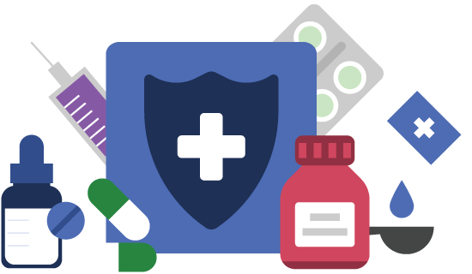
Steps
Collect
Compare
Communicate

Slide 8
Collect
Minimum of two sources
A primary source will be one of the minimum sources used where possible.
Talk to the patient (or their carer)!
Consult and confirm with the patient the secondary and tertiary source information.
Information provided by sources should cover at least a period of six weeks prior to the present day.
Written sources of information should not be used if older than three months.

Slide 9
Sources of information
Primary | Verbal information from the patient, patient’s family/caregiver Patient held medication list eg. yellow card Patient’s own medicines as presented by the patient (noting date of supply and expiry date)
Secondary | General practitioner’s information Community pharmacy’s information Community mental health team information Non-government organisations (NGOs) Aged residential care facility Lead maternity carers Other appropriate community health teams
Tertiary | Clinical notes Current medication chart Transfer letters Hospital pharmacy records Previous reconciliation documentation

Slide 10
Medicine details
Medicine name (generic name)
Medicine dose and units
Frequency of administration
Route(s) of administration
If there are specified individualised times for the medicines to be administered
Supplemental information to aid decision making eg. indication for PRN medicines, recently discontinued medicines, adherence issues.

Slide 11
Remember….
Inhalers, eye drops, creams etc
Patients may not think of these as medicines
Short courses of medicines such as antibiotics and steroids
If a patient has their medicines with them – do they have the patient’s name on them, how old are they?
Does the patient buy over the counter medicines?
Do they use complementary/alternative medicines or Rongoa?
There might be a difference between medicines prescribed, medicines dispensed, medicines taken

Slide 12
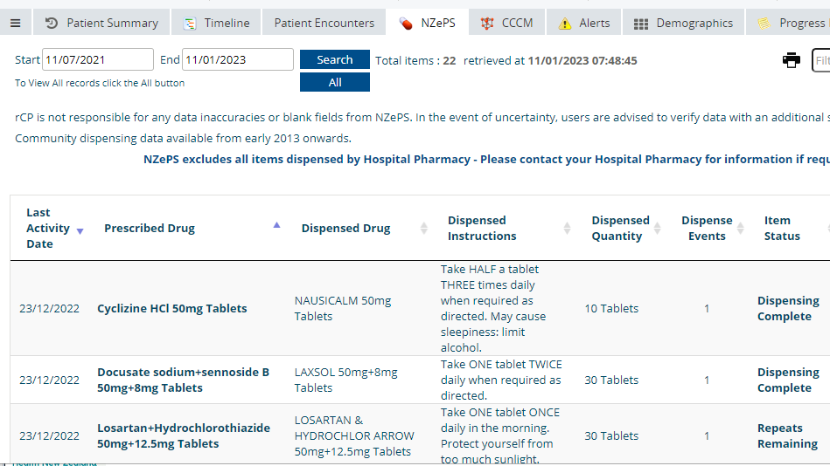
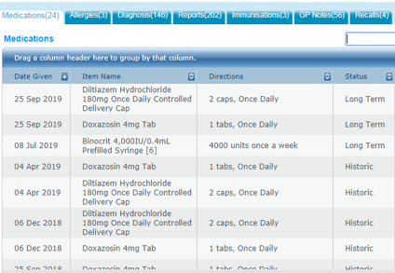
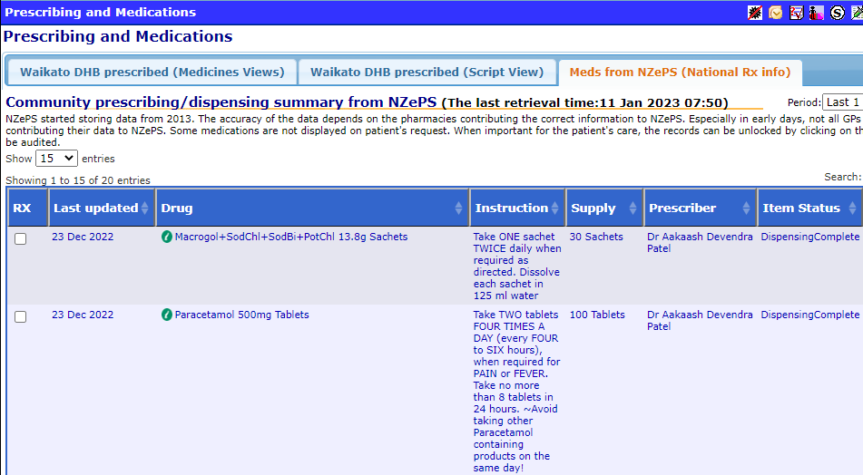
Some electronic sources of medicine histories at Waikato

Slide 13
Compare
Compare the collected medicines, allergies and ADR list to the prescribed medicines, allergies and ADRs (at admission, transfer and discharge) to identify any differences.

Slide 14
Information to share with the pharmacist
Any perceived medication errors
Anything that could result in patient harm
Anything the patient tells you that could cause harm
Final medicines reconciliation form

Slide 15
Communicate
Electronic or paper documentation
Highlight the discrepancies
Pharmacist to relay discrepancies to the prescribers

Slide 16
Paper form at Waikato

Slide 17
Paper form at Waikato

Slide 18
Medicine Reconciliation – an example
Background from clinical notes:
Post-surgical patient
Tramadol commenced for pain
Hypertension, AF and DVT/PE prophylaxis

Slide 19
Medicine Reconciliation - prescribed medication on NMC

Slide 20
NZePS
Metoprolol succinate 95 mg CR tab, 1 tab daily – regularly dispensed
Rivaroxaban 10 mg tablet, 1 tab daily – regularly dispensed
Candesartan 8 mg tablet, 1 tab daily - regularly dispensed
Paracetamol 500 mg tablets, 2 tablets QID – 1000 tablets in the last 3 months
Triazolam 125 mcg tablets for sleep – 1 tablet nocte – 30

Slide 21
What the patient tells you….
Medications that patient actually takes
Metoprolol succinate 95 mg CR tab, 1 tab mane
Rivaroxaban 10 mg tablet, 1 tab nocte
Candesartan 8 mg tablet, 1 tab mane
Paracetamol 500 mg tablets, 2 tablets QID regularly for arthritis pain
Triazolam 125 mcg tablets for sleep – takes half a tablet every night
Aspirin 100 mg po daily – buys OTC
St John’s Wort – buys OTC Thompson’s one a day, 4000 – would like to keep taking this
Allergies: ACE inhibitors - cough

Slide 22
Prepare the med rec documentation

Slide 23
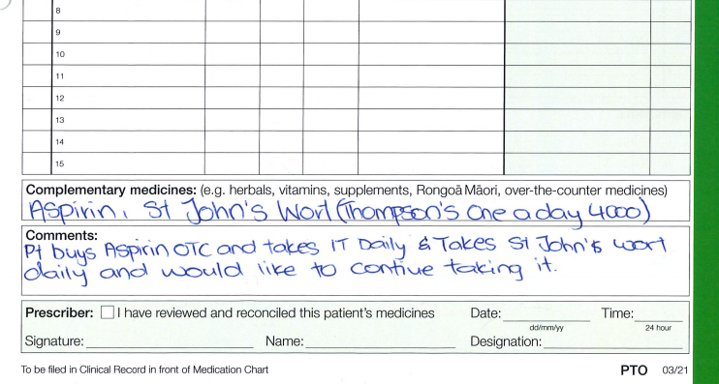
Prepare the med rec documentation

Slide 24
Other useful resources, references
Jessica Nand and Dr Mark Beale talk about medicine reconciliation in NZ | Health Quality & Safety Commission (hqsc.govt.nz)
Medicine Reconciliation | Health Quality & Safety Commission (hqsc.govt.nz)
medication reconciliation video bmj learning

