Slide 1
Rongoā Māori
NZHPA Technician SIG 29 July 2023

Slide 2
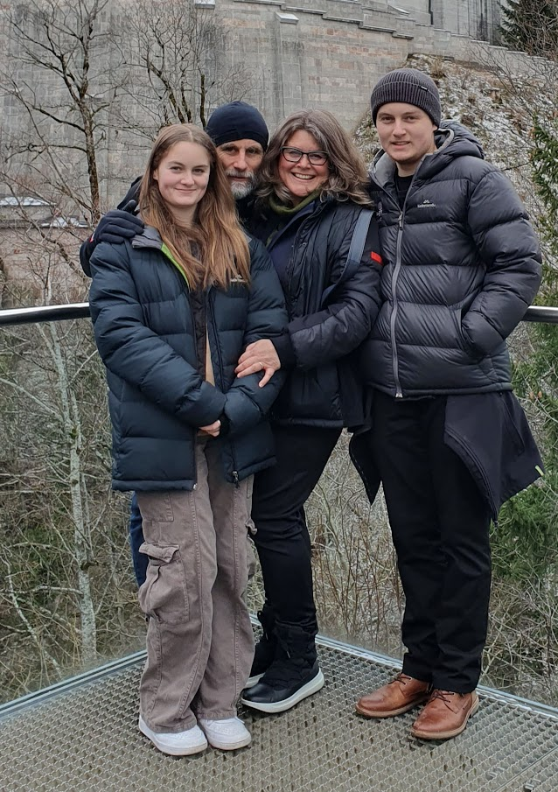
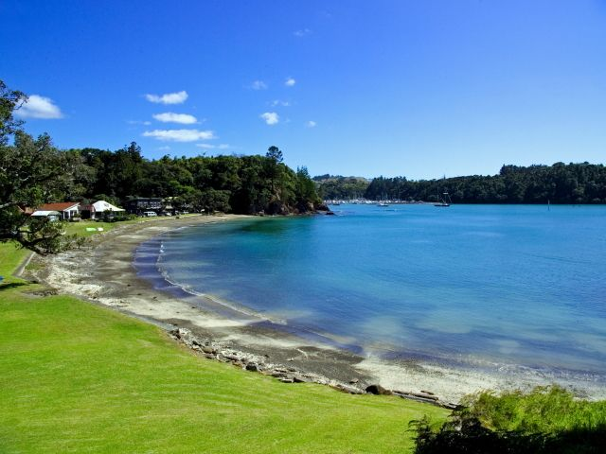
Pepeha
Ko Pukearenga tōku maunga
Ko Ngunguru tōku awa
Ko Ngunguru tōku marae
Ko Ngāti wai, me ko Ngāti Pukenga ōku iwi
Nō Tauranga Moana tōku kainga ināianei.
Ko Claire Stott ahau

Slide 3
Karakia
Tūtua mai i runga
Tūtua mai i raro
Tūtua mai i roto
Tūtua mai i waho
Kia tau ai te mauri tū
Te Mauri ora ki te katoa
Haumi e, Hui e, Tāiki e
Summon from above, summon from below, summon from within, summon for the surrounds.
The universe vitality and energy to infuse and enrich all those present. Unified, connected, blessed.

Slide 4
Intro and Overview
Look at
What do you know about Rongoā Māori
Tikanga
Some examples of Rongoā rakau
What it is all about: a bit of background
Notes:
So, those of you who know me, know this is not where i’m most comfortable... Standing up here presenting to you all.
So I’m going to keep this pretty casual, and welcome any questions too.
I also need to make sure you’re all aware that I’m in no way an expert in any shape or form, and what I’m sharing with you all is just a small portion of this vast, amazing realm of Rongoā.
There’s a lot that is not based on exact science or intimate knowledge of active ingredients in plants and their complete pharmacology etc. It comes traditionally from mātauranga (knowledge) being passed down from tohunga (specialists) over time, and there’s still a lot that’s not written down or entrusted to just anyone.
Just always need to keep that in mind when you come across Rongoā in your professional capacity ... It may not always be easy to find the answers...

Slide 5
What do you already know?
What does Rongōa Māori mean to you?
What are some of the words or descriptions you’ve heard to describe Rongoā?
What examples have you come across so far? At work or outside of work?
Are there any organisations or practitioners in your local communities you know about/have accessed?

Slide 6
The basics
Rongoā is about more than plants (rakau)
Restoring the balance between the
physical (taha tinana,) and
spiritual (taha wairua)
Interconnection between the environment and ourselves.
Ill health and disease comes from an imbalance, or disruption in natural order of things.
Notes:
It’s about the connections between ourselves and the environment around us
Mauri = connection and balance between wairua (spiritual side) and tinana (physical body). If the connection is disturbed, injured, harmed = bad health.
Need to restore those connections and balance to achieve wellbeing and good health.
Traditionally, tohunga would pass their knowledge (mātuaranga) on to those within their hapu/whanau who showed ‘potential’. They would guide, nurture and teach.
It is important to look at plants in their natural environment for clues into how and when they can be used, and what they will help with healing:
- Where they grow, do they struggle with dry, wet or cold weather, shade, or direct sun…, when they’re flowering or fruiting etc (e.g. Patete grows in wet soil – has antifungal properties!)
E.g.
A numberof plants used in rongoa grow around the edges of a regenerating forest – heal the land/forest therefore can heal us.
healing the bark of the tree – how to heal the skin
Wetland plants – help with kidney and urinary issues

Slide 7
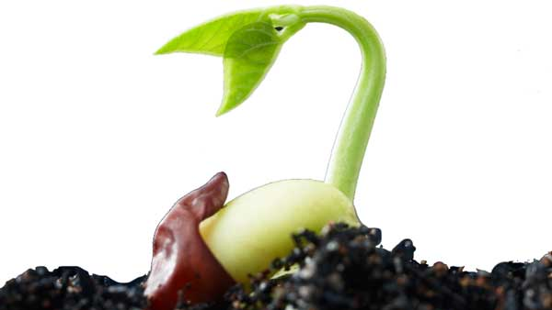
In the beginning
Ko te Pū, te More, te Weu, Te Aka, Te Rea
Ko te wao nui, te kune, te Whē, te Kore, te Pō
Ki ngā Tāngata Māori nā Rangi rāua ko Papa
Ko tenei te timatanga o Te Ao
Ko tēnei te timatanga of te Ao
This karakia encompasses the creation story of Te Ao Māori from te pū (the origin/seed), through the nothingness/unknown (Te Kore), Te Po (the night) were Rangi and Papa were bound and held all their children between them, to their separation, letting in the light of Te Ao (the world).
Notes:
To understand the concept behind this connection more, this karakia explains it pretty well.
Fundamental concept to Rongoā in Te Ao Māori: through whakapapa we share a common ancestor with the plants and trees. We are all children of Tane. So the ngahere (forest/bush) hold our tuakana (senior) and deserve our respect and care. We are kaitiaki (guardians) to the flora and fauna and Papatuānuku, therefore we need to look after our environment to ensure it will look after us.

Slide 8
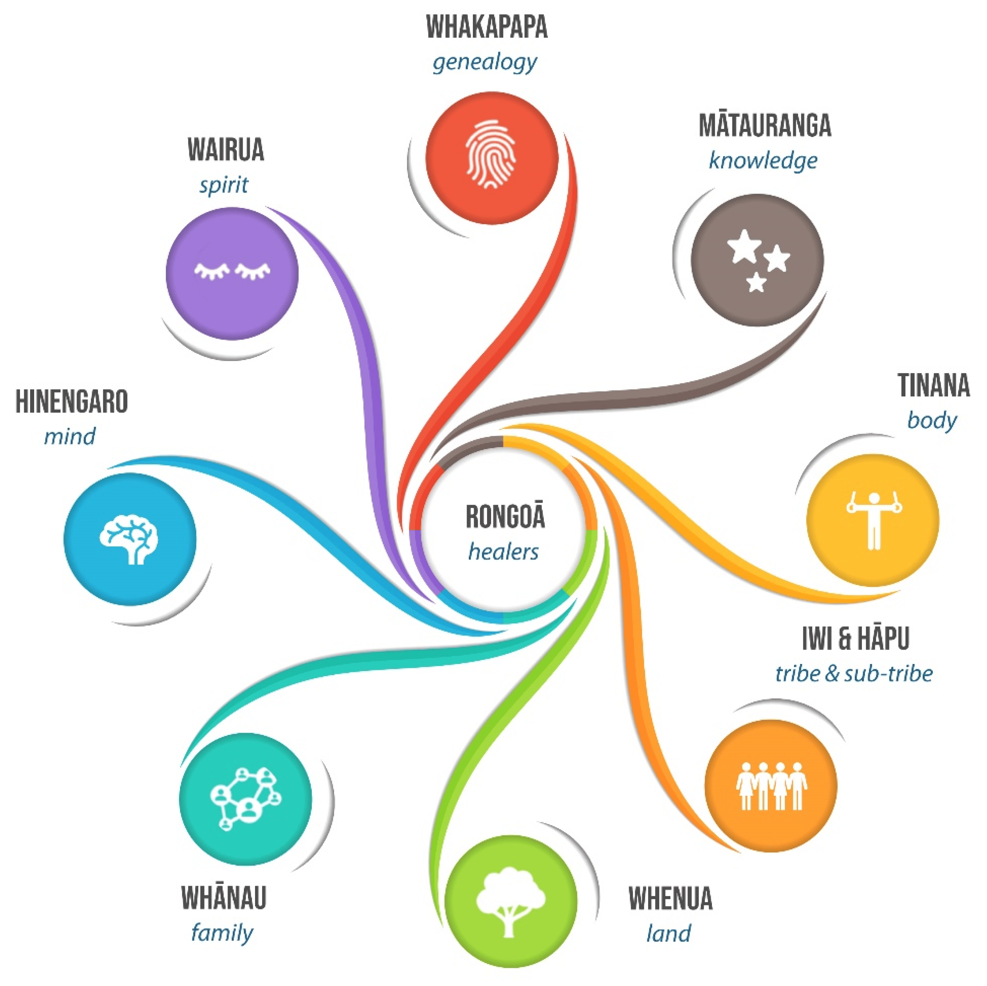

Slide 9
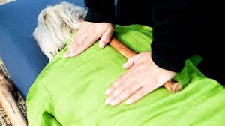
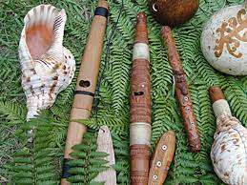
Other types of Rongoā Māori
Karakia
Mirimiri and Romiromi (bodywork)
Mahi Rākau (slef-healing with sticks (rākau))
Hui (with patient, whanau, kaumatua, care-givers etc)
Whitiwhiti kōrero (support and advice)
Kai and wai
Toanga Pūoro (for sound/vibration etc).
Matakite
Rongoā Rakau (Plant medicine)
Manaakitanga
Notes:
Again, these are not necessarily used in isolation by a practitioner.... You’ll always find karakia involved in any session, but not everyone needs Rongoā rakau...
Many people start to decline in health simply due to loneliness, hopelessness, homelessness.
You might find showing kindness, hospitality and spending a little time with someone helps to ease their loneliness and lift their spirits.
Offering a sense of purpose and community gives hope and direction
Medicines are not the only way to help: reconnections

Slide 10
Rongoā Rakau
Salves/balms
Oils
Wai rakau, teas, decoctions
Inhalations
Infusions – hot or cold
Steam
Baths
Poultices
Notes:
Laying leaves on hot stones – steam to fill the room etc.

Slide 11
Tikanga
Tikanga - the right way to do things (tika = correct)
Māori Health and Safety SOP’s ☺
Ensures the mauri (life force/vital essence) is maintained
= balance and wellbeing.
Ensures protection, care and sustainability of the environment

Slide 12
There’s tikanga for every step in the process
Meeting with the patient
Preparing for and completing hauhake (harvesting)
Preparing the Rongoā rakau (set-up, equipment, packaging, labelling)
Tidy-up, disposal and storage etc etc

Slide 13
Hauhake tikanga - example
Karakia
Set your intentions: focus on what you’re looking for and why in your harvest (hauhake)
Clear away distractions, be present
Acknowledge the ngahere (forest) and rākau (plants)
Always, before and after preparation o rongoā
Dont harvest in the rain
Take only what you need (sustainability) and at the right time.
Be aware of best part of plant to harvest from.
Don’t harvest from a plant that’s already been harvested from recently
Avoid areas near heavy traffic, pesticide use, rubbish or sewerage, sprays. Wahi tapu
Plant identification is key
Be sure you’re allowed there!
Anything left over, put it back
Notes:
Karakia: it’s not necessarily the words that are important, but what you’re trying to express: the mauri that gives power to the words. It could be as simple as “I see you” or “Thank you” in your own language. But it’s about the acknowledgement and the connection.
Mauri = connection and balance between wairua (spiritual side) and tinana (physical body). If the connection is disturbed, injured, harmed = bad health. Need to restore those connections and balance.

Slide 14
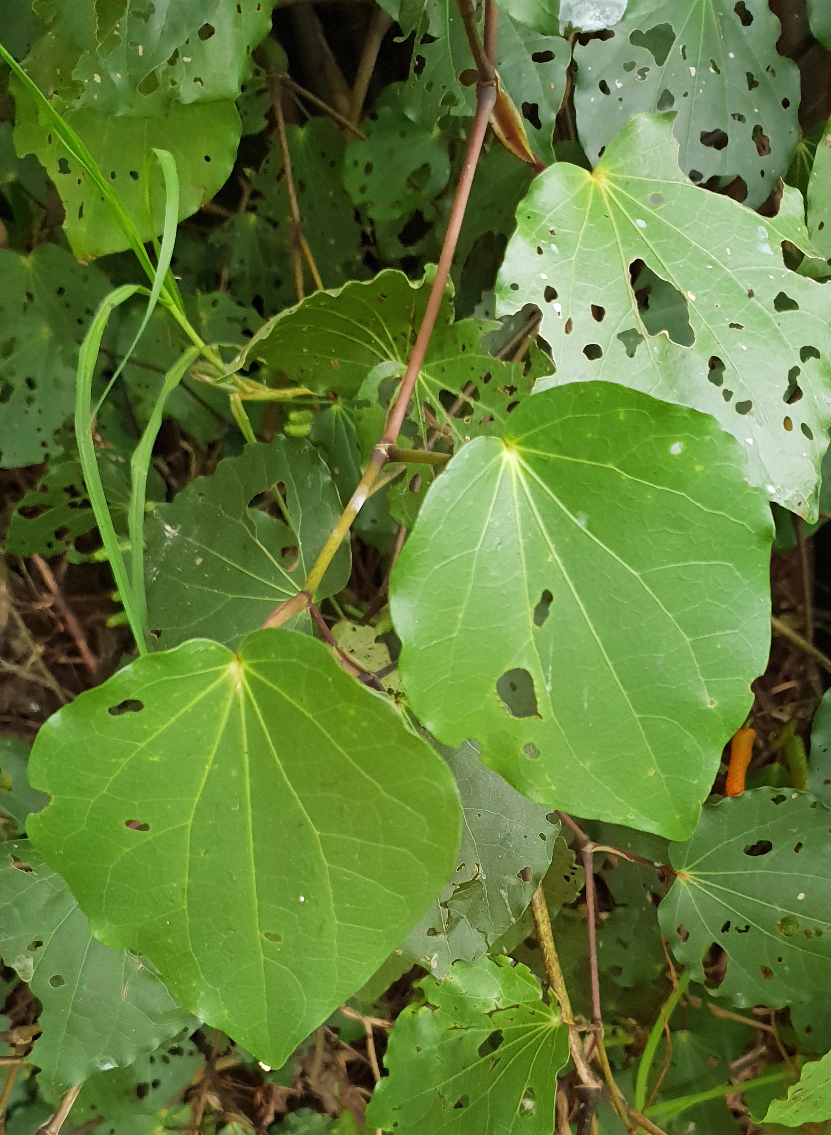
Kawakawa – A gift
Pūrakau (Story) for this plant: gifted to Papatuanuku
Heart-shaped leaf
Aids the circulation (blood thinner and stimulant), analgesic, (tooth ache, rheumatism, arthritis, bruising), general tonic, aids digestive/gut issues,
Insect repellant, skin infections, eczema, cuts, bites, stings
Mixed with kumarahou as a tea: balance blood pressure, blood sugar and cholesterol
Wreath worn at tangi
Care when on warfarin, aspirin
Notes:
Gifted to Paptuanuku to heal her broken-heart after being separated from Ranginui.
The most popular and widely used plant in Rongoa (tea, steamed leaves, poultices, balms, oils, decoctions, burning leaves and twigs to repel insects etc etc)
Also high in magnesium, iron and vitamins.
The holey leaves are also the most harvested, as the looper caterpillars munching on these leaves increases the amount of active ingredients and strength of the rongoā

Slide 15
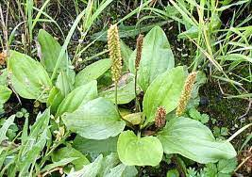
Kopakopa (Plantain)
Nature’s First Aid Kit
Bites, stings, wounds, ezcema, swelling, sprains, rash
Haemorrhoids, constipation, diarrhoea
Kidney inflammation, hepatitis, bladder infections
Coughs, bronchitis, pneumonia, sore throats,
Upper side of leaf heals & seals, under side draws

Slide 16
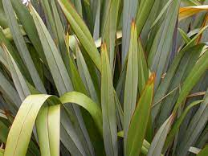
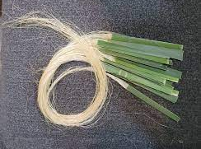
Harakeke - Flax
The most amazingly versatile plant.
Can make muka from leaves
Tying umbilical cords, stitches
Thicker leaves = bandages
Gel (base of leaves)
Burns, sores/wounds
Infusion of roots – purgative!!
Beat roots – apply to swelling.

Slide 17
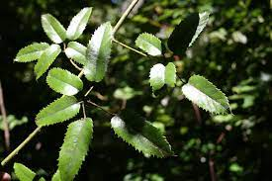
Tataramoa – Bush Lawyer
Grabby little hooks on the edges of the leaves.
Infusions of leaves
Chest congestion and cough, sore throats
Stomach aches and diarrhoea
Menstruation
Steam vapour baths with leaves and roots were used to aid passing the placenta in childbirth
Also can help with relaxing before bed.

Slide 18
What to take away from today
Rongoā Māori is so much more than just plant medicines
Connections are so important in all aspects of Te Ao Māori, and the basis of Rongoā Māori
Establishing a relationship with a practitioner or learning organisation in your area may be helpful when queries relating to interactions etc arise.
Spend some time in the ngahere if you can. See if there are any rākau you can recognise.
And just listen, feel and notice. You’ll get it then

Slide 19
Ka ora te whenua, ka ora te tangata
whakatauki
“When the land is well, the people will be well”.

