Slide 1
Endocrinology and Mental Health Pharmacy
Mental Health Pharmacists Meeting 2023
Professor Patrick Manning

Slide 2
Overview of Topics
Mental Health Drugs with Endocrine Consequences
Antipsychotic Drugs
Hyperprolactinaemia
Metabolic Effects
Lithium
Thyroid effects
Parathyroid effects
Anorexia Nervosa and the Endocrine System
Gender Affirming Hormonal Therapy

Slide 3
Ms M
40 year old woman
2 year history of secondary amenorrhoea following the birth of her son
Found to have hyperprolactinaemia
Also has intermittent galactorrhoea
Prolactin levels: 3000 -4000mIU/L (N<400)
Other medical problems
Psychosis
Depression
Opiate addiction
Ankylosing Spondylitis
Chronic Hepatitis C

Slide 4
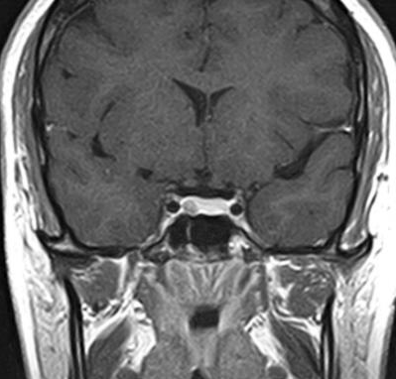
Ms M
Medications
Adalimumab 40mg every 2 weeks sc
Methadone since 2008
Olanzapine 5mg per day
Fluoxetine 20mg per day
MRI scan: small microadenoma of the pituitary (5mm)
How should this be managed?

Slide 5
Control of Prolactin Secretion
Tubuloinfundibular dopamine(TIDA) neurons release dopamine into the hypophyseal portal circulation
Dopamine inhibits prolactin secretion via D2 receptors on lactotrophs
Prolactin feeds back to TIDA neurons hypothalamus to stimulate dopamine secretion

Slide 6
Hyperprolactinaemia Effects 1
Prolactin binds to receptors on KNDy neurons in the hypothalamus
Reduces Kisspeptin secretion that then inhibits GnRH neuronal activity
In turn this causes reductions in gonadotrophin secretion from the anterior pituitary gland
Subsequent hypogonadism
Females: amenorrhoea, infertility
Males: reduced libido, impotence

Slide 7
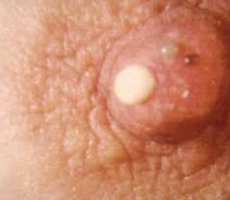
Hyperprolactinaemia Effects 2
Galactorrhoea
Milk secretion when not pregnant
Usually bilateral
Often not present with hyperprolactinaemia because requires oestrogen too

Slide 8
Causes of Hyperprolactinaemia

Slide 9
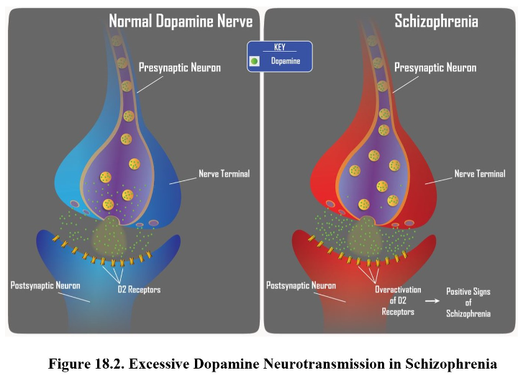
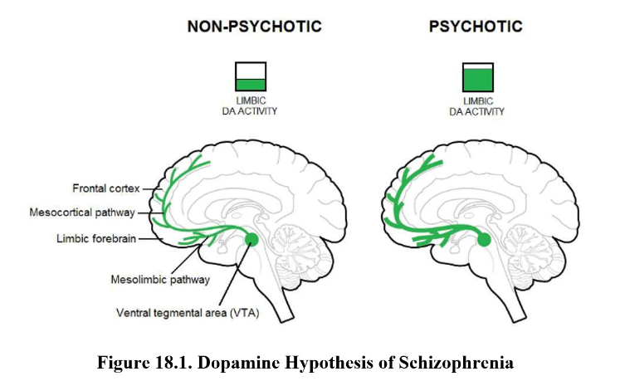
The antipsychotic effects of the antipsychotic drugs are mediated by dopamine D2 receptor blockade as well as D1, D3 and D4 receptor blockade in the mesolimbic area of the brain

Slide 10
 | Typical Antipsychotic Drugs | Atypical Antipsychotic Drugs
Other Names | First generation | Novel or Second Generation
Drugs | Phenothiazines and Butyrophenones | Diverse range of drugs
Mechanism | D2 Receptor antagonism | Multiple receptors: D2, 5HT, M, H
Use in Schizophrenia | Block Positive Symptoms Delusions/Hallucinations Thought Disorder | Block positive, negative and cognitive symptoms Lack of pleasure, interest Social withdrawal Poverty of speech
Other Indications | - | Bipolar Disorder, Depression
Side Effects | Neurologic Extrapyramidal symptoms Tardive Dyskinesia Neuroleptic malignant Syndrome | Metabolic Weight gain Diabetes

Slide 11
Antipsychotic drugs and Hyperprolactinaemia
Hyperprolactinemia (HPRL) occurs in around 70% patients receiving APs
Not all antipsychotic drugs increase PRL levels.
The first-generation agents - the phenothiazines, thioxanthenes and butyrophenones - all raise PRL levels
Among the atypical antipsychotics, risperidone, paliperidone and amisulpride are associated with the highest prolactin increases and rates of hyperprolactinemia (70—100%)
Clozapine, olanzapine, quetiapine, ziprasidone, and aripiprazole much less commonly cause hyperprolactinemia
likely because they only transiently and weakly bind to tuberoinfundibular D2 receptors
having agonist as well as antagonist activity at D2 receptors

Slide 12
Effects on Bone
APs reduce BMD
First generation more than second generation
Correlation between reduced BMD and high prolactin seen in half of studies
Meta-analysis on 12 case control and 7 cohort studies which included over 500,000 subjects on antipsychotics more than 80,000 fracture events were recorded with almost 1.5-fold increased risk associated with use of any antipsychotics
Mechanisms
Hyperprolactinaemia induced hypogonadism
? Increased falls risk due to AP induced sedation and hypotension

Slide 13
Management of Antipsychotic induced hyperprolactinaemia
Is it due to the medication?
Consider MRI scan to rule out pituitary lesion
Consider checking prolactin before starting AP treatment to make sure normal
Is it causing any clinical features?
No – ignore
Yes - options
May be possible to just treat the clinical feature e.g. amenorrhoea with COCP; low BMD with bone sparing therapy; male hypogonadism with testosterone
Galactorrhoea and Infertility
Adding in Aripiprazole appears to be the best option
Otherwise
Switch to Aripiprazole
Add in cabergoline
Lower the dose of the antipsychotic
All options carry a small increased risk of worsening psychosis

Slide 14
Aripiprazole is a potent (high-affinity) partial agonist at D2 receptors, partial agonist at serotonin 5-HT1A receptors, and antagonist at 5-HT2A receptors
Addition of Aripiprazole to Risperidone treatment

Slide 15
Ms M
Management
Could be from the microadenoma or secondary to olanzapine, fluoxetine or Methadone.
Rule out pregnancy
Small tumour (benign) – not causing any mass effect
Can manage the amenorrhoea with HRT/COCP
Measure the BMD
Galactorrhoea not problematic
Monitor prolactin – if increases significantly can re-scan
If galactorrhoea becomes significant
Add in aripiprazole
OR trial of Cabergoline with careful watching for psychosis

Slide 16
Psychiatric Side Effects of Cabergoline
Psychosis
Several case reports of Cabergoline induced psychosis
Impulse Control Disorders
Failure to resist impulses to engage in a pleasurable activity that is harmful to self or others
Encompasses pathological gambling, hypersexuality, compulsive buying, and compulsive eating, punding (preoccupation with meaningless motor activities; eg, arranging objects), hobbyism (preoccupation with specific activities; eg, repairing machinery), and walkabout (excessive wandering without purpose)
The mechanism appears to involve reward system activation via D3 dopamine receptors in the mesocorticolimbic dopaminergic pathway
Variable prevalence in studies but approximately 10-20%
Unrelated to Cabergoline dose
Hypersexuality is the most common and mainly in men
Compulsive eating more common in females

Slide 17
Schizophrenia
2-3 fold increased risk of death
60% related to cardiovascular disease
High degree of obesity, metabolic syndrome and Type 2 Diabetes largely explains this risk
Two of the most effective antipsychotic drugs carry the greatest risk for metabolic disturbances
Clozapine
Olanzapine
Studies have demonstrated limited effects for counteracting antipsychotic induced weight gain with adjunct pharmacologic treatments, behavioural interventions, or switch of antipsychotics

Slide 18
Metabolic Effects of Antipsychotic drugs
Weight gain and obesity are more problematic with atypical antipsychotics than with typical antipsychotics
Of the atypical antipsychotics, clozapine and olanzapine have the most significant effect on weight.
The amount of weight gain with clozapine can be related to duration of treatment and patients not being overweight at baseline
Clozapine: almost half of patients gained 20% or more of their initial body weight
Olanzapine: weight gain of more than 7% from baseline (mean increase of 9.4 kg)

Slide 19
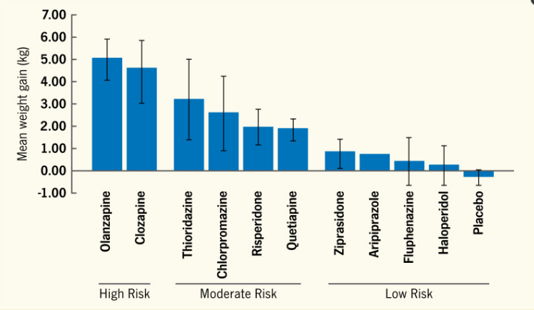

Slide 20
Mechanism
Animal studies suggest that APD-induced weight gain is primarily the result of increased food intake
Hypothalamus of rats treated with Olanzapine
Increases orexigenic neuronal activity[neuropeptide Y (NPY) and agouti related protein (AgRP)]
Via 5HT2C receptor antagonism
Decreases anorexigenic neuronal activity[proopiomelanocortin(POMC)]
Note: Lorcaserin 5HT2C receptor agonist – weight loss medication

Slide 21
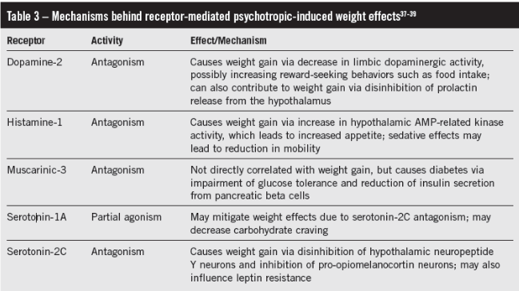

Slide 22
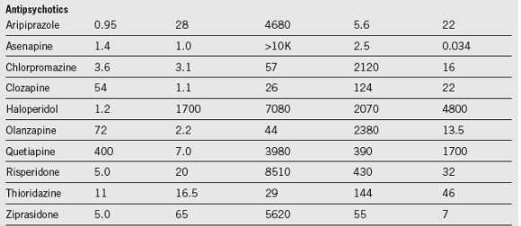
Probably a complex combination of receptors involved in the mechanism of weight gain

Slide 23
Risperidone least atypical and Clozapine most atypical
More atypical the more molecular targets
The more molecular targets the more likely to gain weight

Slide 24
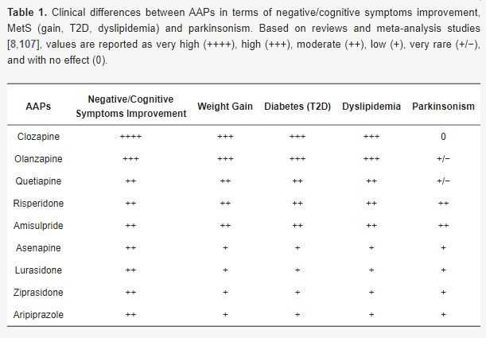
Risk of Diabetes with Atypical APD’s
Not necessarily as a consequence of weight gain
25% of patients develop hyperglycaemia without gaining weight

Slide 25
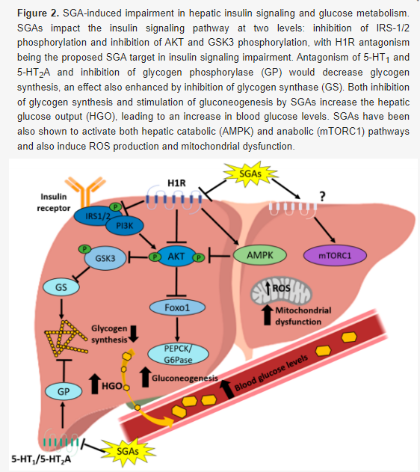
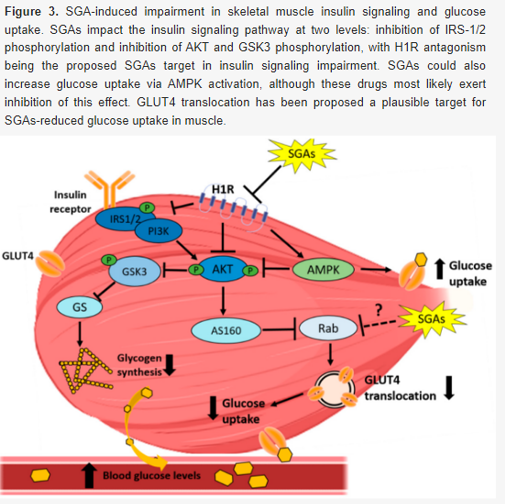
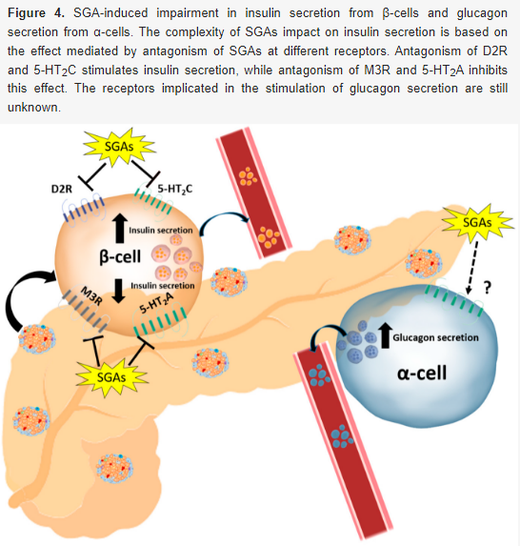
Mechanisms
Liver
Hepatic Insulin Resistance
Increased hepatic glucose output
Reduced glycogen storage
Skeletal Muscle
Insulin Resistance
Reduced glucose uptake
Beta and Alpha Cell Effects
Can be both insulin stimulating and inhibiting
secretion effects depending on drug
Increased glucagon secretion

Slide 26
Management
Weight gain can be a reason for poor adherence
Patient awareness of the effect
Significant inter-individual differences in terms of weight gain for the same drug
Possibly due to genetic effects
Polymorphisms of 5HT2C receptors
Monitor for the development of diabetes
Manage other aspects of the metabolic syndrome
Hypertension
Dyslipidaemia

Slide 27
Pharmacologic Interventions
Weight Loss
Lifestyle education greatest effect
Psychoeducation
Aripiprazole augmentation
Topiramate
GLP1R agonists
Diabetes
Change from Olanzapine/Clozapine to Aripiprazole
Metformin
GLP1R agonists

Slide 28
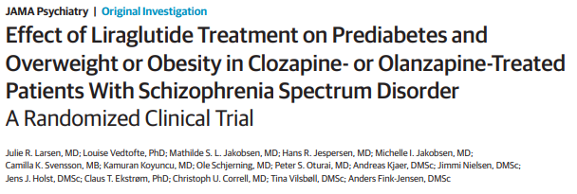
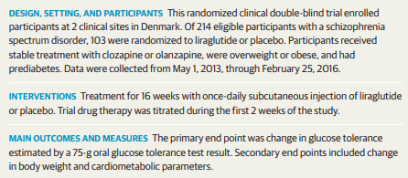
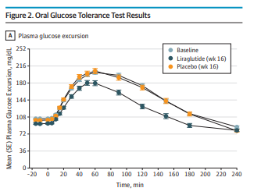

Slide 29
Lithium and Thyroid Function
Approximately 20% of patients on long-term lithium develop hypothyroidism
Mechanisms
? Impairs iodine uptake by the Na/I symporter
impairment of iodotyrosine coupling
reducing colloid droplet formation and impairing TSH stimulated thyroid hormone release from the thyroid gland
Treat with thyroxine

Slide 30
Lithium and Parathyroid Function
Approximately a quarter of patients on long-term lithium treatment develop hypercalcaemia
Lithium increases the set point at which calcium inhibits PTH secretion by binding to the Ca-sensing receptor
May result in 4 gland hyperplasia
Treatment is usually surgical

Slide 31
Anorexia Nervosa – Endocrine Effects
Gonadal Axis
Amenorrhoea common: ~70-80%
Male hypogonadism can occur too
Low leptin levels signal low fat stores to the brain
High Ghrelin levels also implicated
Alter GnRH neuron pulsatility
Induce hypogonadotropic hypogonadism

Slide 32
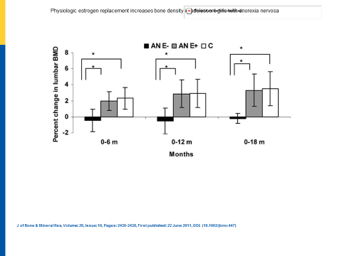
Anorexia Nervosa
Skeletal Effects
Low BMD and increased fracture risk
Contributors include
Low oestrogen or testosterone
Poor nutrition
Low IGF1 levels
Reduced formation and resorption
Weight restoration and resumption of menstrual periods are the cornerstone of therapy
Can consider transdermal oestrogen
Oral contraceptives not recommended
Bisphosphonates
Avoid in women who may want to conceive in the future
Not effective in adolescents as bone resorption already low

Slide 33
Anorexia Nervosa
Thyroid Function
Reduced conversion of T4 to T3
Results in a low T3 state (non-thyroidal illness)
Adaptive – to reduce basal metabolic rate and energy expenditure
No role for thyroid hormones and can be abused
Adrenal Function
Increased cortisol production seen in 1/3 and inversely correlates with BMI
Due to chronic stress and starvation, including elevated ghrelin levels
Activation of hypothalamic–pituitary–adrenal axis through increased corticotropin-releasing hormone (CRH) secretion from the hypothalamus

Slide 34
Gender Affirming Healthcare: Terminology
GENDER IDENTITY refers to a person’s deeply felt, internal, intrinsic sense of their own gender.
GENDER INCONGRUENCE is a diagnostic term used in the ICD-11 that describes a person’s marked and persistent experience of an incompatibility between that person’s gender identity and the gender expected of them based on their birth-assigned sex.
GENDER DYSPHORIA describes a state of distress or discomfort that may be experienced because a person’s gender identity differs from that which is physically and/or socially attributed to their sex assigned at birth. Gender Dysphoria is also a diagnostic term in the DSM-5
TRANSGENDER or trans are umbrella terms used to describe people whose gender identities are not what is typically expected for the sex to which they were assigned at birth.
GENDER DIVERSE is a term used to describe people with gender identities and/or expressions that are different from social and cultural expectations attributed to their sex assigned at birth. This may include, among many other culturally diverse identities, people who identify as non-binary, gender expansive, gender nonconforming, and others who do not identify as cisgender.

Slide 35
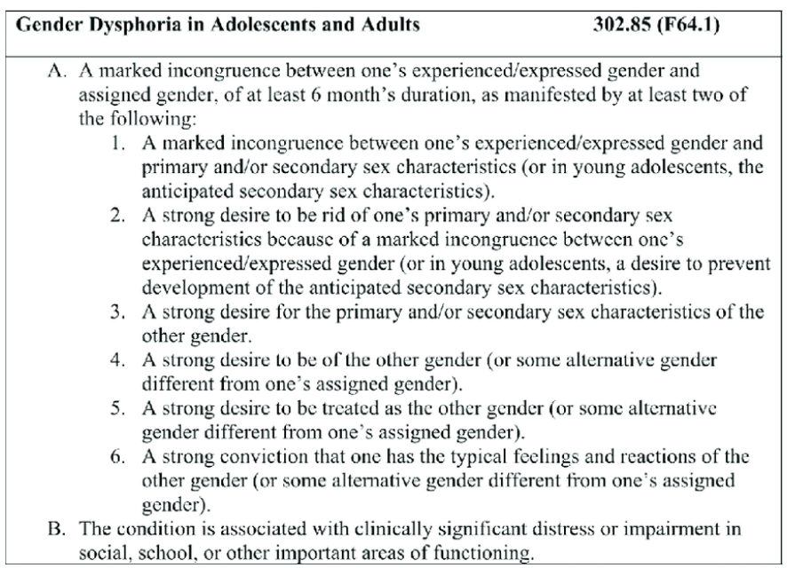

Slide 36
https://www.adhb.health.nz/assets/Documents/OIA/2021/07-21/gender-dysphoria.pdf

Slide 37
Female TGD Patient
Try to simulate puberty
Avoid ethinyl-oestradiol and CEE due to
increased VTE risk
cannot be measured in circulation
Lowest VTE risk with transdermal oestradiol
Estradot
Climara
Parenteral oestradiol unavailable in NZ apart from compounded
Fertility consequences & preservation considered before treatment
Semen cryopreservation
Spironolactone and CPA used as Testosterone blocking therapies
Occasional GnRH usage
GA Surgery
Orchidectomy
Gender reassignment surgery

Slide 38
Male TGD Patient
Fertility
Ovarian cryopreservation unavailable in NZ
What are the long-term effects of testosterone on oocytes?
Most people are fertile on stopping testosterone
GA Surgery
Masculinising chest surgery
Hysterectomy/oophorectomy
Gender reassignment surgery
Simulate puberty
Usually use parenteral testosterone
Depo-Testosterone
Sustanon
Reandron
Concerns
Polycythemia
?Cardiovascular risk

Slide 39
GAHT

Slide 40
