Slide 1
Icons from Noun Project
Huntington’s Disease
More than a movement disorder
Dr Ailsa McGregor
ailsa.mcgregor@otago.ac.nz
Notes:
Thank you for the introduction. Very pleased to be invited to talk.
Pharmacologist with an interest in developing treatments for stroke and HD.
My plan is to tell you a little bit about the type of research we are doing in our lab and focus on some recent data from our stroke work. Thought we could break this up into 2 parts with questions in between each

Slide 2
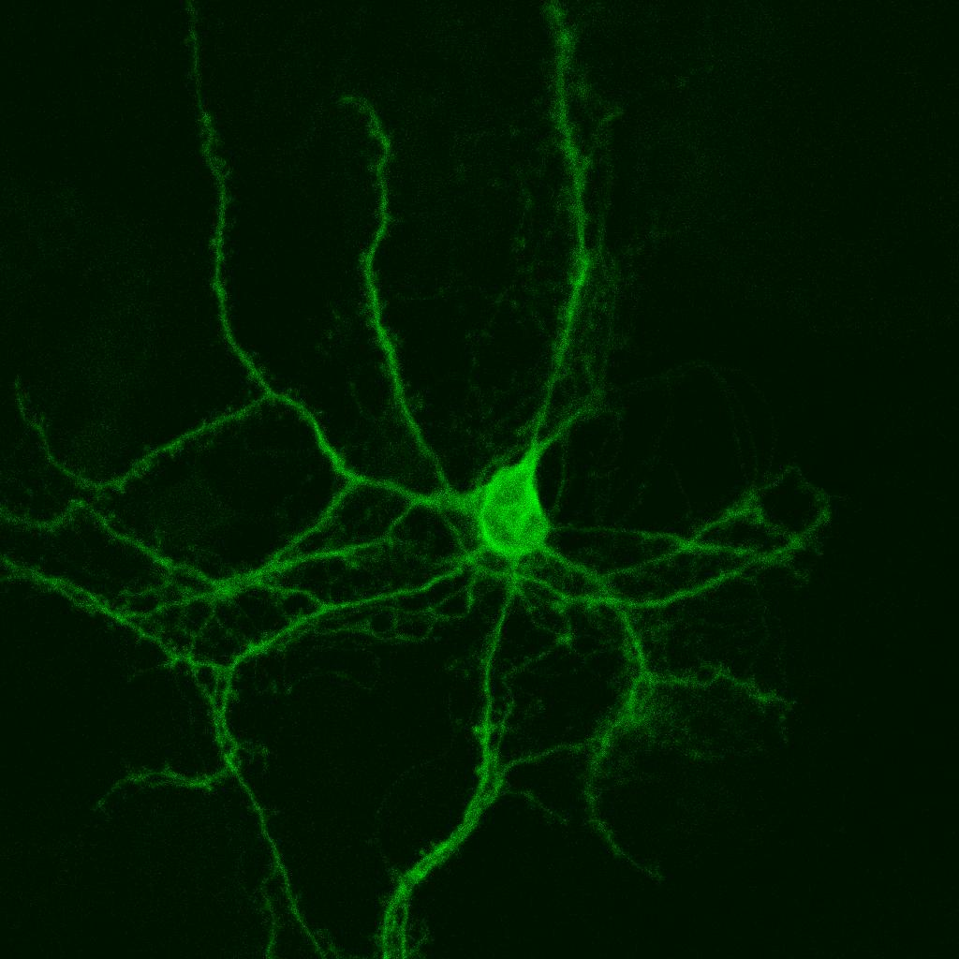
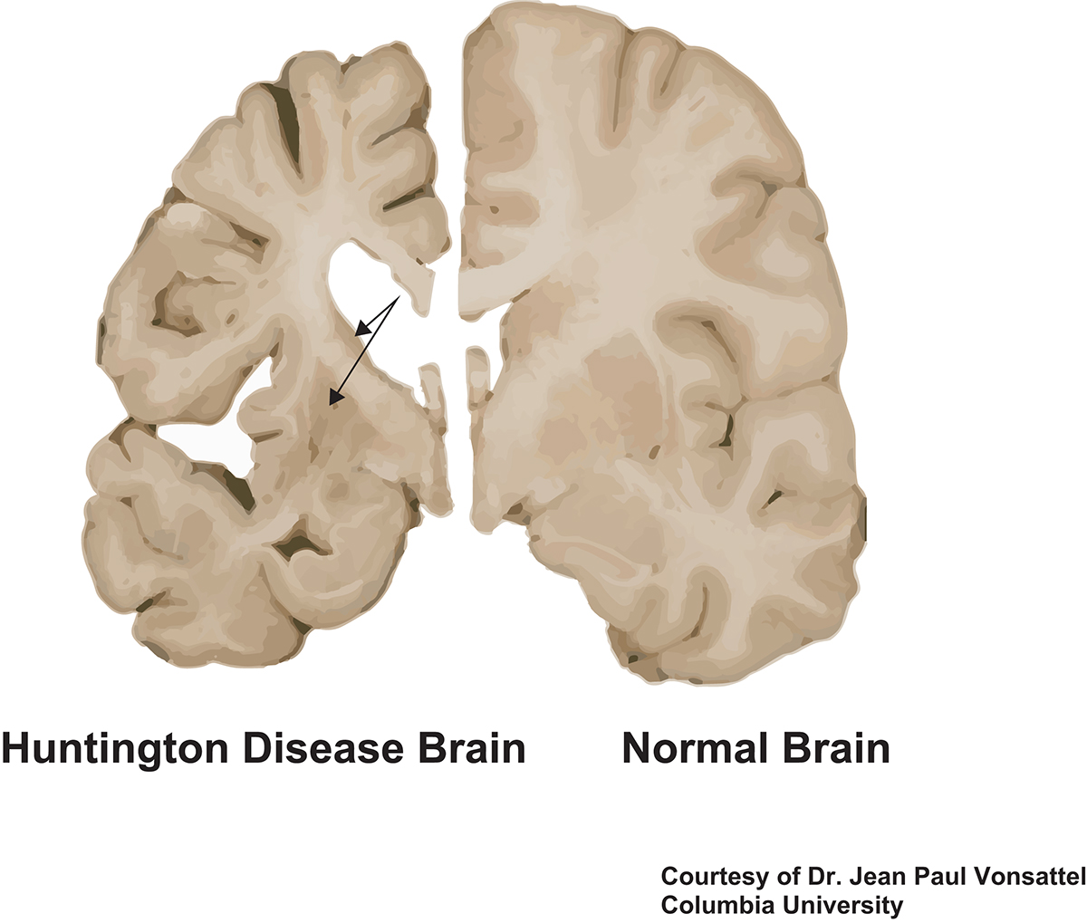
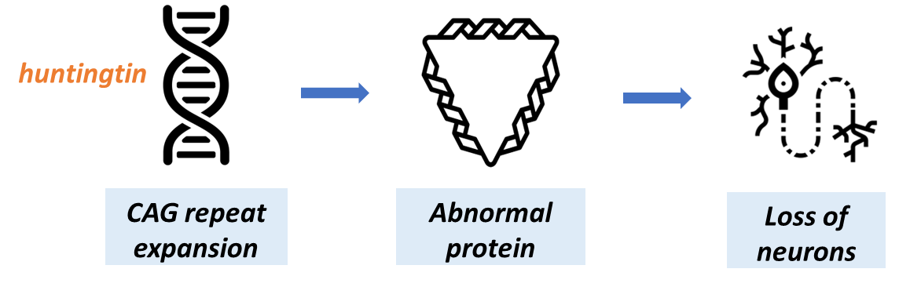
https://thenounproject.com/
Huntington’s Disease
Loss of
Medium spiny neurons
Inhibitory input
Fatal, inherited neurodegenerative disorder
1:10,000 people in NZ
Progressive → death ~20 years after symptom onset
Notes:
Huntington’s Disease (HD) is a rare fatal, inherited neurodegenerative disorder affecting 1:10,000 people in New Zealand.
Single gene mutation leading to a CAG repeat expansion in huntingtin gene , 40 or more repeats are fully penetrant
→ abnormal protein→ Results in loss of brain cells
neuropathological hallmark among individuals with HD is the progressive atrophy of basal ganglia structures - caudate nucleus and putamen due to loss of medium spiny neurons expressing dopaminergic type 1 or 2 receptors. It’s the loss of inhibitory input from the MSNs neurons, that’s thought to underly the uncontrolled movemments that characterize HD.
Global neuronal loss and generalized atrophy occur with disease progression, and the overall brain weight can decrease by up to 40%.
Patients suffer from motor, cognitive and psychiatric symptom
→ Disease coping, relationships, judgement, independence
Death occurs about 20 years after the onset of symptoms.
More than a century after the first description of Huntington's disease (HD), there is still no curative treatment of the disease; however, symptomatic treatments are thought to be efficacious in controlling some of its troublesome symptoms. Yet, symptomatic management of HD remains inadequately documented (1–4), which may lead to variations in care mainly based on clinical experience and not on scientific evidence (5–7).

Slide 3
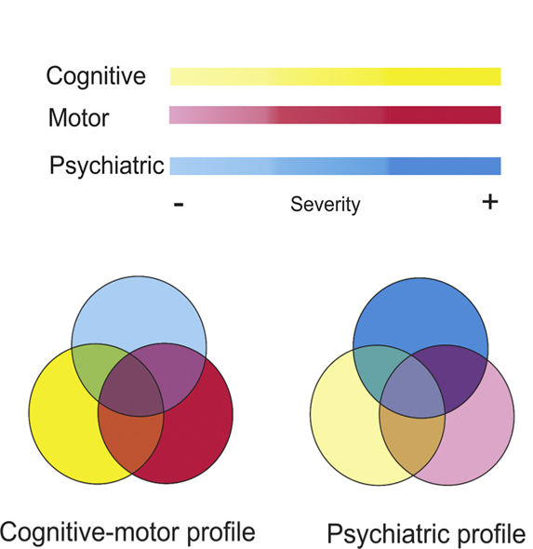
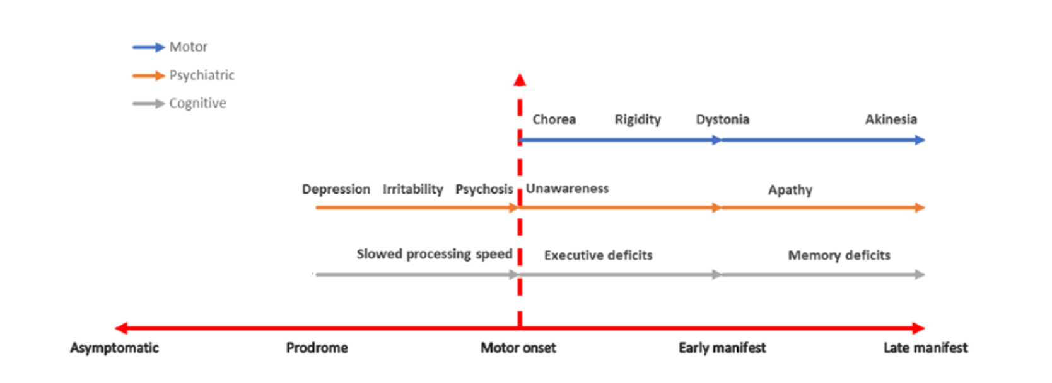
Goh AM, et a.. Huntington’s disease: Neuropsychiatric manifestations of Huntington’s disease. Australasian Psychiatry. 2018;26(4):366-375. doi:10.1177/1039856218791036
Clinical Features
Early changes in cognitive function
High degree of variability
Gene positive
Symptomatic
Notes:
Looking at natural history of HD,
While clinical diagnosis typically depends on motor abnormalities, clear that there are very early changes in cognitive function occur in gene carriers before any other clinical symptoms are apparent.
high degree of variability among patients.
•neurobiological basis of interindividual differences.
Cognitive-motor and psychiatric profiles showed distinct patterns of brain changes.

Slide 4
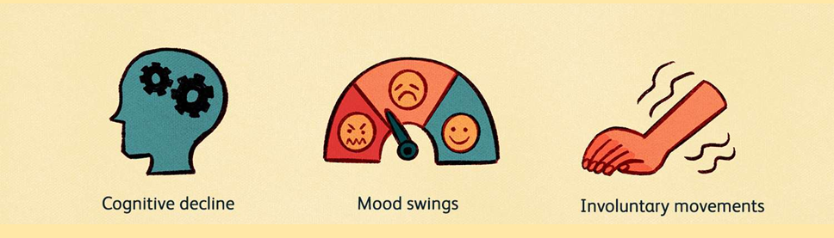
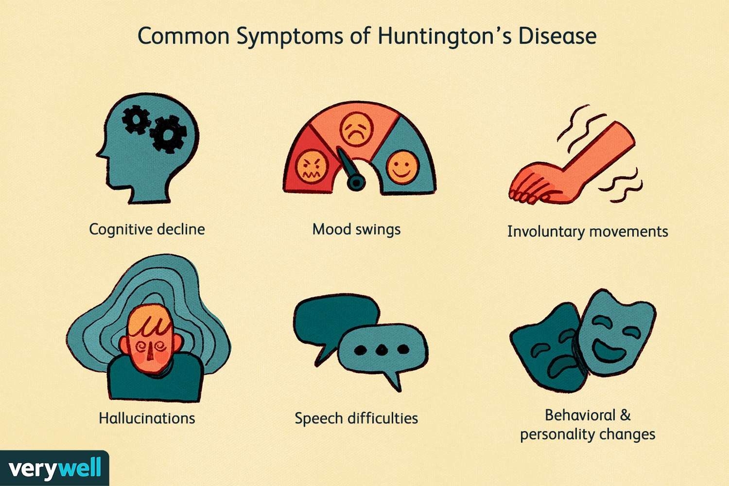
Motor Symptoms
Chorea
Dystonia
Bradykinesia/Akinesia
Gait disturbances
Eye movement
90% of patients
Worsened by fatigue, stress
Absent during sleep
A key element of diagnosis
Not a marker of disease severity
Often well tolerated
Dysarthria
Dysphagia
→ choking, aspiration
Notes:
HD is characterized by progressive movement, cognitive and psychiatric symptoms
Abnormal, involuntary spontaneous uncontrollable irregular movements affecting trunk, face, limbs.
Chorea, dystonia, myoclonus
Diagnosis of manifest HD based on presence. Worsened by fatigue, stress, disappear during sleep.
Not always a marker of disease severity
While easily detected and might be a source of anxiety, often well tolerated in comparison to cognitive and behavioural symptoms

Slide 5
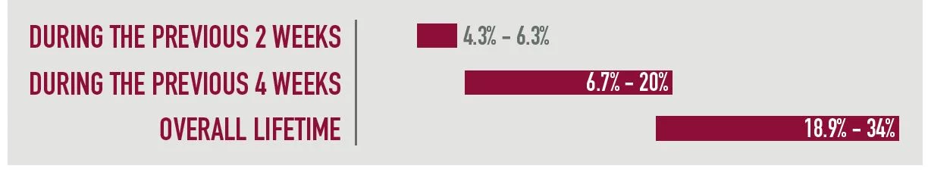
Tampi and Weber (2021) Psychiatric Times Vol 38, Issue 3 Volume 03
Neuropsychiatric Symptoms
Executive function
(Rigid thinking, difficulty concentrating, multitasking)
Memory loss
Subcortical dementia
Disease coping
Interpersonal relationships
Judgement
Independence
Most distressing aspect of HD
Depression
Apathy
Irritability and agitation
Obsessive-compulsive behaviour
Psychosis
Suicidal Ideation
Notes:
For many patients and their families, neuropsychiatric symptoms constitute the most distressing aspect of HD.
Cognitive dysfunction includes impairments in executive function, perception, visuospatial and psychomotor skills, memory loss and problems learning new skills. These cognitive deficits ultimately lead to frontal and subcortical dementia
Patients with HD also have a significant lifetime prevalence of psychiatric disorders, cCombined with the progressive decline in cognitive function, these behavioural symptoms have a significant impact on disease coping, interpersonal relationships, judgement and the ability to live independently

Slide 6


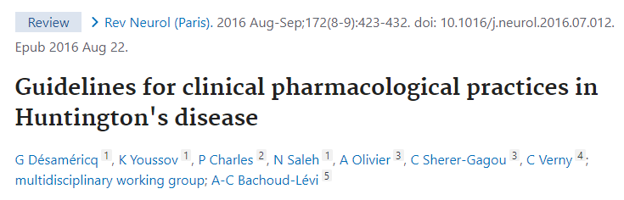
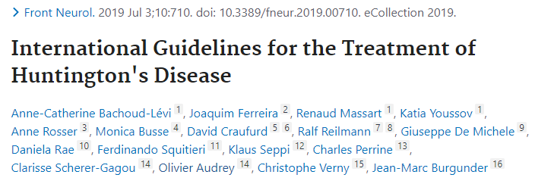
EBM: A difficult goal in rare diseases
No cure
Few RCTs to guide symptom management
Variation in care: experience > scientific evidence
Standardise treatment
Improve care and QoL
Notes:
More than a century after the first description of HD, still no cure
Symptomatic treatments to manage troublesome symptoms
EBM is a difficult goal in rare diseases, with few RCTs.
2019: EHDN international task force to provide global evidence based recommendations for everyday clinical practice. Objective to standardise treatment regimens, improve care and quality of life.

Slide 7
Guidelines
A = Established scientific proof
B = Scientific presumption
C = Low level of scientific proof
“ Symptoms worsened by stress, fatigue, and intercurrent disorders….treated appropriately and in parallel with the HD symptoms”
At / near maximum dose
Tetrabenazine (A)
Contraindicated: depression, suicidal thoughts
Haloperidol (C)
No recommended Tx
Depression: SSRI, SNRI, Mirtazapine (sleep disturbances) (B)
Anxiety, irritability: SSRI or SNRI (C)
Obsessions: SSRI (anxiety), olanzapine/risperidone (irritability) (C)
Notes:
Except for the beneficial effects of tetrabenazine in chorea, none of the published recommendations based on established scientific evidence.
Tetrabenazine, VMAT2 inhibitor

Slide 8
Beyond the clinical context
……the reality for people living with HD…
Notes:
Few studies have investigated the disease from the personal experience and the context of people living with HD.
Interested to understand, from the perspective of people living with HD what the key challenges ar

Slide 9


Symptom incidence & medication use
85% response rate
64% analysis rate
NZ European cohort
At risk (n=8)
Gene positive prodromal (n=19)
Younger, female
Diagnosed (n=10)
Older, male, carer assisted
Neuropsychiatric symptoms higher than reported (~80% c.f. 30%)
SSRIs most widely prescribed
Rated “moderately effective”
Supplemented with counselling, mindfulness
Notes:
Interested to understand how people living with HD cope with their daily lives outside the clinical setting.We recently explored the symptom incidence and medication use in a cohort of people living with HD.
Recruited from Enroll-HD registry
Collaboration with Dr Mike King and Nicola Liebergreen in Bioethics.
Prevalence of self reported behavioural/psych symptoms like anxiety, depression and irritability significantly higher in our premanifest cohort than approx. 30% reported in the literature
40% severe enough o require mediation. In keeping with huidelines, SSRIs most widely prescribed, of interest that many patients don’t know their medication.
Treatment seems to follow the guidelines, most common meds are SSRIs
People find them generally OK,
Supplementing meds with alternative therapies, not available to manifest people
More effective treatments for cognitive and behavioural symptoms are required to optimise patient outcomes.

Slide 10
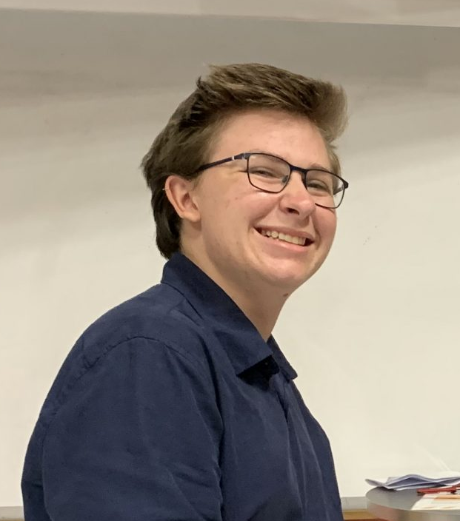
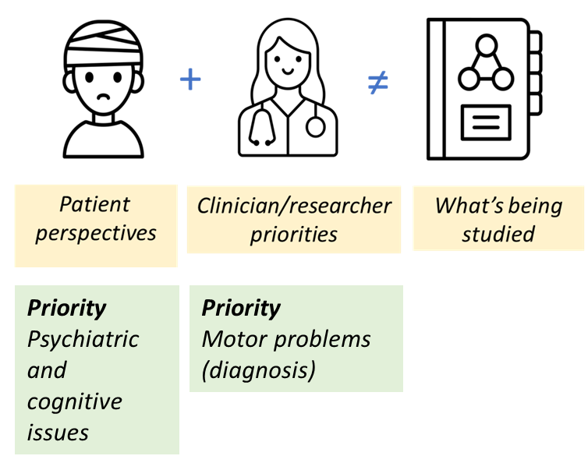
A difference in perspectives…
More effective treatments for cognitive and behavioural symptoms are required to optimise patient outcomes.
Notes:
In a second recent qualitative study conducted by Jamie Hounsell
Confirmed that most troubling symptoms for participants were those that affected their mood
He also highlighted a difference between patients’ priorities, and what clinicians and researchers think patients want, meaning what’s being studied doesn’t meet patients need
Involving consumers at every step of the research journey, planning, and execution could ……

Slide 11
Hope on the horizon?
……clinical trials landscape…

Slide 12


“The saddest possible result”
“I was really shocked, really tearful”
GENERATION-HD1
Tominersen
Phase III
Poorer cUHDRS score (TMS +TFC)
Enlarged ventricles
PRECISION-HD1&2
WVE-120101, 120102
Phase I/II
No change in mHtt
“We didn’t see it coming at all”
“I felt really frightened and worried about my future
Notes:
In mid-March 2021, Roche announced that it was halting a phase III study of its ASO drug, tominersen.
A week later, Wave Life Sciences said that it would discontinue the development of two of its HD ASOs that were in phase I/II clinical trials.

Slide 13




Sellers J, et al . A Systematic Review of Neuropsychiatric Symptoms and Functional Capacity in Huntington's Disease. J Neuropsychiatry Clin Neurosci. 2020
Primary endpoint for many regenerative and small molecule RCTs is motor function
Apathy and depression are associated with decreased functional capacity
Notes:
2 bombshells sandwiched in a series of disappointing outcomes. Including pridopidine and branaplam.
Despite the knowledge neuropsychiatric symptoms are known to increase caregiver burden and decrease patient quality of life among patients with Huntington's disease the endpoint for several regenerative and small molecule investigational drugs was total motor score.
evidence that there is a relationship between neuropych symptoms and functionalc apacity.
depression and apathy are associated with decreased functional capacity in Huntington's disease – better endpoint in conjunction with specific clinical rating scales to assess disease progression or intervention response

Slide 14
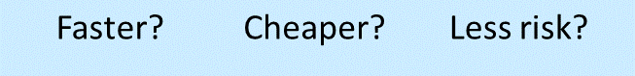
Are new drugs the best option?
……might people benefit more from identifying new uses for approved drugs?

Slide 15
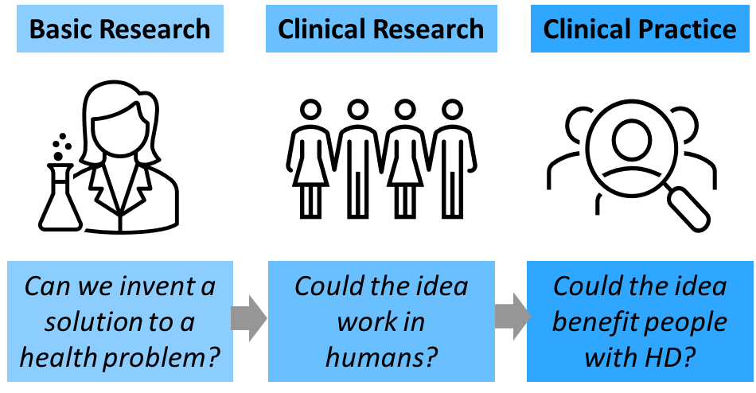



A translational approach
Impact = tangible benefits
Improved health
Quality of life
~15 years
Expensive
95% failure
Notes:
How do we investigate this? Well, we are a preclinical lab but we’ve adopted a translational approach to our research.
Can we invent a solution, can we be sure that it will work in people and does it benefit patients
No longer enough to understand how things work, it’s important to demonstrate impact, or the tangible benefits that occur as a result of this flow of knowledge.
We want to apply the findings from our fundamental science research to medical practice and improve health outcomes.
The current process of translating a new discovery into a therapy is slow and expensive. The average length of time from discovery to approval of a new drug is more than 15 years, and the failure rate exceeds 95 percent.

Slide 16


Cholinergic dysfunction in HD
Acetylcholine
+ Nicotinic R
Neuroprotection
Synaptic plasticity
Neurogenesis
Stand-in
agonist
Varenicline
Smoking cessation aid
Two receptor subtypes of interest
α7, α4β2
Reward, mood, cognition, attention
Notes:
The cognitive deficits associated with normal aging and age-related neurodegenerative diseases are proposed to be caused by impairments in cholinergic neurotransmission, in particular due to a reduction in the number of nicotinic acetylcholine receptors (nAChRs) (8-10).
However, post-mortem analysis of the HD brain shows no change in the number of nAChRs, rather a significant loss of the neurotransmitter acetylcholine (ACh), its key synthetic enzyme (ChAT: choline acetyl transferase) and transporter (VAChT: vesicular acetylcholine transporter) (11-13).
These neurochemical changes within the brain correlate with cognitive defects (3) and support the hypothesis that dysfunctional cholinergic transmission, through a loss of agonist, rather than receptors, may a significant contributing factor in the cognitive decline observed in HD.
A4b2 subtypes and to an extent a 7 play important role in mediating central processes that control reward, mood, cognition and attention
Cholinesterase inhibitors – rivastigmine, galantamine – limited success

Slide 17
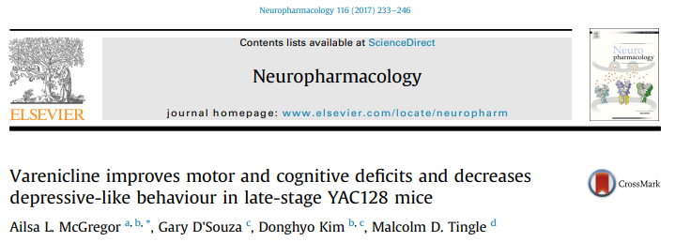

Proof of principle - preclinical
Varenicline has beneficial effects in a mouse model of HD
Notes:
The aim of this study was to describe the effects of varenicline on cognitive function in patients with early clinical Huntington’s disease (HD) who
were current smokers. Three gene positive patients transitioning to symptomatic HD were evaluated at baseline and after 4 weeks of treatment.
The frequency, intensity and burden of side effects were recorded weekly, in addition to self-reported cigarette use.
Disease symptom severity was assessed at baseline and after 4 week treatment with varenicline using part I (motor) and III (behaviour) of the Unified
Huntington’s Disease Rating Scale (UHDRS).
Cognitive function was assessed using the IntegNeuro™ computerised test battery (Brain Resource Company Ltd).
Domains assessed were manual dexterity (motor tapping), impulsivity and attention (Go No-Go), switching attention, verbal interference, executive maze,
and basic emotion recognition, in addition to a measure of premorbid intelligence (spot the real word).
IntegNeuro™ uses different task versions for repeat testing sessions to minimize the effect of familiarisation and practice effects.

Slide 18

Proof of principle – safety/tolerability
Varenicline is safe and improves aspects of cognition
Notes:
The aim of this study was to describe the effects of varenicline on cognitive function in patients with early clinical Huntington’s disease (HD) who were current smokers. Three gene positive patients transitioning to symptomatic HD were evaluated at baseline and after 4 weeks of treatment.
The frequency, intensity and burden of side effects were recorded weekly, in addition to self-reported cigarette use.
Disease symptom severity was assessed at baseline and after 4 week treatment with varenicline using part I (motor) and III (behaviour) of the Unified
Huntington’s Disease Rating Scale (UHDRS).
Cognitive function was assessed using the IntegNeuro™ computerised test battery (Brain Resource Company Ltd).
Domains assessed were manual dexterity (motor tapping), impulsivity and attention (Go No-Go), switching attention, verbal interference, executive maze, and basic emotion recognition, in addition to a measure of premorbid intelligence (spot the real word).
IntegNeuro™ uses different task versions for repeat testing sessions to minimize the effect of familiarisation and practice effects.
After 4 weeks of varenicline treatment UHDRS total motor score decreased by 44% from16 to 9 with notable improvement in oculomotor function and hyperkinesia scores
UHDRS total motor score decreased 28% from 11 to 8.

Slide 19
VCAS-HD study
Randomised, double-blinded, placebo-controlled
Clinical HD (symptomatic), non-smokers
Varenicline vs Placebo
12 week treatment with varenicline will:
1. Improve total functional capacity (TFC)
UHDRS
2. Improve cognitive function
IntegNeuro®: Motor tapping, Go No-Go, Switching attention, Verbal interference, executive function, emotion recognition
3. Improve Mood
Clinical rating scales: depression, anxiety and irritability12-week

Slide 20
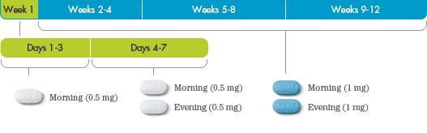
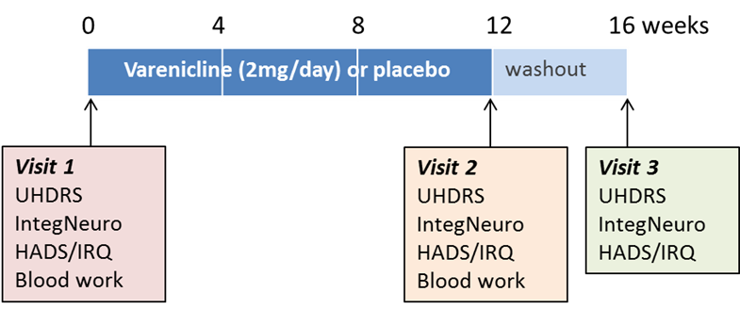
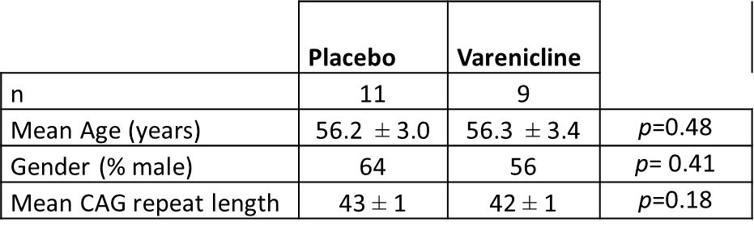
VCAS study protocol
Notes:
Recent evidence from our preclinical experiments shows that the nicotine analogue, varenicline improves motor, cognitive and affective symptoms in a transgenic mouse model of Huntington’s disease, HD (1). Results from an open label study suggest that varenicline may also improve motor function and improve cognitive performance in patients with early HD (2). Varenicline (2mg/ day for 4 weeks) produced modest improvements in motor score (assessed by the Unified Huntington’s Disease Rating Scale; UHDRS) and significantly improved performance in executive function and emotional recognition tasks in patients with early motor symptoms.

Slide 21
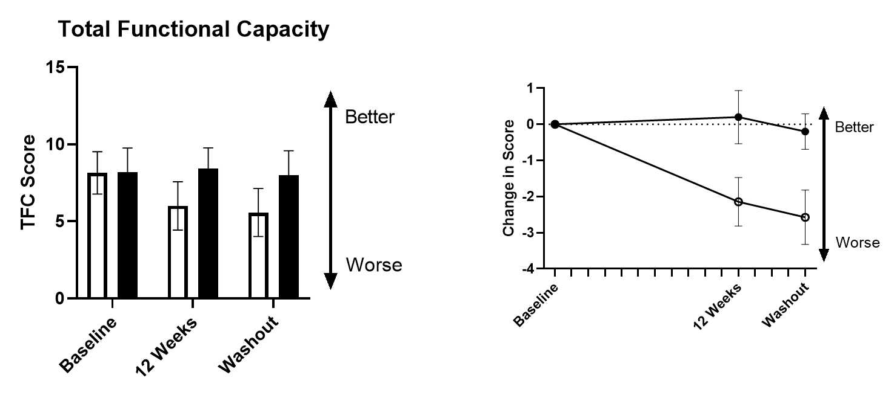
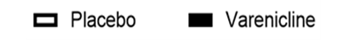

Primary Endpoint
~25% decline in TFC in placebo group
No decline in varenicline group
Long-lasting effect?
UHDRS Total Functional Capacity (25 point score)
*
p<0.05
p<0.05
*
Visit 1
Visit 2
Visit 3
Baseline
Week 12
Week 16

Slide 22

Secondary Endpoint
Z scores
Performance relative to age, sex, and education matched people without HD
Negative score indicates poorer performance
Cognitive Function: Executive maze
Improved maze navigation in varenicline group
Correlates with [varenicline]_{plasma}

Slide 23
Tertiary Endpoint
Mood Rating Scales – Irritability (126-point scale)
p<0.05
No change in anxiety, depression
Increased irritability in varenicline group
? Improved awareness of mood

Slide 24
What’s the impact?
Varenicline treatment for 12 weeks
Prevented decline in function observed in placebo group
Improved executive function (maze task)
Mild GI side effects at 1-8 weeks but not 12 weeks
No change in anxiety or depressive symptoms
Increased irritability at 12 weeks, clinically meaningful?
Self-reports of feeling sharper, clearer thinking
→ Compassionate use

Slide 25
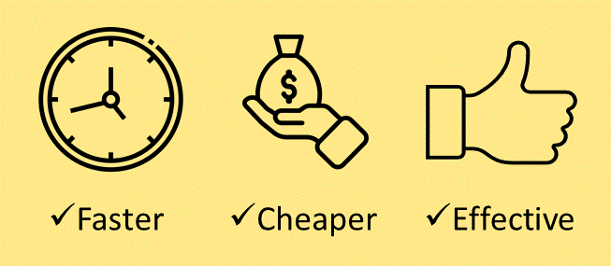
What’s next?
Incomplete data from week 16 visit
→ benefits are long-lasting
Mouse studies show we can delay the onset of memory impairments with pre-symptomatic treatment
Repurposing Varenicline:
Future work
Larger, two centre trial (Auckland, Southern)
Notes:
While we have an incomplete dataset at 16 weeks, improved TFC scores 4 weeks after participants stopped taking the drug suggest effects are long lasting
Taken together with evidence from ur mouse studies that showe we can delay onset of memory impairments if we treat mice before they are symptomatic hints at a potential disease modifying effect

Slide 26




Acknowledgements
Jo Dysart
Emma Lambert
Dr Robert Chen
Dr Greg Finucane
Prof. Malcolm Tingle
Maree Jensen
Annalyse Welford
Jamie Hounsell
Dr Mike King
Nicola Liebergreen
Dr Christina Buchanan
Participants
Margaret Begg Charitable Trust (University of Otago)

Slide 27
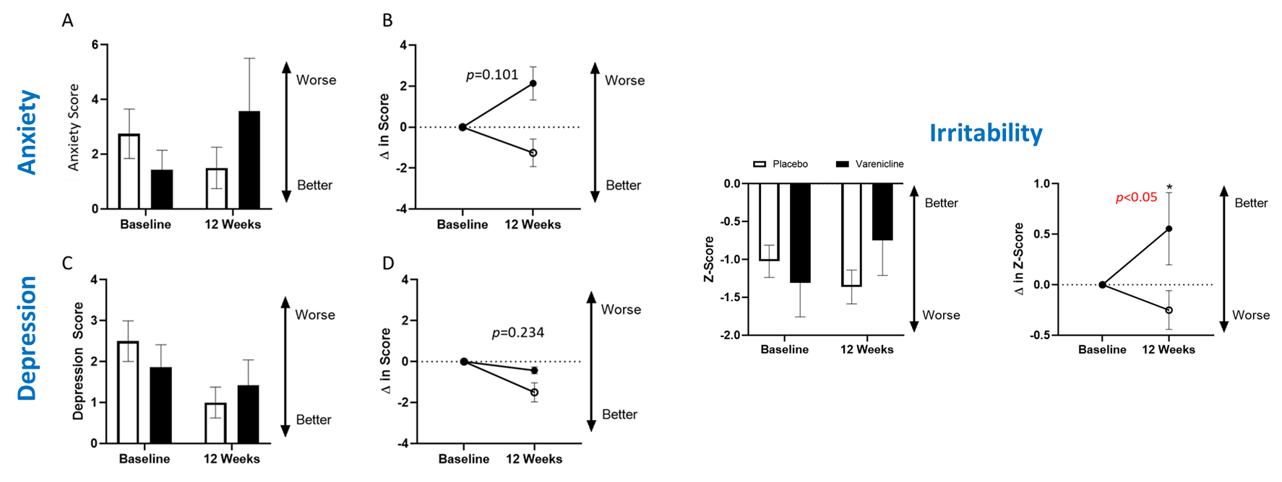
Results
Tertiary Endpoint
Mood

Slide 28
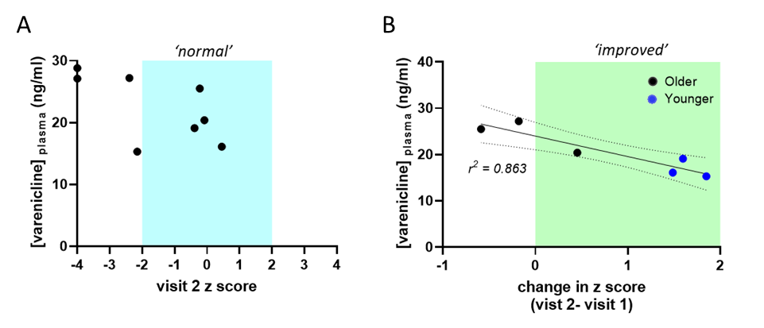
Blood levels correlate with response
Participants under age 50 displayed greater improvements in maze performance between visit 2 and baseline than older participants (B, r²=0.863). than those over 50 years of age.

