Slide 1
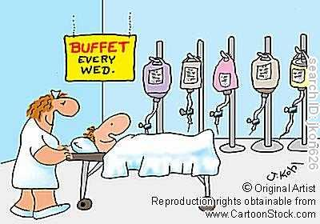
Parenteral Nutrition
Presented by Ivana Jovicic
Associate Lead Pharmacist - Surgical
July 2023

Slide 2
Malnutrition
What is it?
Prevalence in hospitalised patients?
Why does malnutrition matter?
https://onlinepublichealth.gwu.edu/resources/hospital-nutrition/

Slide 3
Malnutrition
“Malnutrition refers to deficiencies or excesses in nutrient intake, imbalance of essential nutrients or impaired nutrient utilization.”
– World Health Organization
https://www.hcbh.org/blog/posts/2022/april/cultivating-mental-health-how-to-improve-your-mental-health-through-nutrition/

Slide 4
Malnutrition
Prevalence in hospitalised patients?
Literature reports 20-50% of hospitalised patients are malnourished
Why does malnutrition matter?
Impaired wound healing
Longer length of hospital stay
Increased healthcare costs
Higher infection and complication rates

Slide 5
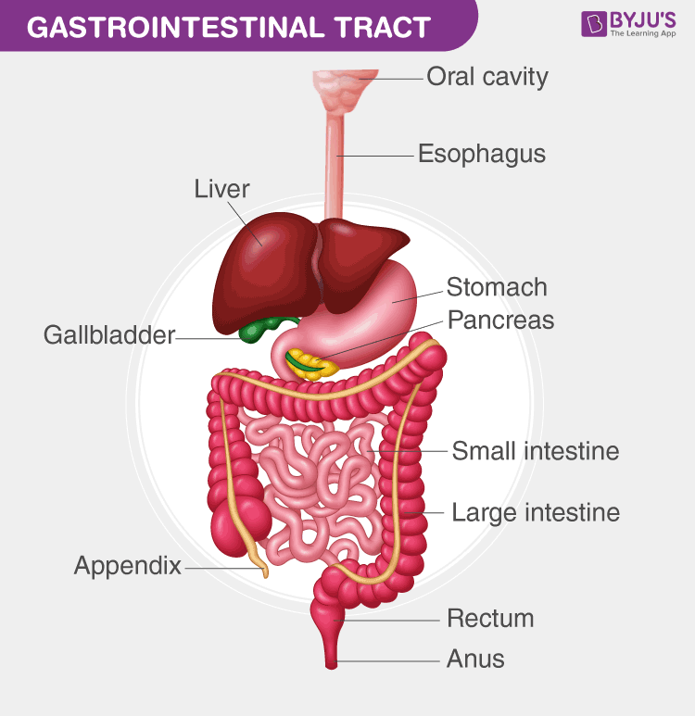
Nutrition support
Functioning gut
absorbs required nutrition
- water, protein, carbohydrates, fat, vitamins, minerals, electrolytes
Specialised nutrition products
- used to prevent or treat malnutrition

Slide 6
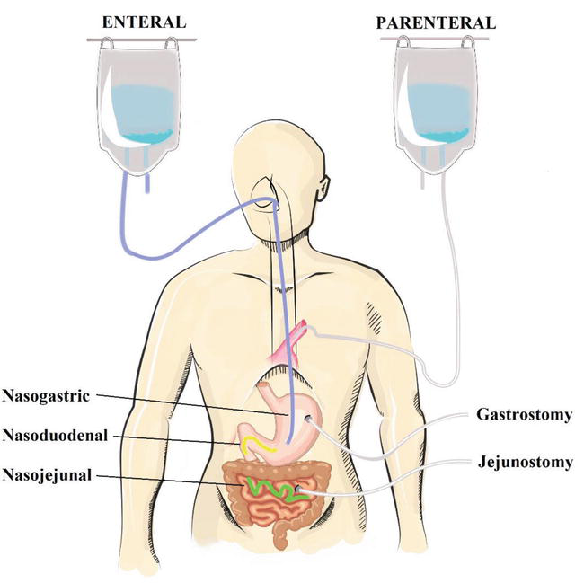
Nutrition Support
Enteral nutrition
functioning gut
may need feeding tube
Parenteral nutrition
bypass GI tract – IV
Intravenously administered nutrition
TPN = Total Parenteral Nutrition or
IVN = Intravenous Nutrition
https://www.intechopen.com/chapters/65073

Slide 7
Golden Rule
Enteral feeding should always be considered as first line option for feeding.

Slide 8
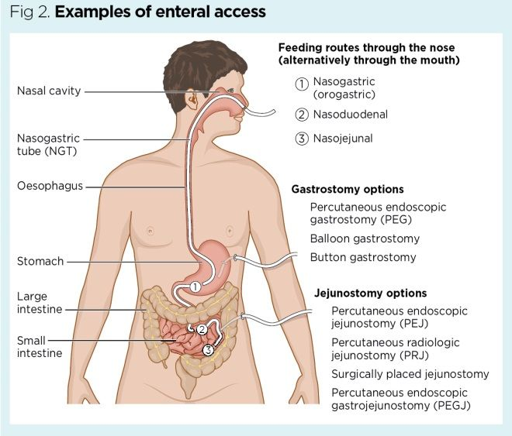

Slide 9
Nutrition support
Examples when to use
IV nutrition
‘Nil by mouth’ for extended periods
Intestinal obstruction, bowel injury, surgery
Malabsorption – eg cancer, Crohn’s Disease
Fistulas with high output
Intestinal ischaemia
Short bowel syndrome
Nutrition support team
– multidisciplinary team

Slide 10
What is in IVN?

Slide 11
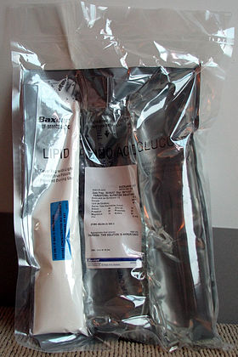
IVN Composition
Lipid
Energy source & essential fatty acids
Amino Acid
nitrogen/protein source
Glucose
Most common energy source

Slide 12
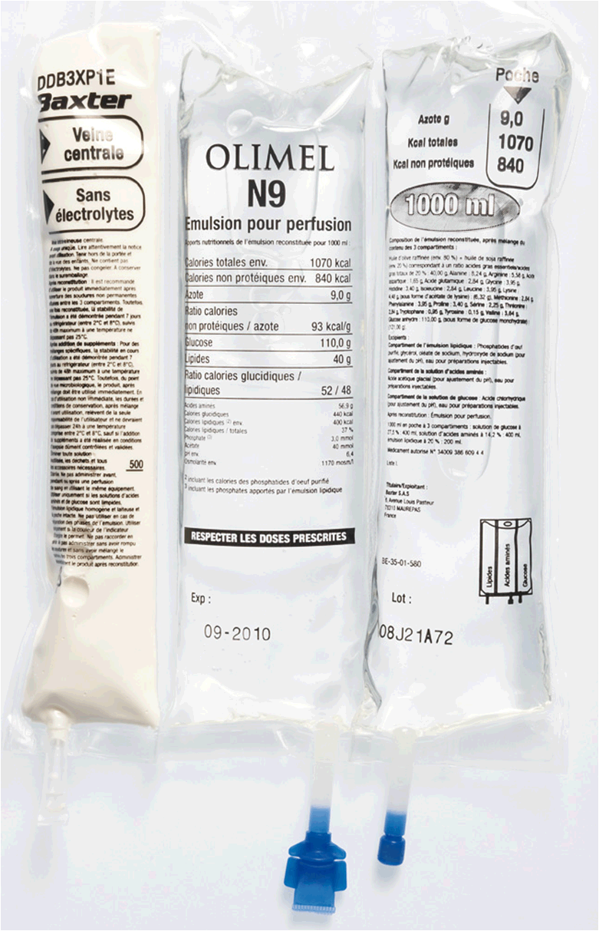
What is in IV nutrition bags?
Intravenous administration of:
Fluid - water
Protein (amino acid mixture)
Carbohydrate (Glucose)
Fat (lipid emulsions)
Electrolytes
Minerals (trace elements)
Vitamins

Slide 13
Lipids
Brand name | Intralipid 20% | ClinOleic 20% | Omegaven 10% | SMOFlipid 20%
Oil source (% by wt) | Soybean | Olive (80%), soybean (20%) | Fish | Soybean (30%), coconut (30%), olive (25%), fish (15%)

Slide 14
IVN Administration
What are our options for IV nutrition administration?
Central vs peripheral lines
- what is the difference

Slide 15
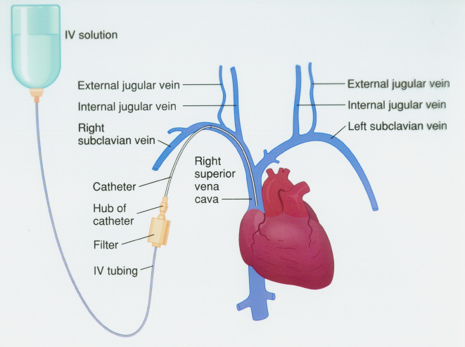

Slide 16
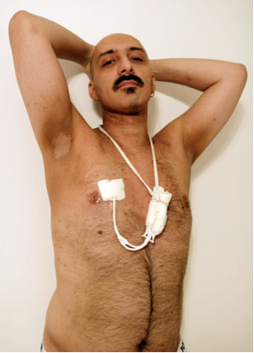
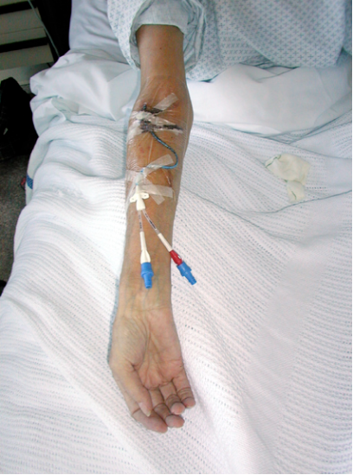
Central Venous Access
Central Venous Catheter (“Hickmans”)
Peripherally inserted Central Catheter (PICC)

Slide 17
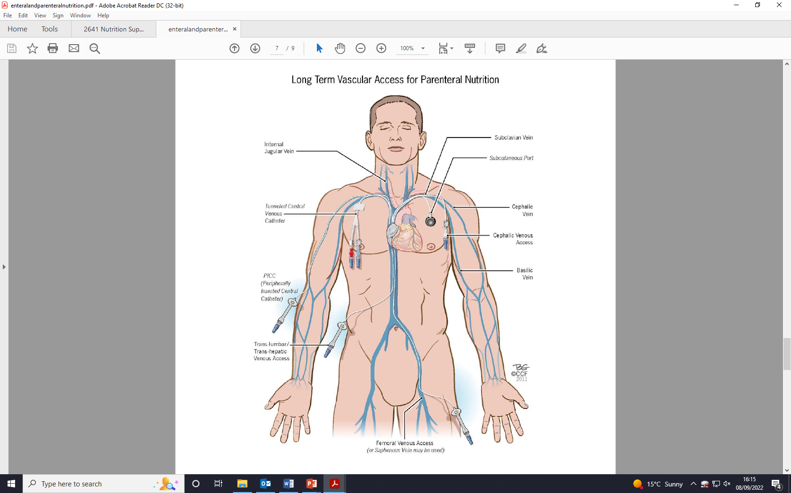
Notes:
Long term vascular access for parenteral nutrition

Slide 18
Peripheral venous access
suitable for short term use
- weeks
greater care with solution choice
(lower osmolarity, pH, dextrose)
increased risk of thrombophlebitis

Slide 19
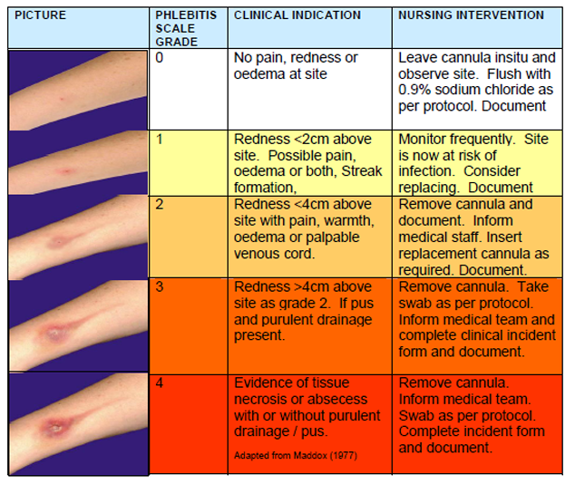
Phlebitis
chrome-extension://efaidnbmnnnibpcajpcglclefindmkaj/http://www.midcentraldhb.govt.nz/WorkingMDHB/CareerInformation/Nursing/Documents/Students%20IV%20Resource%20Book.pdf
Notes:
An insult to the endothelial vessel wall causes inflammation, redness, pain and possible extravasation

Slide 20
IVN Administration
Before starting IVN
Baseline weight and height, baseline BGL
Ensure appropriate iv access
Electrolytes (CBC, LFTs, U+E, PO₄³⁻, Mg²⁺)
Daily bloods for the first week
Ensure insulin is charted
4 hourly BGLs for 24 hrs or with rate increase

Slide 21
IVN Administration
Rate
Start slowly for first 24 hrs
Infusion pump is used to ensure proper rate
Example: Start at 40ml/hr x 24hr. Then progress to 80ml/hr x 24h, etc. until goal rate has been reached
Cyclic IVN – daily requirements are administered over shorter time – more natural

Slide 22
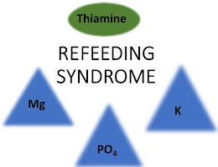
Re-feeding Syndrome
Electrolyte disturbances
This can lead to serious complications
- heart failure, seizures, coma, sepsis and sometimes death

Slide 23
Advantage of IVN
Potentially life-saving
…when GI tract cannot be used or when oral/enteral nutrition cannot meet patients’ nutrient requirements

Slide 24
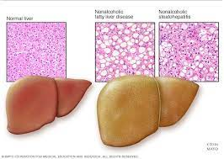
Disadvantages
Costly
Increased infection risk
Non-physiological
Long term risks
- liver dysfunction, kidney & bone disease

Slide 25
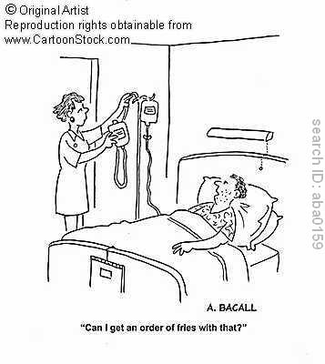

Slide 26
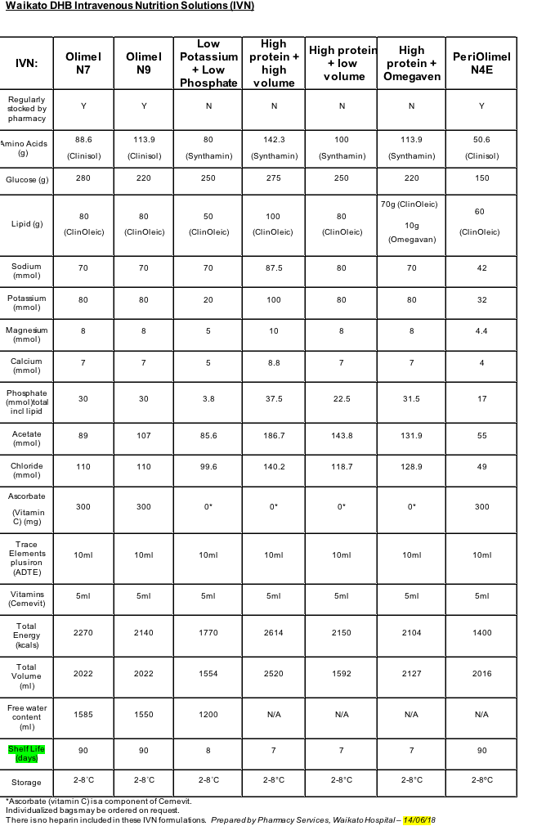
Adult Waikato Hospital Formulations

Slide 27
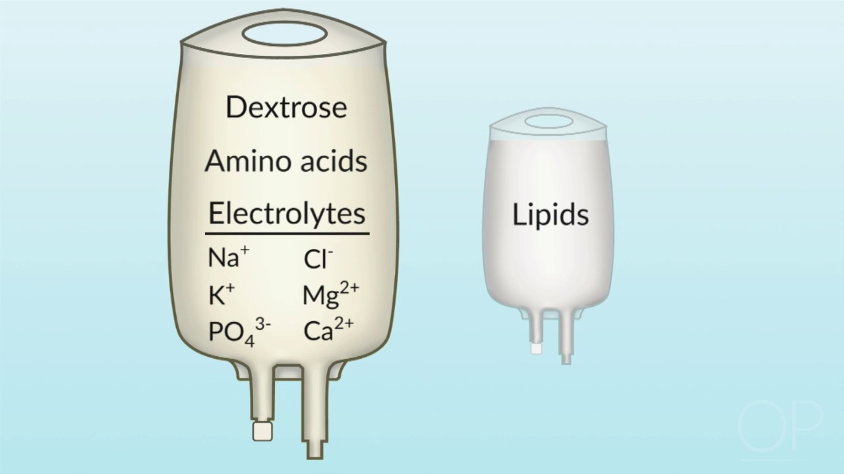
Neonates & young children
Two phase bags
glucose and amino acid
Vitamins and trace elements
“Reg96”
Lipids separate
SMOF
vitamins
Notes:
May have lipid and clear phase administered separately

Slide 28
Waikato Neonatal Formulations
Volume: Composition: | 300 mL | 600 mL | 1000 mL
Protein g | 12.6 | 25.2 | 42
Glucose g | 30 | 60 | 100
Sodium mmol | 16.5 | 33 | 55
Potassium mmol | 8.4 | 16.8 | 28
Chloride mmol | 6 | 15 | ?
Acetate mmol | 11.4 | 19.8 | 41
Calcium mmol | 5.1 | 10.2 | 17.02
Phosphate mmol | 5.7 | 11.4 | 19
Magnesium mmol | 0.9 | 1.8 | 2.8
Zinc mg | 1.32 | 2.64 | 4.4
Heparin units | 150 | 300 | 500
Manganese mcg | 3.51 | 6.48 | 11
Copper mcg | 66 | 132 | 220
Chromium mcg | 0.64 | 1.31 | 2.21
Iodine mcg | 3 | 6.6 | 11
Selenium mcg | 9.3 | 18.6 | 30.9
Neonatal Reg96 Solution
Volume: Composition: | Pre-Term Neonatal Lipid emulsion 55 mL syringe | Term Neonatal Lipid emulsion 150 mL bag | Term Neonatal Lipid emulsion 300 mL bag
Lipid (SMOF) g | 10 | 28 | 56
Multivit. (Infuvite) mL | 5 | 10 | 20
Phosphate mmol | 0.8 | 2.1 | 4.2
Neonatal Lipid Formulations

Slide 29
Waikato Hospital Formulations
Different formulations
– advantages and disadvantages
Vitamins
Electrolytes
Expiries
Storage/temperature
Ordering

Slide 30
Pharmacy Role
Optimising composition of IVN
Products available
Compatibilities
Dispensing and ordering IVN
Advice on supplementary electrolytes and medicines
Advice on infection prevention, n&v, reducing stoma output/diarrhoea, formulations available
Prescribing role

Slide 31
Example 1 Figure out how many bags to dispense to this patient:
Adult patient using:
- Olimel N9 (2022 mL bag)
80ml/hr via PICC over 24 hours
- Low potassium low phosphate bag (1554 mL)
via PICC line 80ml/hr via PICC over 24 hrs
= __ bag/s per 24 hours
= __ bag/s per 24 hours
Notes:
When it comes to dispensing and ordering we need to calculate how many bags to supply

Slide 32
Example 2 Figure out how many bags to dispense to this patient:
Adult patient using:
- Olimel N9 (2022 mL bag)
90 ml/hr via PICC over 24 hours
- Olimel N9 (2022 mL bag)
120 ml/hr via PICC over 18 hours
= ___ bag/s per 24 hours
= ___ bag/s per 24 hours

Slide 33
Is this appropriate charting:
Paediatric patient charted:
- Olimel N9
40 ml/hr IV over 12 hours
- Olimel N7
120 ml/hr via midline over 24 hours
- PeriOlimel N4
50 ml/hr via PICC over 24 hours

Slide 34
Questions?
https://www.nutritionletter.tufts.edu/general-nutrition/nutrition-then-and-now/

