Slide 1
PHARMAC, HML & NPPAs
Jan Goddard
29 July 2023

Slide 2
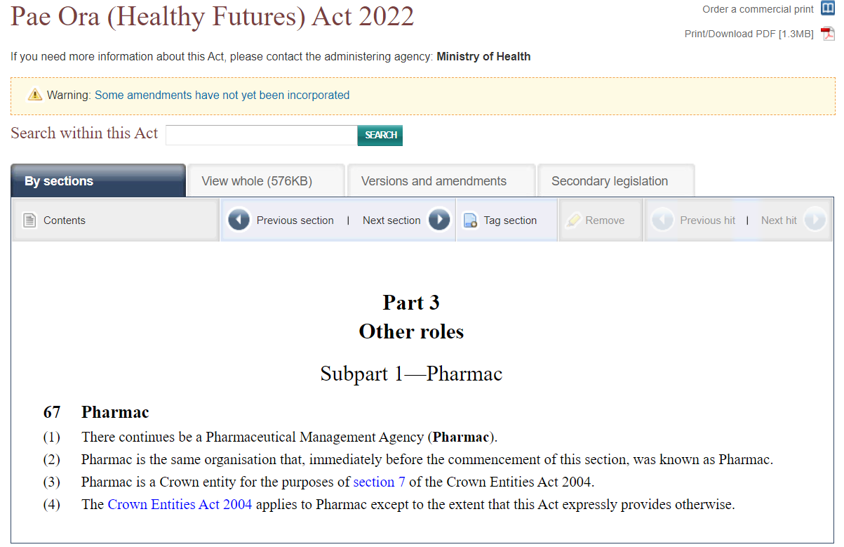
What is PHARMAC?
Section 67 Pae Ora (Healthy Futures) Act 2022
(replaced the New Zealand Health and Disability Act 2000 (repealed))
S67(3): Pharmac is a Crown entity for the purposes of section 7 of the Crown Entities Act 2004.

Slide 3
Who?
Board
CEO
PTAC and subcommittees
Operational team
Pharmaceuticals
Devices
Other

Slide 4
Role of PHARMAC
To secure for eligible people in need of pharmaceuticals, the best health outcomes that are reasonably achievable from pharmaceutical treatment and from within the amount of funding provided;
Maintain and manage a pharmaceutical schedule that applies consistently throughout New Zealand, including determining eligibility and criteria for the provision of subsidies.
Promote the responsible use of pharmaceuticals (and devices)
Any other objectives it is given
All within budget!
(For eligible people – defined under s102 as being eligible to receive services funded under this Act).

Slide 5
Other supporting legislation
Crown Entities Act 2004
Public Records Act 2005
Operating Policy Schedule 2022/23

Slide 6
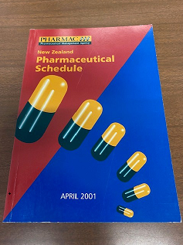
History
NZ Pharmaceutical “Community” Schedule, sections A-G
Formularies/ Preferred medicines list
Medicines management committees
Uneven pharmaceutical budgets based on PBF
Post code prescribing

Slide 7
And then…..
Government decided PHARMAC should take responsibility for funding all DHB hospital pharmaceuticals in order to improve consistency of funding and access to medicines for patients across the country.
Better alignment of funding between hospitals and the community.
Ability to review medicines that may need to be added.
Introduction of the CPB

Slide 8
Combined pharmaceutical budget
Part of the health budget. Money set aside to pay for medicines and related products.
Pays for medicines and related products given in hospitals and dispensed by pharmacies
Pays for funded vaccines (except the COVID-19 vaccine).
Pharmac is legally required to not exceed the CPB
Budget bid each year

Slide 9
Dear Minister….

Slide 10
HML development

Slide 11
PTAC & sub-committees

Slide 12
Who is using what?

Slide 13
HML birth

Slide 14
Implementation + Communication
From 1 July 2013 the Hospital Medicines List (HML), or Pharmaceutical Schedule Section H, replaced the different formularies and preferred medicines lists used in DHB hospitals.
Long consultation phase leading up to 1st July.
Phased transition from 1 July, so PHARMAC can monitor what is happening on the ground, be responsive to DHB feedback and update the list as it is tested against actual practice.
To ensure appropriate clinical decisions can be made for patients, the transition phase will be flexible and make allowances for clinical decision making. PHARMAC

Slide 15
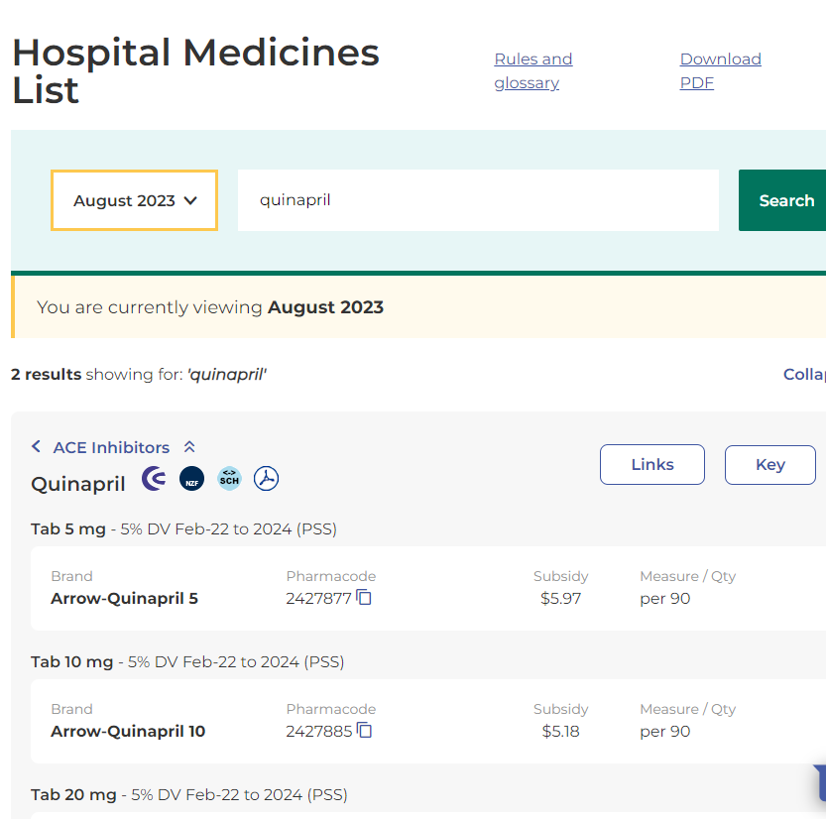

Slide 16
General rules and exceptions
Grand-parenting (pre-existing use, pre-2013)
Clinical trials – Ethics approved
Free stock
Familiarisation programmes
Not privately funded
Patient’s own (continuation only)
ACC and other government entities
Paediatric oncology (although…)
Pharmaceutical Schedule General rules, Part 8.0: Funding exceptions

Slide 17
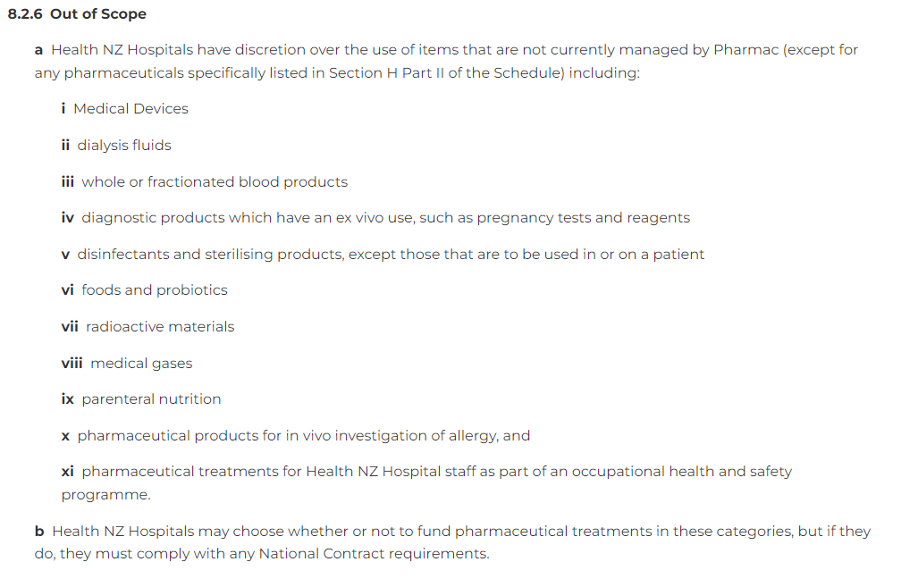
Exceptions…
Out of scope

Slide 18
Exceptions: NPPA
“An Unlisted pharmaceutical or a Hospital Pharmaceutical outside of any relevant Restrictions may be Given in accordance with the NPPA Policy”
Named Patient Pharmacuetical Assessment (NPPA)

Slide 19
NPPA policy
1. Does the person have exceptional clinical circumstances?
The purpose of the NPPA policy is to consider those patients whose needs can’t feasibly be met by the Pharmaceutical Schedule process.
an urgent clinical need or their clinical circumstances are unusual.
NPPA is for individual people. How does the patient’s circumstances differ from the wider patient population.
Pharmac will consider whether funding this person will have an implication for the wider patient population.
2. Has the person tried all existing funded alternative treatments?
The patient must have tried all suitable funded options before seeking funding for a treatment through NPPA.
This may include non-pharmaceutical treatments, such as surgery, physiotherapy or lifestyle changes.
Treatments funded through NPPA must be “end of spectrum”. This means that there are no other clinically suitable funded options for the person.
NPPA cannot be used to undermine the Pharmaceutical Schedule by providing a competing pathway to access funded treatment.
3. Has Pharmac considered the treatment for funding previously?
Check the Application Tracker(external link)
Already considered? Unlikely to fund it through NPPA unless:
there's something exceptional about patient’s clinical circumstances, or
we've approved similar NPPA applications in the past.

Slide 20
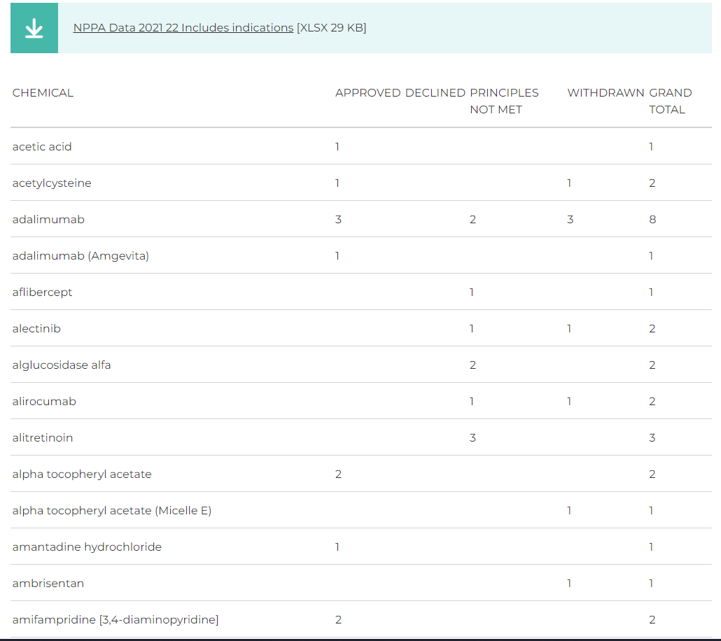
NPPA process
NPPA applications
Emergency
Rapid internal
Rapid
Standard

Slide 21
Other quirks..
Compounded medicines
HSS/ PSS
DV limits
30 day rule

Slide 22
Scenarios
HML but not on the Community Schedule
HML and only short supply needed (under 30 days)
Not on HML “but they only need it for a little while”
NPPA approval post-fact
Rapid internal vs rapid PHARMAC (“but they need it now”)
I don’t care, I want to use it…or “everyone else is using it”
“It’s not on the HML but it’s near enough”
Is this on the HML or not? Is it a medicine?

Slide 23
Questions?

