Slide 1
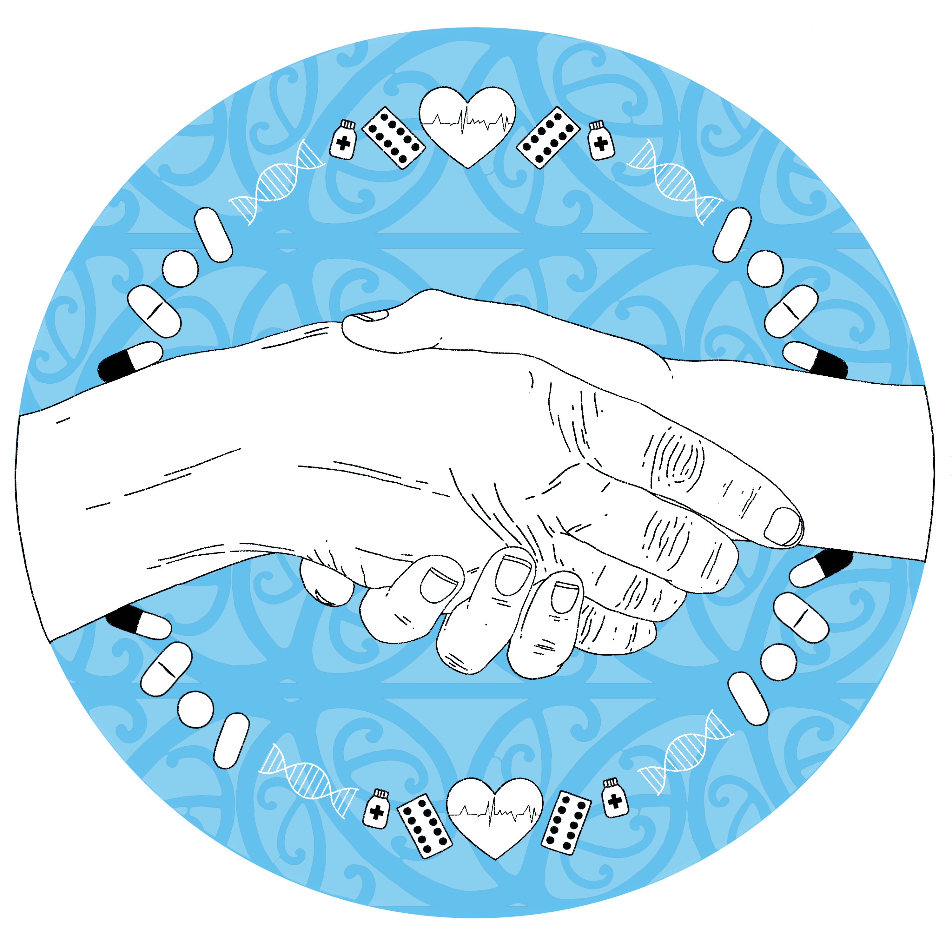
Medicines, Mental Health & Māori
Dr Joanna Hikaka
Senior Research Fellow, University of Auckland

Slide 2
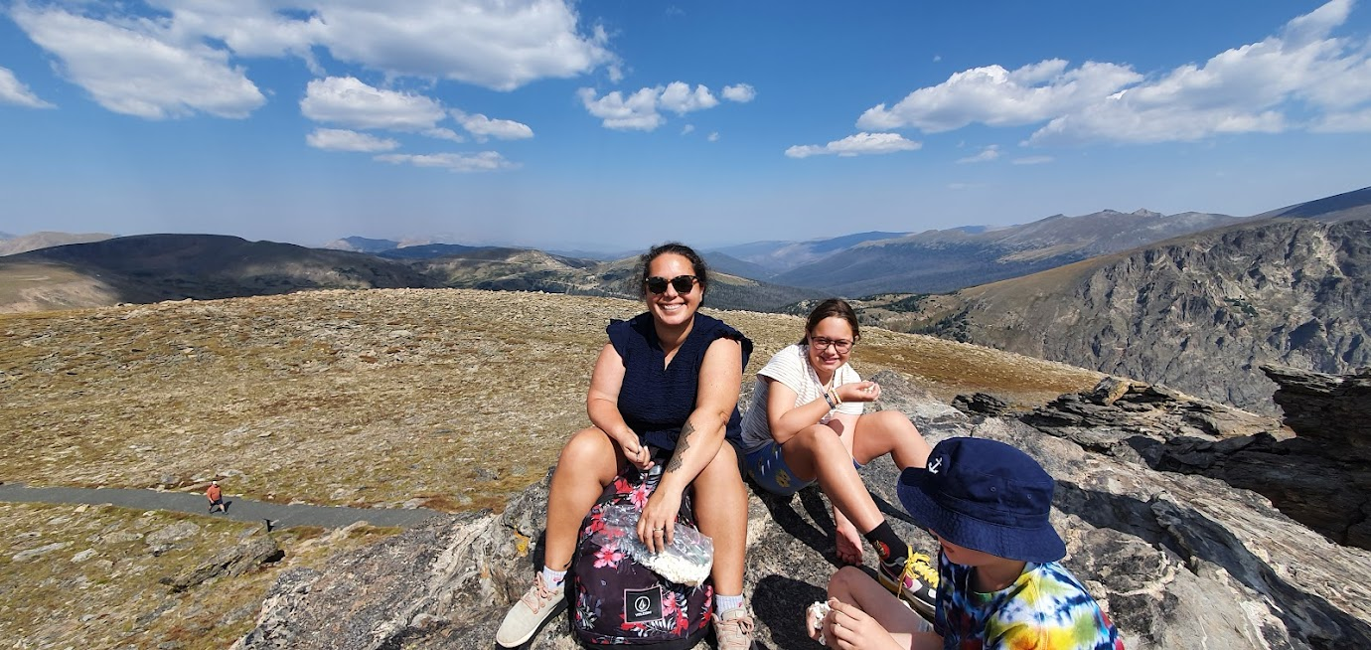
Ko wai au?
Notes:
Pharmacist for 20 years. Most of my time has been working at Waitemata DHB in the inpatient wards and also in aged residential care. In terms of my experience in mental health, I worked in a private mental health hospital in London, the Priory Roehampton which specialised in addiction treatment and eating disorders but did respond to the spectrum of mental health treatment for inpatients and outpatients. At Waitematā, I have specialised in older adult health and so in that context have supported health care related to dementia, long term mental health conditions and management through the end stages of life and new presentations in older age. About 8 years ago I started doing some research in aged residential care and then started a PhD looking at medicines review service development for older Māori and I stopped all clinical work 2 years ago because of my research load. In the research space my focus has been on gerontology, medicines use, Māori health hand health equity and health service development.

Slide 3
Objectives
Equitable access to mental health medicines in older age
Medicines adherence
Potential for pharmacist mental health care in primary care
Discussion
Notes:
Hoping the pitch is right – assuming a diverse group with a variety of expertise – leaving lots of time at the end for discussion

Slide 4
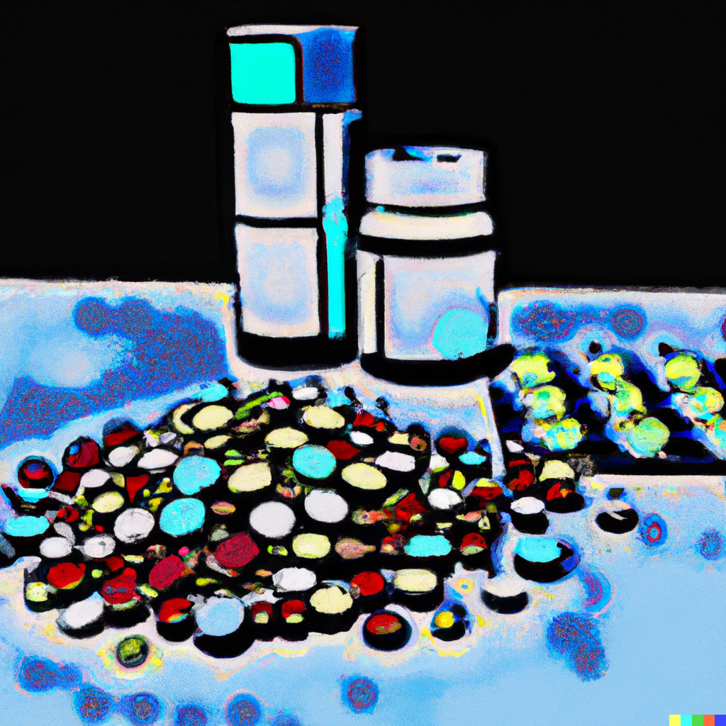
Equity of access to MH medicines by ethnicity
Inequity in access to medicines¹
And we also know that there is ethnic variation in mental health medicines
Notes:
If we look at a population level, across all types of medicines, e know there are inequities in access to medicines by ethnicity with Māori and Pasifika less likely to have equitable access to medicines given the disease burden (million missing scripts

Slide 5
Depression and age
https://epic.akohiringa.co.nz/
Notes:
National data available to all. Primary care precribers can access their own data and their practice level data.
Prescribers
Youth mental health dashboard

Slide 6
Depression and ethnicity

Slide 7
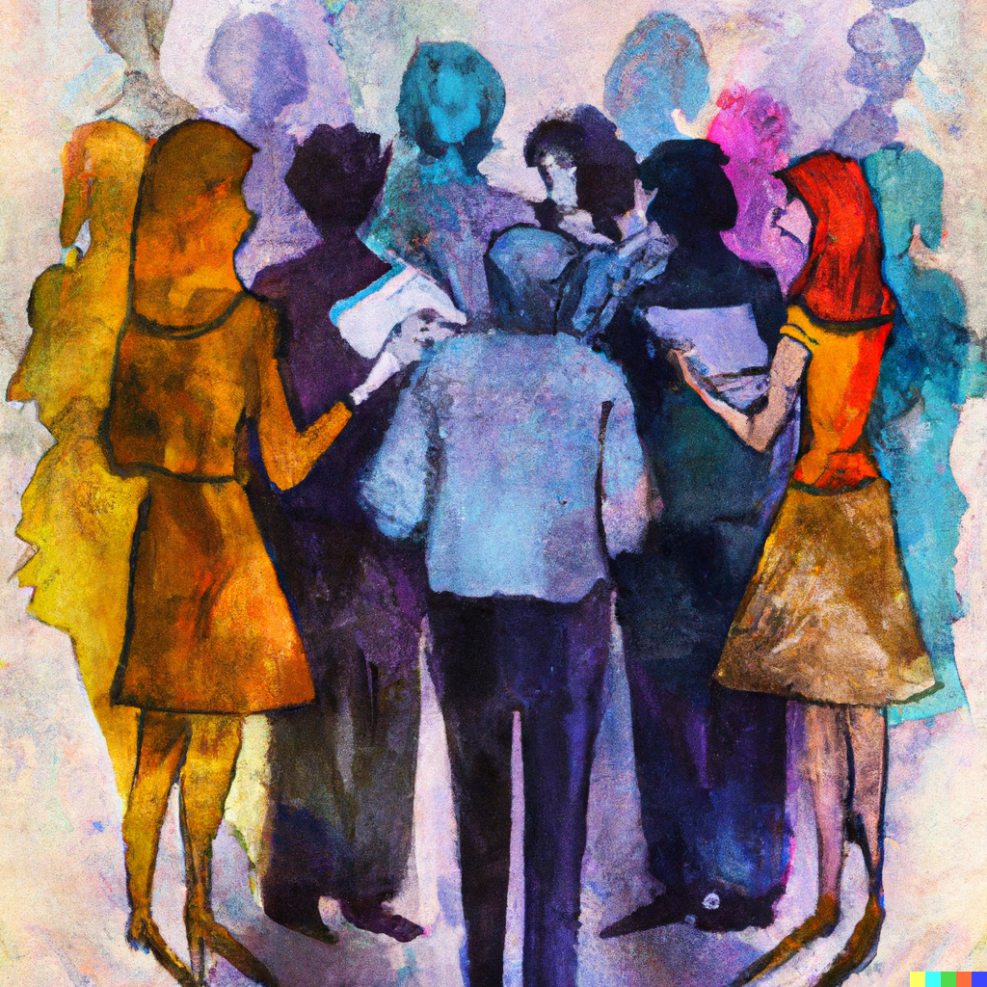
Depression
Māori had lower rates of any dispensing as well as repeat dispensing^{2,3}
Similar to international findings³
Variation in anxiolytic/hypnotic use^{2,3}
Māori have higher rates depression and anxiety⁴
Reasons for variation?
Notes:
Reasons – reduced access to health care
What do we know about effectiveness or appropriateness of antidepressant treatment ? Who do we want to be treating?
To understand treatment access more fully, the inclusion of non-pharmacological management, which may include rongoā Māori (traditional Māori system of healing and treatment) such as karakia (prayer), is needed. Non-pharmacological management of mild depression is more effective than medicines [62], although it has been noted that the mainstream delivery of these services may not meet the needs of Māori [63].

Slide 8
Antipsychotics and age

Slide 9
Antipsychotics and ethnicity

Slide 10
Antipsychotics
Indication changes with age
Variation in use³
⬆Māori younger age
⬇Māori older age

Slide 11
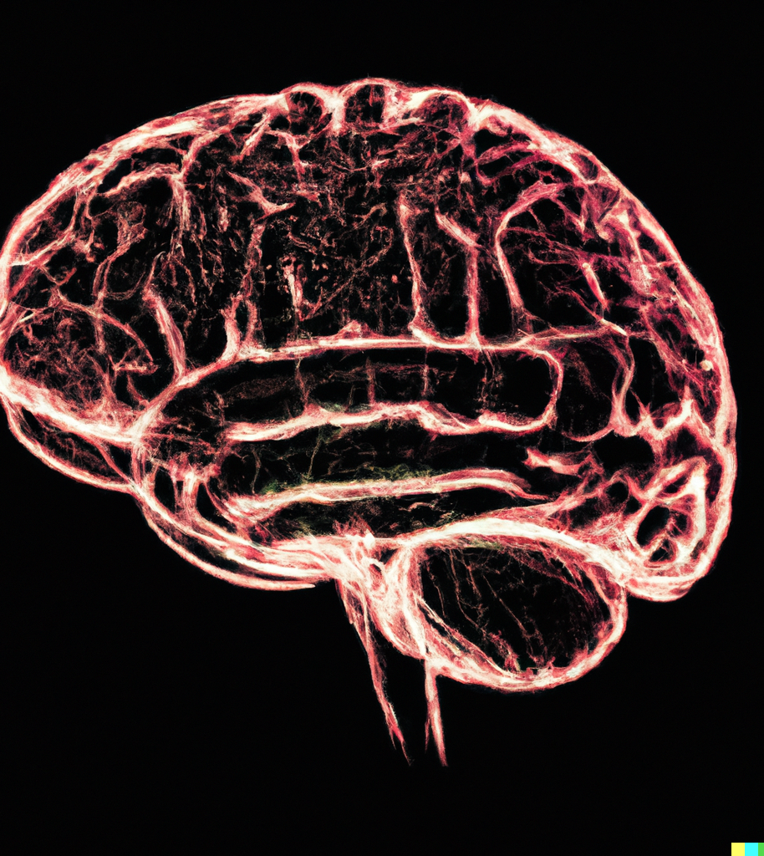
Dementia medicines
Prevalence probably higher for Māori and Pasifika⁵
Difference in potentially modifiable risk factors by ethnicity⁶
Inequities in access to anti-dementia medicines^{7,8}
Notes:
Prevalence probably higher for Māori and Pasifika than NZ European. There are multiple studies being undertaken to better understand this and that includes development of screening tools or methods that better suited to different cultural or ethnic groups.
Highest PAFs for Europeans were hearing loss (8%) and social isolation (5.7%), and for Asians hearing loss (7.3%) and physical inactivity (5.5%). For Māori and Pacific peoples, highest PAFs were for obesity (7.3% and 8.9% respectively) and hearing loss (6.5% and 6.6%). Hearing loss and access to care – this will be a changing picture but I still remember I Māori genetlman about 10 years ago when I was working in aged care who had a longstanding diagnosis of schizophrenia and had been institutionalized most of his life and certainly all of his adult life. Admitted to the aged care facility on 8mg risperidone, over a long period of time he was down titrated to 2mg and he actually had profound hearing loss that had been previously undiagnosed.
Overall, one-third of the dementia population received a funded anti-dementia medication in the total population (all ages) between 2016 and 2020. Donepezil tablets were dispensed in 31.6-34.0% and rivastigmine patches in 1.4-2.1% across the four study years. Compared to people of European ethnicity, Māori, Pacific peoples, and Middle Eastern, Latin American and African groups were less likely to be dispensed an anti-dementia medication (Māori: relative risk = 0.79-0.81, p < 0.0001; Pacific peoples: relative risk = 0.72-0.74, p < 0.0001; Middle Eastern, Latin American and African: relative risk = 0.73-0.78, p < 0.05). Compared to the age 80+ group, the 65-79 age group was more likely (relative risk = 1.50-1.54, p < 0.0001), while the age <65 group was less likely (relative risk = 0.67-0.71, p < 0.0001) to be dispensed an anti-dementia medication. There were no statistically significant differences in anti-dementia medication use between males and females.

Slide 12
What can we do?
Notes:
This may have prompted each of you to think about ways to respond in your own work places, scopes of practices and realms of influence. I am now just going to introduce some research I have been part of and the ways that could potentially support these issues.
Medicines adherence

Slide 13
Medicines adherence

Slide 14
Research team
Notes:
Introduce ourselves

Slide 15
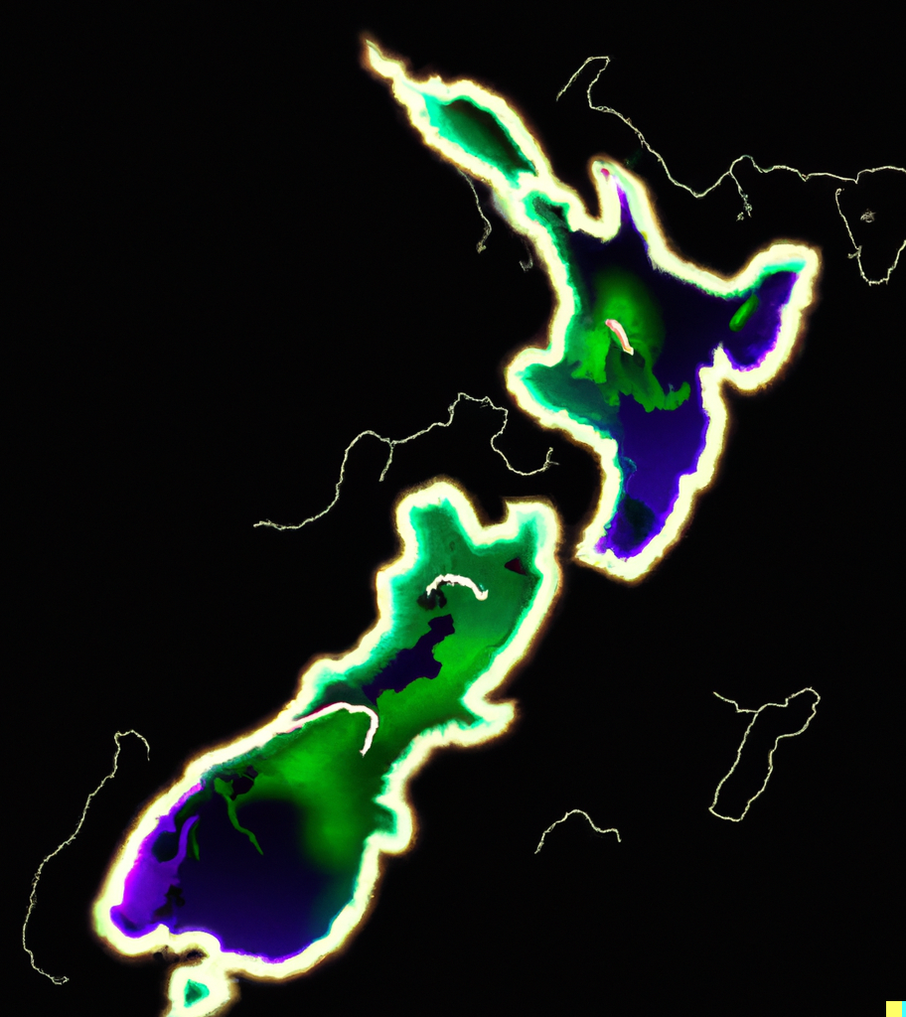
Who participated?
64 Māori across 7 regions in Aotearoa NZ
34 different iwi affiliations
10 online wānanga
3 in-person wānanga

Slide 16
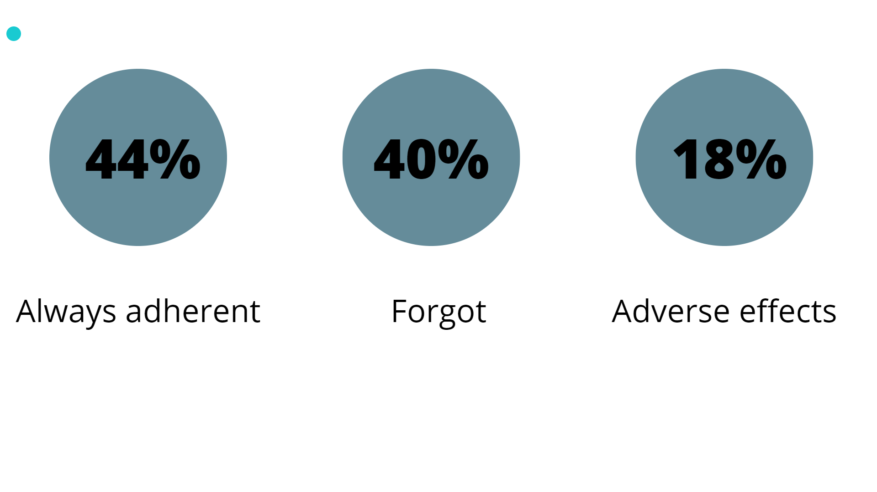
9
Notes:
44% of people who took medicines said they were always adherent
Forgetting medicines or not having medicines on hand when people travelled were the most common reasons for non-adherence.
Next most common reason was intentional non adherence due to adverse effects of medicines.

Slide 17
Notes:
Importantly, no one reported that lack or trust or lack of belief in medicines was a reason for non-adherence
Which is relevant as a lot of narrative around medicine taking suggests that there are cultural barrrirs to acceptance of medicines where as our information highlights more the role of systems and health services as barriers to adherence
CANT MAKE ASSUMPTION ABOUT REasons

Slide 18
It would be really great to see rongoā practitioners working in pharmacies. [They can] whakamana (uplift) each other… share the rongoā knowledge and uptake some of the pharmacist knowledge at the same time - a transfer of information.
Notes:
4 themes relating to Māori and medicines adhernce were generated from our data.
First = Medicines are an important part of wellbeing but were just one component of holistic care

Slide 19
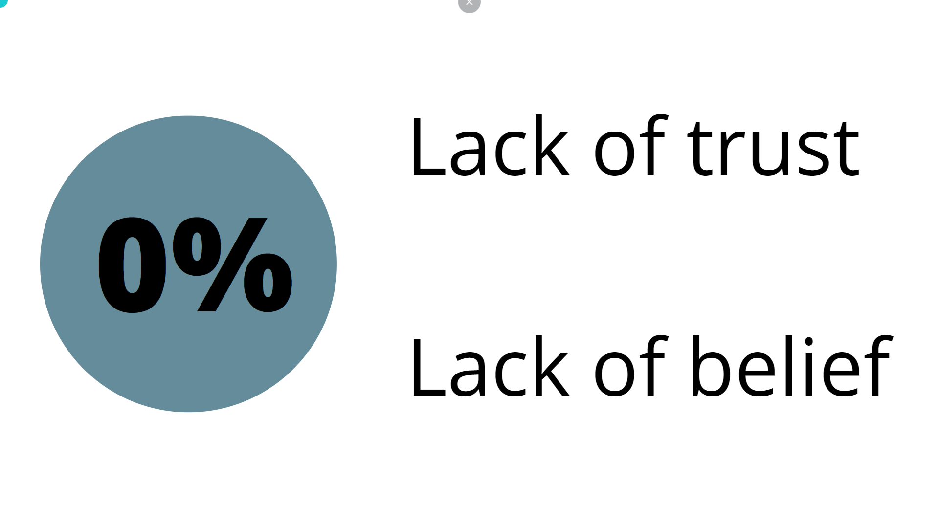
Notes:
The second - that relationships with proactive pharmacists was important in supporting adherence

Slide 20
Notes:
Knowledge was the next theme
whereby knowledge was viewed as a privilege possessed by pharmacists, and the importance of sharing knowledge to rebalance power and understanding was discussed

Slide 21
Notes:
The last themese was that participants discussed their ability to advocate for themselves and others in relation to medicines adherence and processes that support this. Family and other social relationships and networks were important in supporting others to take medicines.

Slide 22
Access to mental health support in primary care
Reduced access to primary care for²:
- people with MH diagnosis
- to greater extent for Māori and Pasifika
International examples of mental health support in community pharmacy
https://bloomprogram.ca/

Slide 23
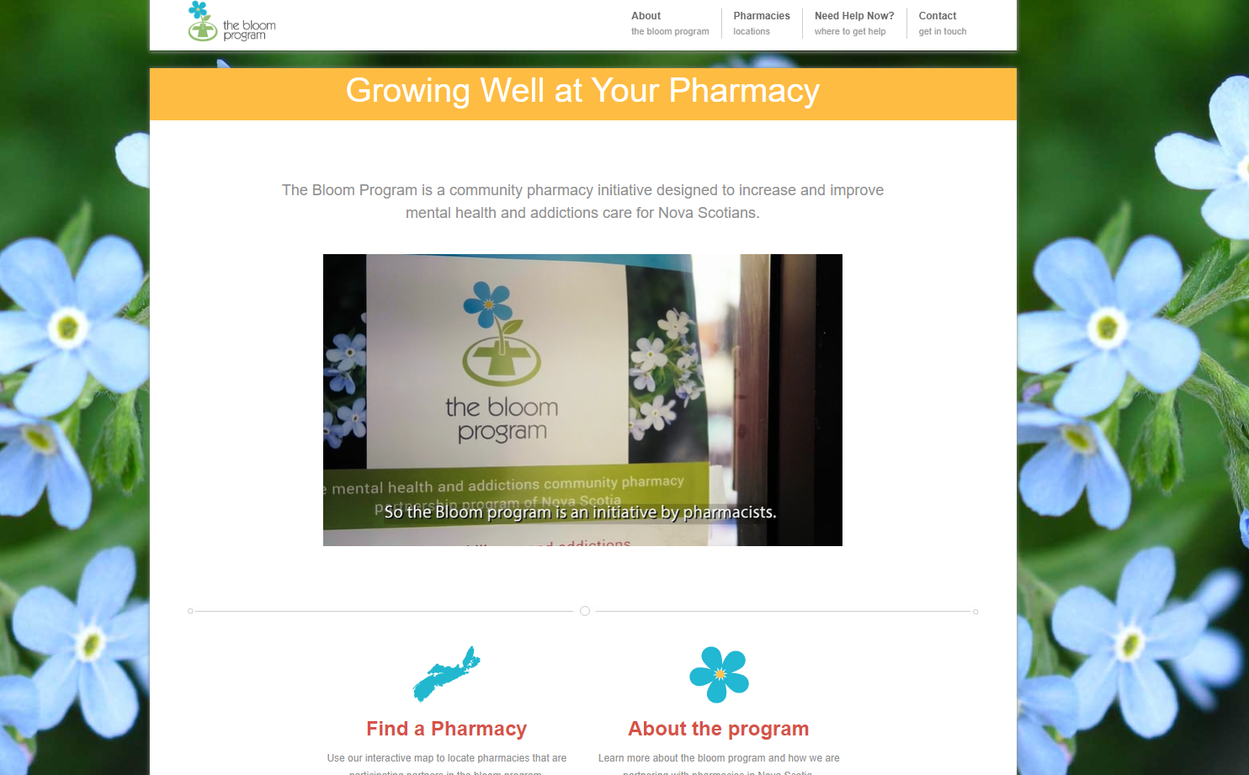

Slide 24
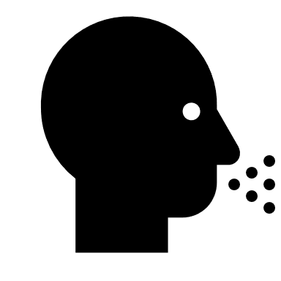
Conditions that people would most likely go to a pharmacy first for:¹⁰
Eczema
Coughs and colds
Kutu / nits
Insect bites

Slide 25
Medicines for minor ailments
Conditions that people would least likely go to a pharmacy first for:
Low mood / depression
Period pain
Haemorrhoids /piles
Birth control
Notes:
Still over 50% said they would go to pharmacy first

Slide 26
The right environment is important
At the moment, you walk in the [pharmacy] door, and you're assaulted by the stink of perfume… When you have a pharmacist who goes out into the community and meets you in a comfortable setting, not surrounded by those bright lights and shiny shelves, you're more likely to listen to what they're saying, [and the] advice on product, than someone that kinda looks like a retail salesperson.

Slide 27
Care needs to be clinically safe AND culturally safe
You can make it as accessible as you want. But if there’s mamae (pain) about going into the pharmacy shop, it'll always be there. I think, in terms of cultural safety, [pharmacists] would score low, but in terms of the ability to give a really good professional advice based on their tenure of their education I wouldn't have an issue with that.

Slide 28
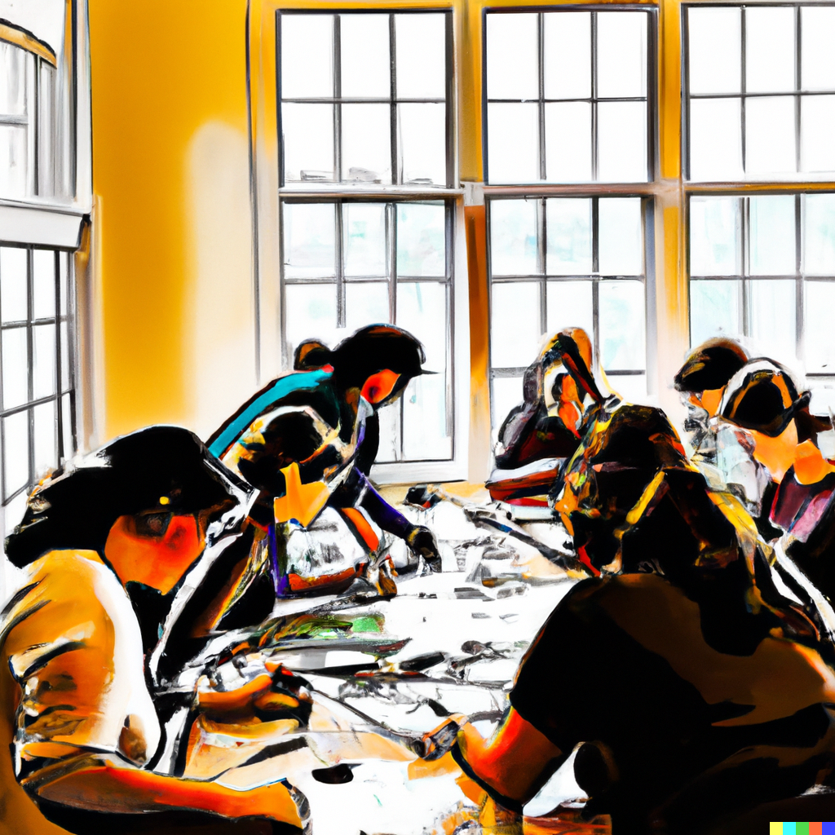
What could equitable pharmacist primary care mental health services look like in Aotearoa?

Slide 29
Questions?

Slide 30
References
1. Metcalfe S, Beyene K, Urlich J, Jones R, Proffitt C, Harrison J, et al. Te Wero tonu—the challenge continues: Māori access to medicines 2006/07–2012/13 update. New Zealand Medical Journal. 2018;131(1485).
2 - https://www.hqsc.govt.nz/our-data/atlas-of-healthcare-variation/mental-health-in-primary-care/
3 - Hikaka, J., Jones, R., Hughes, C. et al. Ethnic Variations in the Quality Use of Medicines in Older Adults: Māori and Non-Māori in Aotearoa New Zealand. Drugs Aging 38, 205–217 (2021). https://doi-org.ezproxy.auckland.ac.nz/10.1007/s40266-020-00828-0
4 – rates of anxiety and depressionBaxter J. Mental health: psychiatric disorder and suicide. In: Hauora: Māori Standards of Health IV: a study of the years 2000–2005, 4th edn. Wellington: Te Rōpū Rangahau Hauora a Eru Pōmare; 2007.
5. Cheung G, To E, Rivera-Rodriguez C, Ma'u E, Chan AHY, Ryan B, Cullum S. Dementia prevalence estimation among the main ethnic groups in New Zealand: a population-based descriptive study of routinely collected health data. BMJ Open. 2022 Sep 7;12(9):e062304. doi: 10.1136/bmjopen-2022-062304.
6. Ma'u E, Cullum S, Cheung G, Livingston G, Mukadam N. Differences in the potential for dementia prevention between major ethnic groups within one country: A cross sectional analysis of population attributable fraction of potentially modifiable risk factors in New Zealand. Lancet Reg Health West Pac. 2021 Jul 5;13:100191. doi: 10.1016/j.lanwpc.2021.100191.
7. Cullum S, et al. Predictors of mortality in Maori, Pacific Island, and European patients diagnosed with dementia at a New Zealand Memory Service. Int J Geriatr Psychiatry. 2020;35(5):516–24. https://doi-org.ezproxy.auckland.ac.nz/10.1002/gps.5266.
8. Chan AHY, Hikaka JA, To E, Cullum S, Ma'u E, Ryan B, Rivera-Rodriguez C, Cheung G. Anti-dementia medication use in Aotearoa New Zealand: An exploratory study using health data from the Integrated Data Infrastructure (IDI). Aust N Z J Psychiatry. 2023 Jun;57(6):895-903. doi: 10.1177/00048674221121091.
9. Hikaka J, Parore N, Haua R, Anderson A, Hudson M, McIntosh B, Pewhairangi K, Brown R. Māori, pharmacists, and medicines adherence–A mixed methods study exploring indigenous experiences of taking medicines ‘as prescribed’and mechanisms of support. Exploratory Research in Clinical and Social Pharmacy. 2022 Sep 1;7:100175.
10. Hikaka J, Haua R, Parore N, McIntosh B, Anderson A, Pewhairangi K, Brown R. Designing for health equity: A mixed method study exploring community experiences and perceptions of pharmacists' role in minor ailment care. Research in Social and Administrative Pharmacy. 2023 Apr 1;19(4):643-52.

