Slide 1
No Country for Older Men. A/Prof Yoram Barak.
Based in part on work by:
Dr Jordan Whitelock, Registrar.

Slide 2
Introduction
Worldwide suicide rates increase in later life
Older men show the highest death by suicide rate
Much research on suicide in older age focused on 60-80years old
There is a gap in research 85+
Awareness lacking
How are we doing in New Zealand?

Slide 3
Background

Slide 4
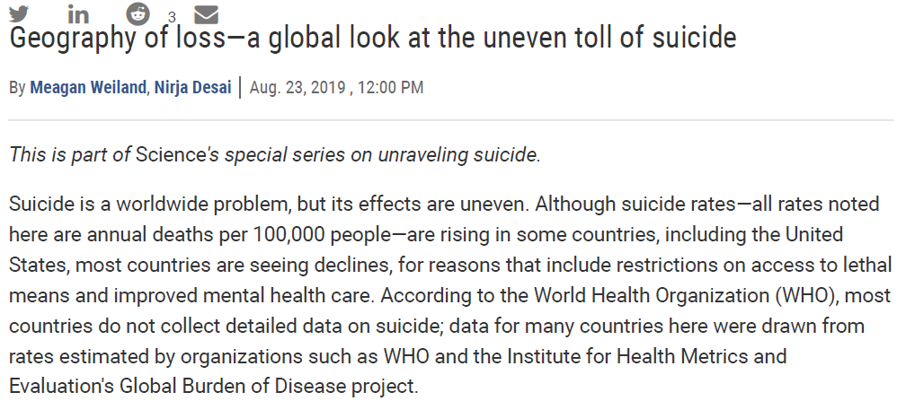

Slide 5
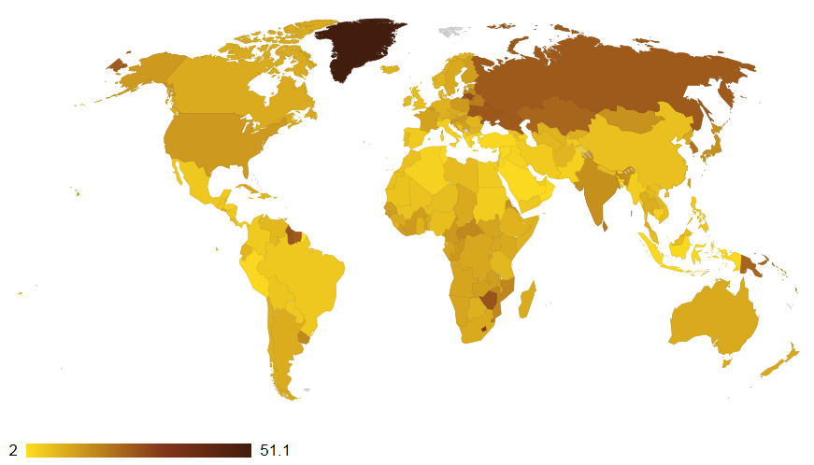
Global suicide

Slide 6
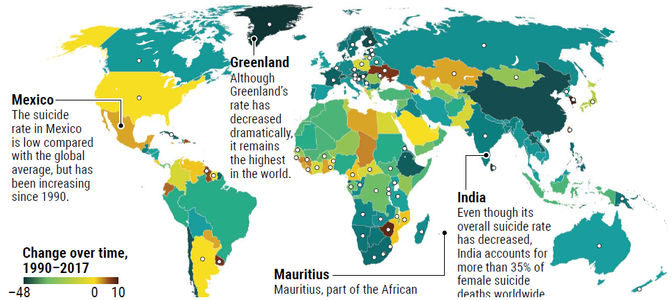
Changing rates

Slide 7
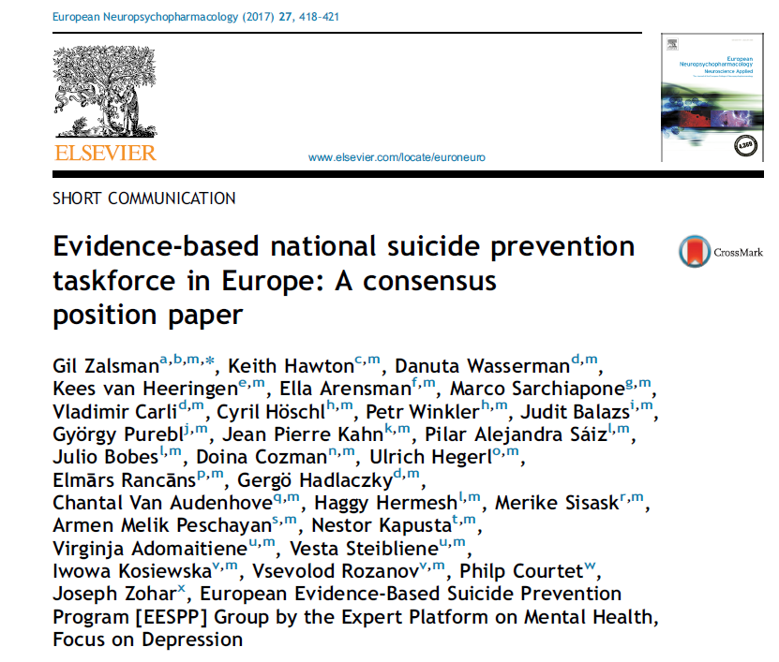

Slide 8
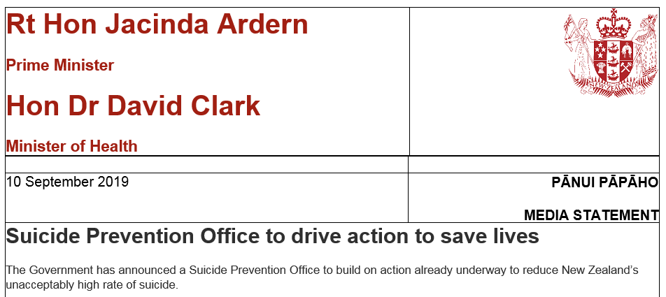

Slide 9
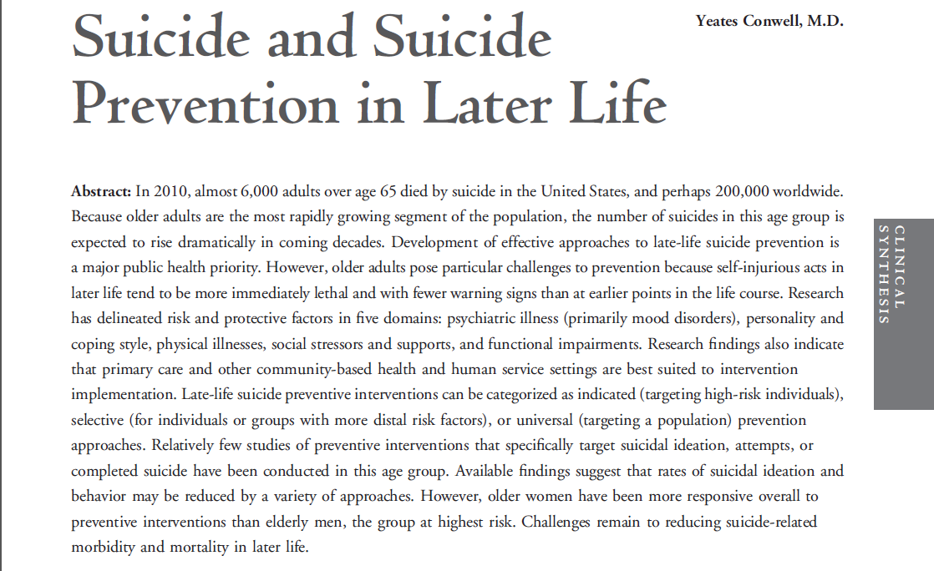

Slide 10
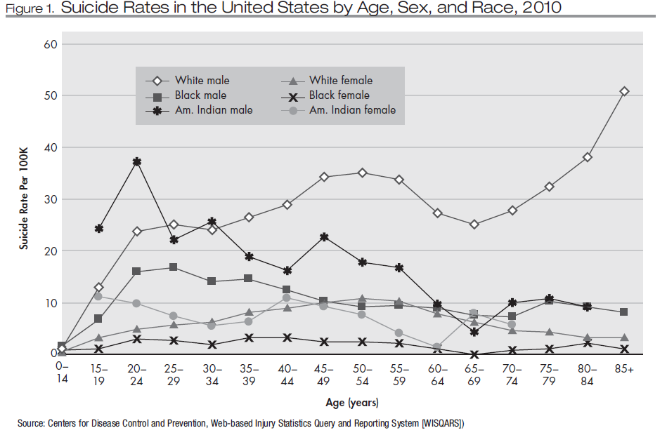
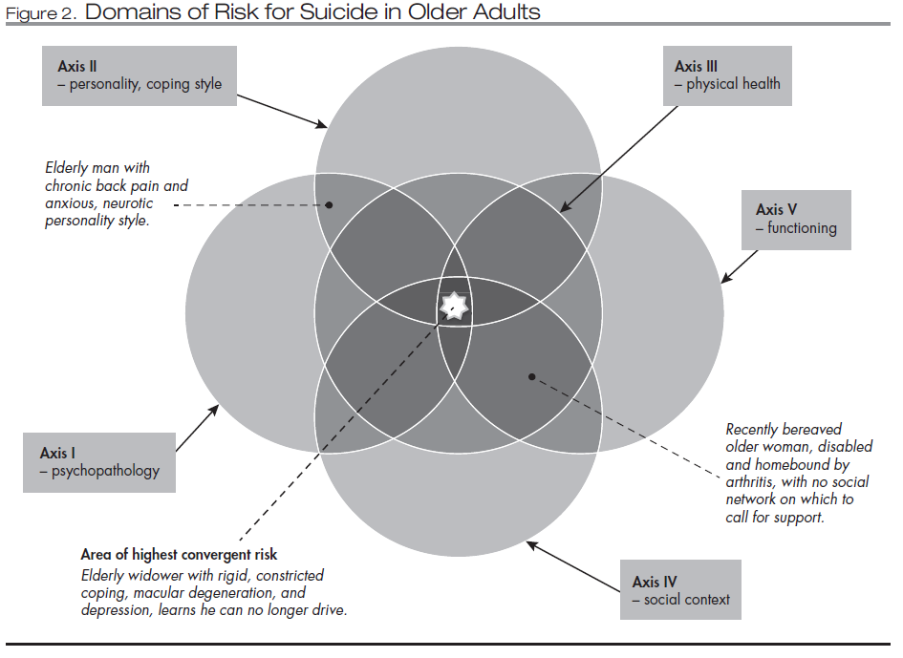

Slide 11
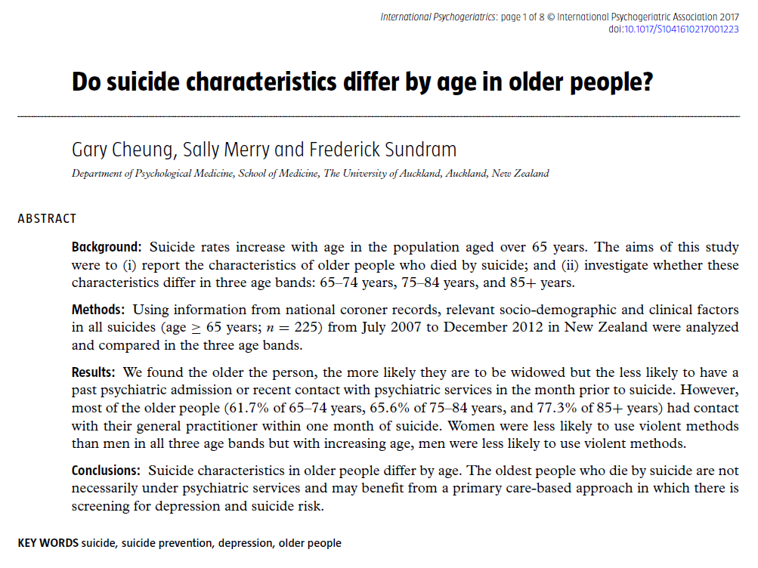

Slide 13
The Paper

Slide 15
Objective
To evaluate the rate of death by suicide in the oldest old men (age 85+) in New Zealand
To provide a theoretical discussion as to the factors driving these rates

Slide 16
Method
New Zealand Coroners Court
All unexpected deaths
Classified using ICD-10 AM
Suicide= Self inflicted act + Death was intended outcome
Approx. 600 suspected suicide per annum

Slide 17
Method

Slide 18
Method
Suicide data obtained from New Zealand Coronial Services website
Suicide rates per 100,000 collected for 85+ male and female
Note 2018 combined 85-89 and 90+ cohorts
High risk groups identified by Coroner: 15-19y, 20-24y, 25-29y (all male)
Mean suicide rates 2011-2019 calculated for 85y+ male cohort and high risk groups

Slide 19
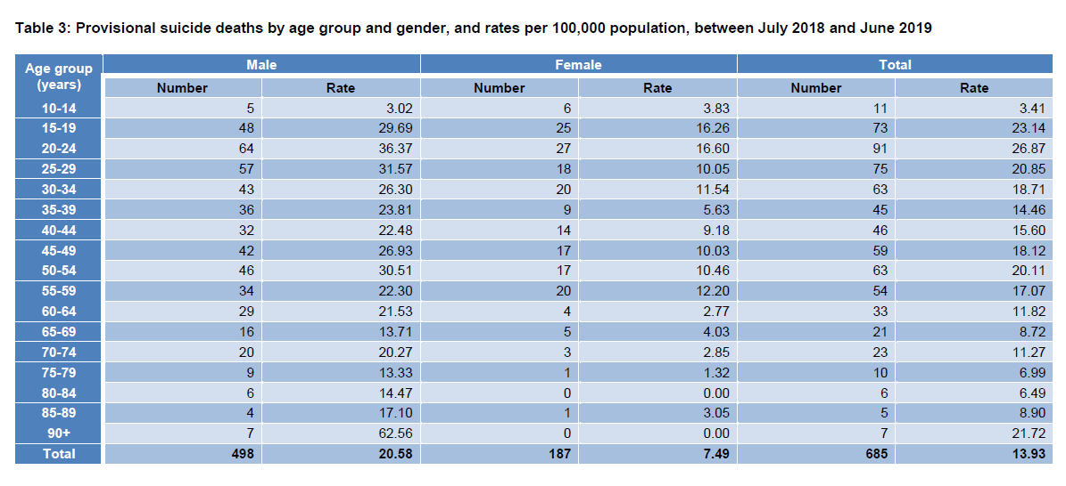
Results

Slide 20
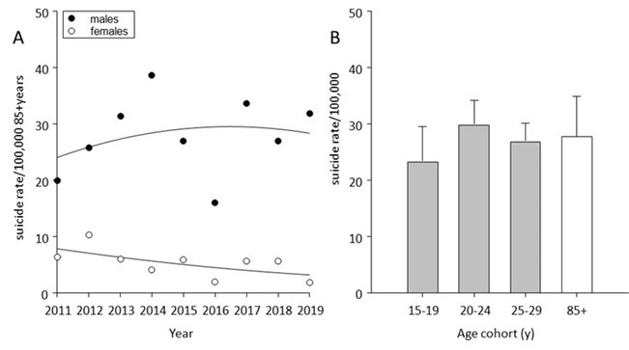
Results

Slide 21
Discussion- What should we do?
Older males in New Zealand are at high risk of death by suicide, comparable to young males
Prevention strategies should be emphasised
Assertive clinical assessment and intervention
Primary and hospital care providers need to consider suicide when in contact for physical health complaints
Data suggest prevalence in non-Maori males

Slide 22
Discussion- Factors to consider
Loneliness
Loneliness is becoming increasingly significant amongst older NZ males. This is directly associated with increased risk of suicide
Poverty
Poverty in the form of worse economic status, diminished wealth and unemployment are associated with suicidal ideation and behaviours. More than half of older NZ citizens have less than $100 a week non government income
Physical illness and Depression
There is an association between physical illness and suicide in the elderly. This is thought no to be direct but mediated through a mood disorder

Slide 23
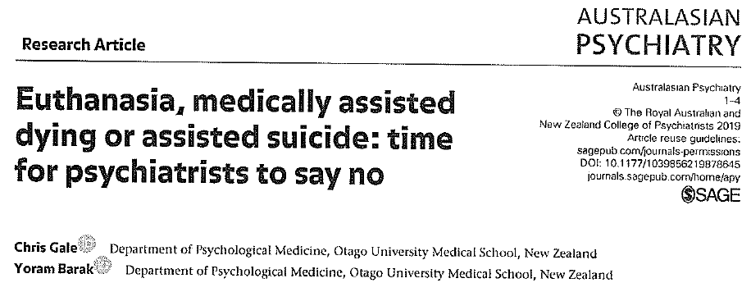
Food for Thought

Slide 24
Thank You!
Any questions?

