Slide 1
A Mental Health Pharmacist’s Journey: Making an Impact on Physical Health Monitoring
Royal Brisbane and Women’s Hospital
Ruby Cole
Senior Mental Health Pharmacist
Royal Brisbane and Women’s Hospital, Queensland, Australia

Slide 2
How mental health pharmacists have supported physical health monitoring at Royal Brisbane and Women’s Hospital:
Pharmacy audited compliance to guideline
Pharmacy standard updated to include CV risk monitoring
2017
Pharmacy created physical health screen pathology form
Reaudited compliance
2020
What did we already know
2016
Local HHS guideline developed
2019
Pharmacy reaudited compliance to guideline following updated pharmacy standard
2021
PRIMROSE comparative study

Slide 3
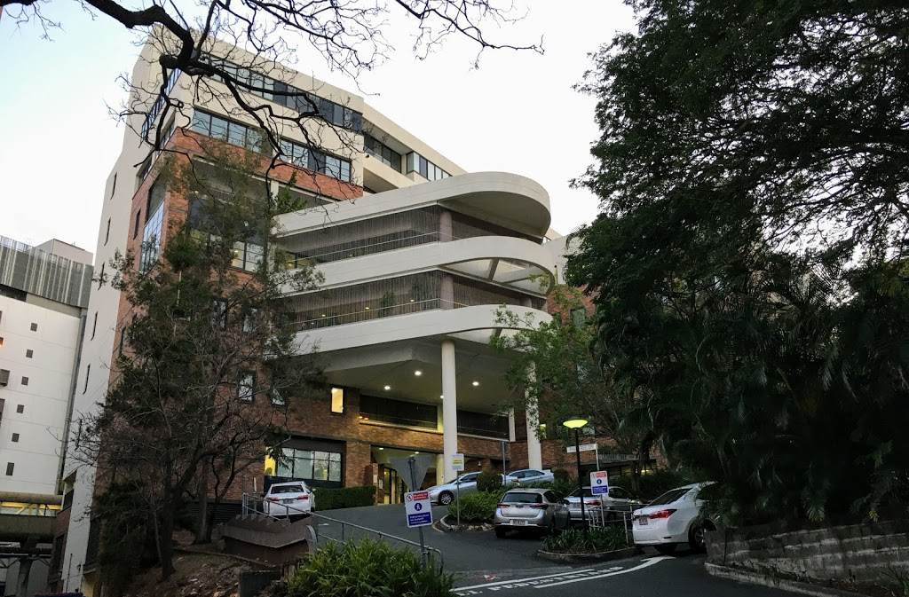
But first…a bit about us!
Royal Brisbane and Women’s Hospital (RBWH)
Largest tertiary hospital in QLD
Approx. 1000 beds
RBWH Mental Health
Service Brisbane metropolitan area
Community, inpatient and emergency services
87 acute mental health beds
4 FTE pharmacists, 1 dispensary technician

Slide 4
Our Journey on Improving Physical Health Outcomes for People with Mental Illness…
What did we already know?

Slide 5
What did we already know?
People with severe mental illness (SMI) die 15-25 years younger than the general population
WHY?
Illness-related Factors
Fatigue
Disorganisation
Lack of drive and motivation
Cognitive dysfunction
Weight gain
Sedentary lifestyle
Personal Factors
Poor financial means
Diet choices
Tobacco, alcohol, illicit substance use etc.
Systems Factors
Financial barriers to accessing healthcare
stigma
Metabolic Syndrome

Slide 6
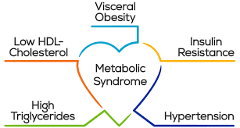
What do we already know about metabolic syndrome?
Constellation of obesity and related metabolic abnormalities that predict poor cardiovascular and overall health
Factors: underlying genetic predisposition, lifestyle factors, antipsychotic meds…
Burden of MS: 32.5%
¾ had abdominal obesity
½ were hypertensive
½ had abnormal LDL and TG concentrations
1/3 had elevated fasting glucose levels

Slide 7
So…what does this mean for us?
Early identification and preventative measures are key in avoiding or ameliorating the risk of metabolic syndrome
Prevention of weight gain and recognition/rapid intervention for emergent cardiometabolic risk parameters is key from very early stages of illness
Metabolic parameters should be monitored and followed up routinely

Slide 8
So… what did we do about it?
2016:

Slide 9
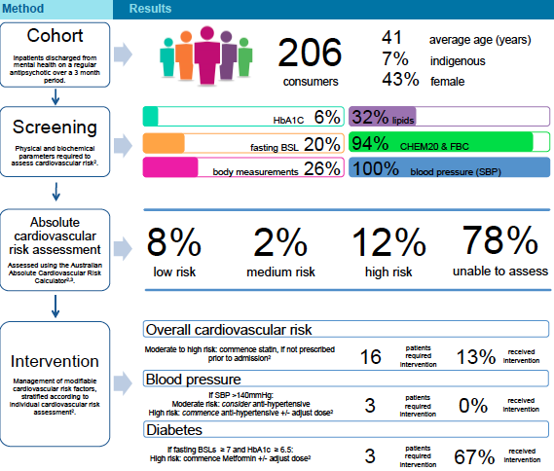
2017:
Conclusion: We weren’t doing very well…
What did we do next?
Updated RBWH MH pharmacy standard:
1. Calculate CVD risk for in-patients using the Australian absolute cardiovascular disease risk calculator.
2.Recommend interventions per local guideline.
3. If CV risks were unable to be calculated due to incomplete metabolic screening, prompt medical officers.
Then re-audited …

Slide 10
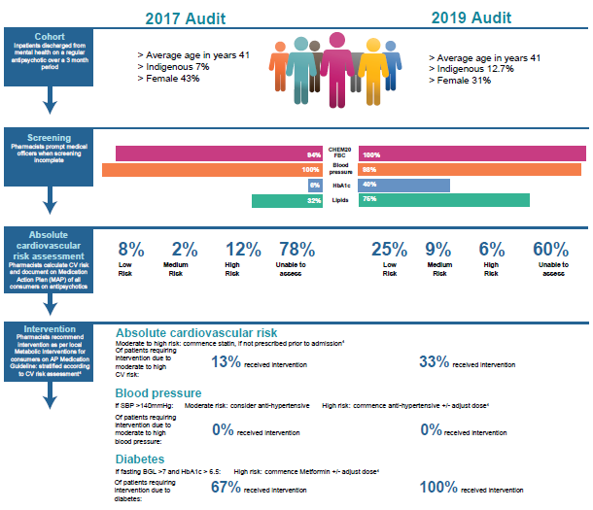
Conclusion: we were getting there…
Pharmacists are well positioned to recommend monitoring and management of CVD risk factors
Still lots of room to improve!

Slide 11
Why were the calculation numbers still so low?
No HbA1c and no lipids – can’t use CV risk calculator

Slide 12
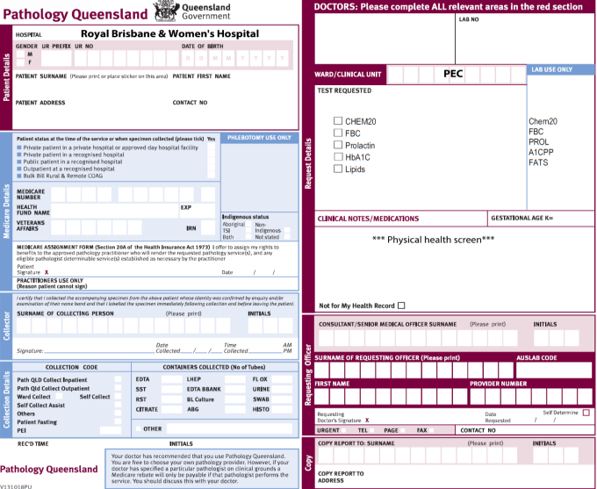
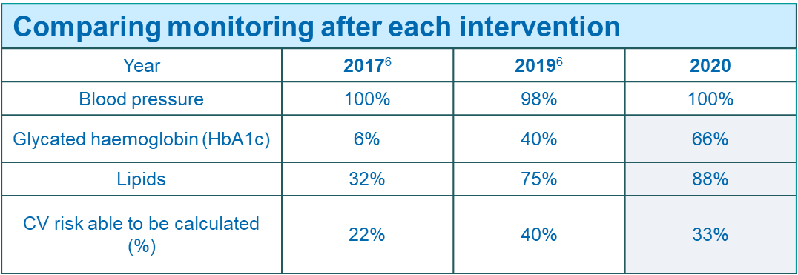
2020:
HbA1c and lipids improved… but CVD risk calculations didn’t?

Slide 13
HbA1c and lipid monitoring increased
Still large proportion couldn’t be calculated due to age…

Slide 14
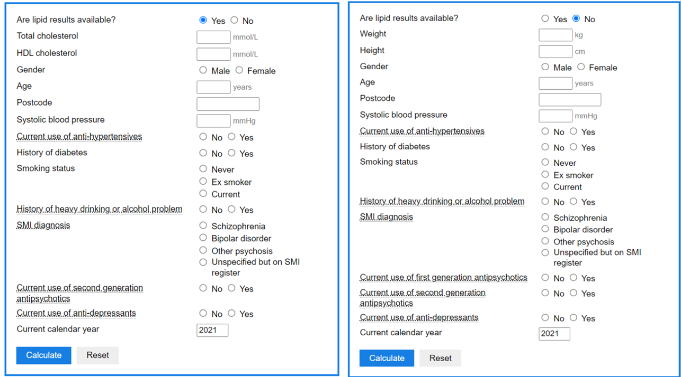
2021 – PRIMROSE Metabolic Monitoring
PRedIction and Management of cardiovascular Risk in people with SEvere mental illness

Slide 15
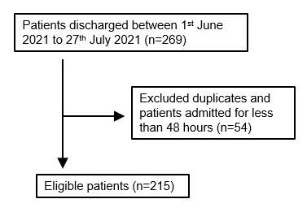
Aim
To calculate and compare CV risk for mental health inpatients using ACC and PRIMROSE to assess if PRIMROSE increases CV risk detection compared to ACC.
Evaluate potential benefit and applicability of PRIMROSE
PATIENT COHORT
Age (mean) | 38 years
Gender | 46% female (n=99) 54% male (n=116)
Indigenous Australians (%) | 10% (n=23)
LOS (average) | 12 days
SMI diagnosis | 85.1% (n=183)

Slide 16
Risk Rating % Score (total patients)
What did we find?
PRIMROSE risk rating % score
(patients outside age range for ACC)

Slide 17
PRIMROSE – let’s talk
Retrospective – lack of documentation meant not all data available
(anticipated 100% calculation with PRIMROSE if prospective)
Unable to apply the UK postcode functionality to Australian patients
Results from ACC were more conservative, with patients receiving higher CV risk scores with ACC than PRIMROSE.
Conclusion: PRIMROSE increases number of patients able to be assessed but doesn’t increase risk detection
Current processes and calculators can be assumed to capture the high-risk population.

Slide 18
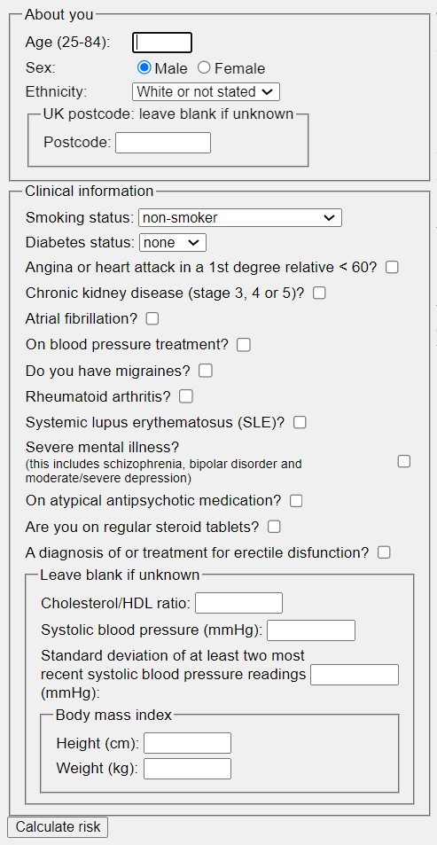
What now?
Use other calculators that take mental health into account e.g. QRISK3?
Implement PRIMROSE into practice?
Create our own SMI CV risk calculator?

Slide 19
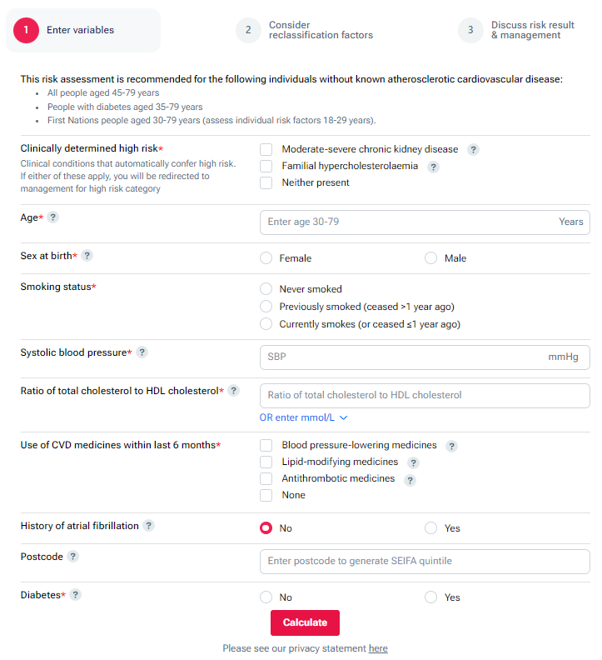
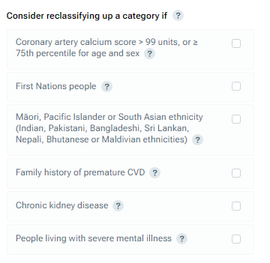
July 2023:
New CVD risk calculator

Slide 20
Where to from here?
More audits!!!

Slide 21
