Slide 1
Sexual Dysfunction and Antidepressants
Rochelle, psychiatry trainee
Notes:
Kia Ora
Introductions
Thanks for having me

Slide 2
Sexual health
Sexual health is a state of physical, emotional, mental and social well-being in relation to sexuality; it is not merely the absence of disease, dysfunction or infirmity. Sexual health requires a positive and respectful approach to sexuality and sexual relationships, as well as the possibility of having pleasurable and safe sexual experiences free of coercion, discrimination and violence. For sexual health to be attained and maintained, the sexual rights of all persons must be respected, protected and fulfilled.
Sexuality
Sexuality as a central aspect of being human encompasses sex, gender identities and roles, sexual orientation, eroticism, pleasure, intimacy and reproduction. Sexuality is experienced and expressed in thoughts, fantasies, desires, beliefs, attitudes, values, behaviours, practices, roles and relationships. While sexuality can include all of these dimensions, not all of them are always experienced or expressed. Sexuality is influenced by the interaction of biological, psychological, social, economic, political, cultural, legal, historical, religious and spiritual factors.

Slide 3
A Declaration on Sexual Pleasure was issued by the World Association for Sexual Health (WAS) on September 11, 2021 at the General Assembly of the 26th World Congress of Sexual Health
1. The possibility of having pleasurable and safe sexual experiences free of discrimination, coercion, and violence is a fundamental part of sexual health and well-being for all
2. Access to sources of sexual pleasure is part of human experience and subjective well-being
3. Sexual pleasure is a fundamental part of sexual rights
4. Sexual pleasure includes the possibility of diverse sexual experiences
5. Sexual pleasure shall be integrated into education, health promotion and service delivery, research and advocacy in all parts of the world
6. The programmatic inclusion of sexual pleasure to meet individuals’ needs, aspirations, and realities ultimately contributes to global health and sustainable development and it should require comprehensive, immediate and sustainable action

Slide 4
Small nod towards a complex stigma
For many decades the primary medical, academic and cultural discourses on sexuality have been dominated by concerns about disease, risk, danger, sin and shame.
Historically, medical science has exercised considerable authority over sexuality since the second half of the 19th century where sexual pleasure was often seen as pathology.
For example, masturbation, homosexual desire and overt sexual interest, particularly if expressed by women were, until quite recently, seen as symptomatic of psychiatric illness and perversion.
Many remnants of a focus on the negative outcomes of sexual expression remain today.

Slide 5
Sexual Response Cycle +
SPIRTUAL
SOCIAL
BIOLOGICAL
RELATIONAL
CULTURAL
EDUCATIONAL
PSYCHOLOGICAL
ENVIRONMENTAL

Slide 6
Sexual Dysfunction
Common
Up to 40% of the general population
50 – 70% of people affected by depression
Up to 80% of people taking SSRI medication

Slide 7
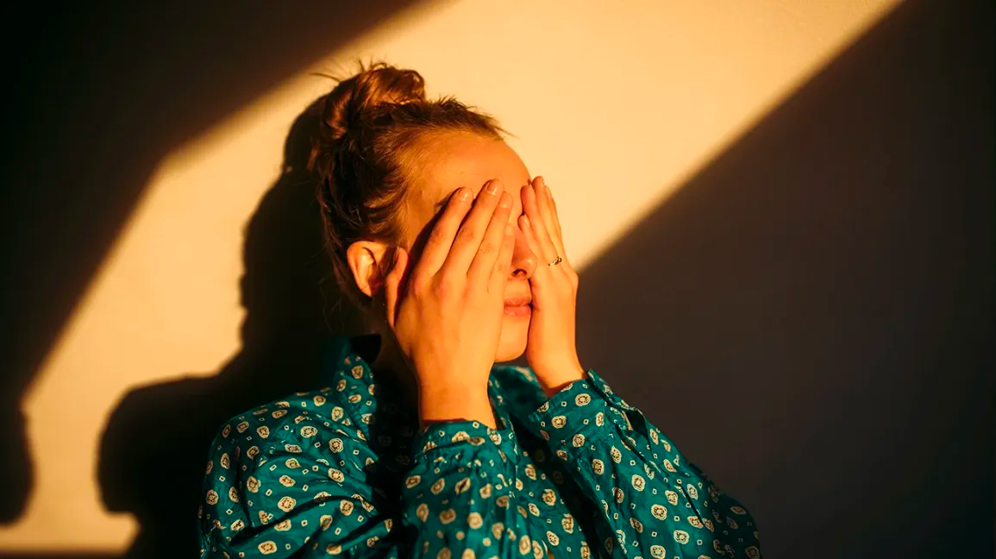

Slide 8
Sexual Dysfunction and Depression
The main type of sexual dysfunction that occurs with depression is low sex drive, with disorders of arousal and orgasm or ejaculation occurring less commonly.
Adequate treatment of depression may improve sexual functioning in some patients.
Large variations in types of dysfunction and methodological approaches in clinical trials make it difficult to estimate the exact incidence, which is further complicated by the overlap between sexual dysfunction and depression.
Strong bidirectional relationship.

Slide 9
Sexual Dysfunction and Depression

Slide 10
Antidepressants and Sexual Dysfunction
SSRI sexual dysfunction incidence can be as high as 80%.
A leading cause of medication non-adherence and early discontinuation of treatment.
Often under-reported and over-looked.
Spontaneous reporting < direct questioning < questionnaires/scales.
Affects all phases of sexual activity, including desire, arousal and orgasm, in both men and women.
Despite the overlap -> The additional relationship between serotonergic drug use and sexual side effects has been demonstrated convincingly.

Slide 11
Antidepressant related sexual dysfunction – Mechanism
Serotonin appears to be the main neurotransmitter that has negative effects on sex drive and sexual function, both centrally and peripherally.
In particular, the activation of post-synaptic serotonin (5-HT) 2A receptors in the central serotonergic system is considered a significant contributor to antidepressant-induced sexual dysfunction.
In contrast, dopamine and noradrenaline agonism may have positive effects on sex drive and arousal.

Slide 12
Antidepressant related sexual dysfunction – Mechanism

Slide 13
Antidepressant related sexual dysfunction – Mechanism

Slide 16
Assessment
Identify patient preferences
Previous sexual S/E
Sexual history, family history, medical history
Baseline pretreatment sexual function
Track sexual S/E across course of treatment
Validated scales (more next slide)
Or at least directly ask

Slide 17
Assessment CSFQ

Slide 18
Assessment
PRSexDQ
A – Have you observed any type of change in your sexual activity since you began taking this medication?
Have you observed any decrease in your desire for sexual activity?
Have you observed any delay in ejaculation/orgasm?
Have you observed that you are unable to ejaculate/orgasm?
Have you experienced any difficulty in obtaining or maintaining an erection or vaginal lubrication during sexual activity?
How well have you tolerated these changes?

Slide 19
Comparing Antidepressants

Slide 21
Management options/considerations
Consider other causes – depression, alcohol, diabetes, cardiac disease, other medications e.g. antipsychotics, lithium, mood stabilisers, diuretics, B-blockers
Watch and wait – resolution or at least moderate improvement occurred in 6-12% in 4-6 months. Could consider if mild SD.
Reduce dose – limited evidence, consider if well-controlled/high dose or other ADRs.
Change times/drug holiday – not that practical or safe.
Switch to a different antidepressant
– If switching from escitalopram/paroxetine could consider same class otherwise likely limited benefit
Switch to antidepressant with less risk of SD e.g. moclobemide, mirtazapine or bupropion (agomelatine, reboxetine, vortioxetine, desvenlafaxine)
Augmentation or adjunction treatment (next slide)
Non-pharmacological treatments – psychotherapy, CBT, couples therapy, mindfulness, exercise, saffron

Slide 24
A note on PSSD
Post-SSRI sexual dysfunction/ Persistant
Since 2006 growing number of publications, including case reports, case series and qualitative research.
Largely unrecognised in research trials and professional communities, but increasingly identified in online communities.
EMA recently acknowledged potential for this adverse effect with SSRIs and SNRIs.
PSSD includes decreased libido, genital anaesthesia, pleasureless or weak orgasm, erectile dysfunction, delayed ejaculation, loss of lubrication in women, and anorgasmia. Of these symptoms, the most characteristic triad consists of genital anaesthesia, loss of libido, and erectile dysfunction.
Incidence unknown. Pathophysiology unclear but there are proposed mechanisms.
To be aware but not advisable to discuss necessarily.
It is important to record baseline sexual function and perform regular follow-up during and after SSRI or SNRI use.

Slide 25
Summary
Importance of psychosexual history
Bidirectional relationship between depression and sexual dysfunction
Sexual dysfunction is a frequent, potentially distressing, adverse effect of antidepressants and a leading cause of medication non-adherence
Need to actively assess and try to use validated rating scales
Risk is greatest with SSRIs/SNRIs, less with tricyclics (except clomipramine) and mirtazapine, and least with moclobemide and bupropion
Management requires an individualised approach (consider other causes, dose, switch, adjunct/augment, non-medication options)
Let's take note of the WAS declaration and take a positive, holistic view of sexual health including sexual pleasure, and try to keep the stigma and shyness on the down low

Slide 26
References
Jessie V. Ford, Esther Corona-Vargas, Mariana Cruz, J. Dennis Fortenberry, Eszter Kismodi, Anne Philpott, Eusebio Rubio-Aurioles & Eli Coleman (2021) The World Association for Sexual Health’s Declaration on Sexual Pleasure: A Technical Guide, International Journal of Sexual Health, 33:4, 612-642, DOI: 10.1080/19317611.2021.2023718
Rosenberg KP, Bleiberg KL, Koscis J, Gross C. A survey of sexual side effects among severely mentally ill patients taking psychotropic medications: impact on compliance. J Sex Marital Ther 2003; 29: 289–296
Hirsch M, Birnbaum RJ. Sexual dysfunction caused by selective serotonin reuptake inhibitors (SSRIs): management [website]. UpToDate 2019, 24 Aug. https ://www.uptod ate.com/conte nts/sexual-dysfu nction-caused-by-selec tive-serot onin-reupt ake-inhib itors-ssris-manag ement
Anita H. Clayton, Harry A. Croft & Lata Handiwala (2014) Antidepressants and Sexual Dysfunction: Mechanisms and Clinical Implications, Postgraduate Medicine, 126:2, 91-99, DOI: 10.3810/pgm.2014.03.2744
Joan Winter, Kimberly Curtis, Bo Hu & Anita H. Clayton (2022) Sexual dysfunction with major depressive disorder and antidepressant treatments: impact, assessment, and management, Expert Opinion on Drug Safety, 21:7, 913-930, DOI: 10.1080/14740338.2022.2049753
Carcedo, R. J., Fernández-Rouco, N., Fernández-Fuertes, A.,A., & Martínez-Álvarez, J. L. (2020). Association between sexual satisfaction and depression and anxiety in adolescents and young adults. International Journal of Environmental Research and Public Health, 17(3) doi:https://doi.org/10.3390/ijerph17030841
Stefano Eleuteri, Valeria Saladino & Valeria Verrastro (2017) Identity, relationships, sexuality, and risky behaviours of adolescents in the context of social media, Sexual and Relationship Therapy, 32:3-4, 354-365, DOI: 10.1080/14681994.2017.1397953
Antidepressant-related sexual dysfunction — Perspectives from neuroimaging (sciencedirectassets.com)
Female sexual dysfunction and adolescents.pdf
Angel K. The history of 'Female Sexual Dysfunction' as a mental disorder in the 20th century. Curr Opin Psychiatry. 2010;23(6):536-541. doi:10.1097/YCO.0b013e32833db7a1
Psychosexual history-taking in the 21st century: new terminology, new technology and new risks (otago.ac.nz)
Rothmore J. Antidepressant-induced sexual dysfunction. Med J Aust. 2020 Apr;212(7):329-334. doi: 10.5694/mja2.50522. Epub 2020 Mar 15. PMID: 32172535.

