Slide 1
rTMS
An introduction to repetitive transcranial magnetic stimulation
12th Aug 2023
Dr Lawrence Leung
The Ashburn Clinic

Slide 2
Contents
Demonstrative video
Background and development
Proposed mechanism of action
Evidence
Treatment
Time for questions

Slide 3
Video
https://www.youtube.com/watch?v=UmSe9LIq3LM

Slide 4
Available treatments for Psychiatric Disorders
Pharmacotherapy
Psychotherapy
Neuromodulation (eg ECT)

Slide 5
Emerging trends
Pharmacogenetics (precision medicine)
Psychedelics (+ therapy)
TMS

Slide 6
Emerging trends
Pharmacogenetics (precision medicine)
Psychedelics (+ therapy)
TMS
Non-invasive procedure
Magnetic pulses
Stimulate brain cells

Slide 7
History of electrical brain stimulation
Wide area stimulation: ECT (1930s)
Precise brain stimulation (invasive):
Awake brain surgery with intraoperative motor mapping - to preserve function in motor area tumour resection
Deep brain stimulation, with electrode implant
Precise brain stimulation (“non-invasive” 1980s):
Transcranial electrical stimulation of motor cortex, invoking motor response
Published in nature: “stimulation of the cerebral cortex in the intact human subject”
Painful

Slide 8
Early attempts of electromagnetic brain stimulation
Jacques-Arsene d’Arsonval, Paris 1896
Silvanus P Thompson, London 1910

Slide 9
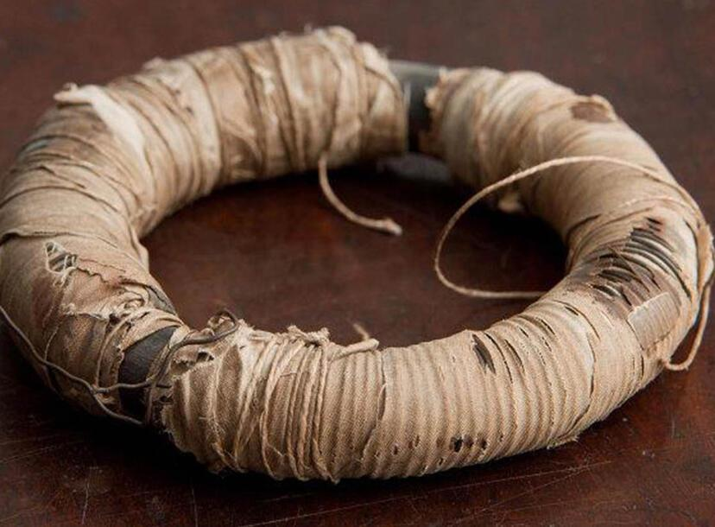
Anthony Barker, PhD, 1985 UK
Conducted research in nerve stimulation
Using magnetic field to induce an electrical current with a Faraday coil
Move a hand muscle by stimulating motor cortex

Slide 10
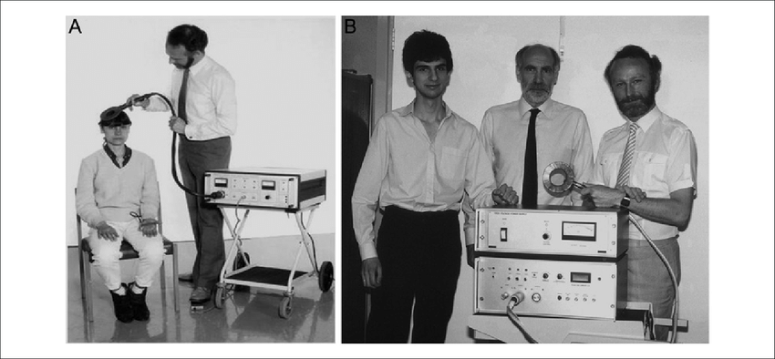
The prototype TMS machine

Slide 11
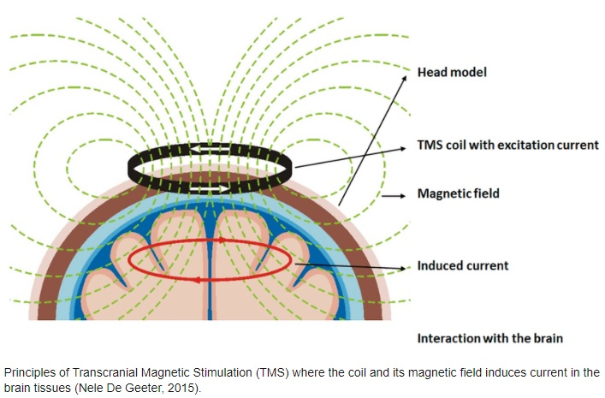
TMS machine

Slide 12
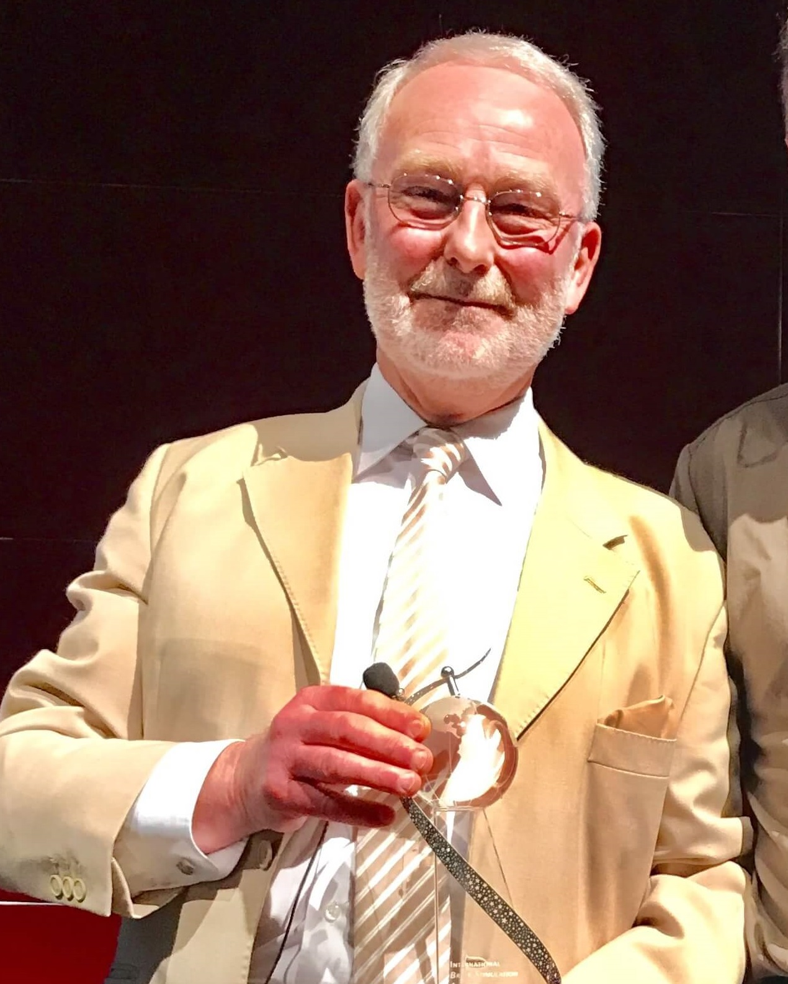
Anthony Barker’s legacy
Chose not to patent the device

Slide 13
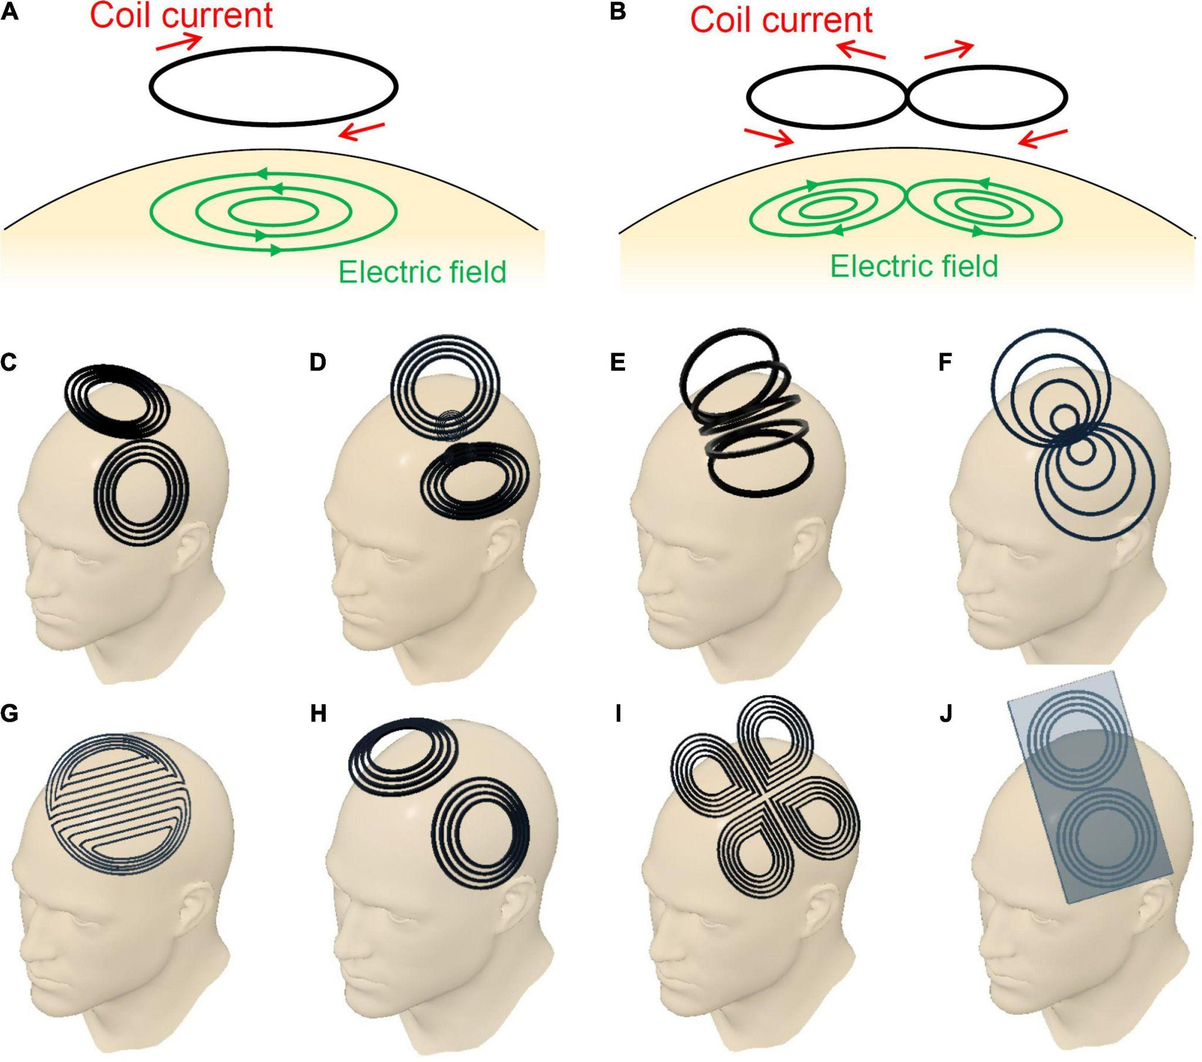
Improved coil shape
(A) Circular coil
(B) planar figure-eight coil
(C) butterfly coil
(D) quadruple butterfly coil
(E) slinky coil
(F) eccentric figure-eight coil
(G) double-D coil
(H) H6-coil
(I) cloverleaf coil
(J) figure-eight coil with iron core

Slide 14
Angulated figure of 8 coil, with cooling
2 vortices merge at the centre of figure 8
Enables localised and focal brain stimulation: 3x stronger
Angulated coil reaches deeper target area
Capable of repetitive stimulation
Notes:
Figure of 8 coil depth : 1-3.4cm
Figure of 8 coil surface spread area: 5cm2
Circular coils: 34cm2

Slide 15
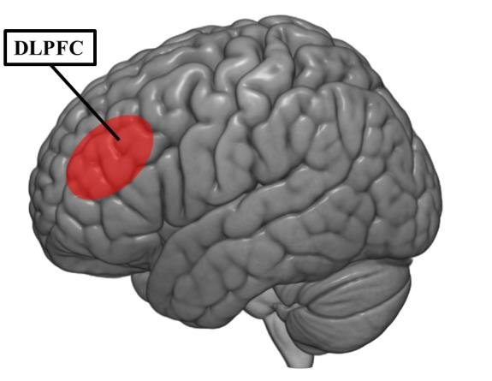
How did it become a treatment for depression?
Functional imaging studies in Major Depressive Disorder
L dorsolateral prefrontal cortex (DLPFC) underactive compared to R DLPFC
Theory: stimulating L DLPFC leads to improvement in symptoms
Also can be done bilaterally by inhibiting R DLPFC
Notes:
DLPFC - part of default mode network and central executive network

Slide 16
Proposed mechanisms of action
Effects on neurotransmitters and synaptic plasticity
Effects on gene/enzyme expressions in neurons
Neuroprotective effects
Neurotrophic effects - increase BDNF
“Quantum effects”!
Chervyakov, A. V., Chernyavsky, A. Y., Sinitsyn, D. O., & Piradov, M. A. (2015). Possible Mechanisms Underlying the Therapeutic Effects of Transcranial Magnetic Stimulation. Frontiers in Human Neuroscience, 9. doi:10.3389/fnhum.2015.00303
Notes:
modulating GABA inhibitory pathways, increase endogenous dopamine, change in receptor numbers
- reduced β-adrenoreceptors in frontal/cingulate cortices
- increased NMDA receptors in ventromedial thalamus/amygdala/parietal cortex

Slide 17
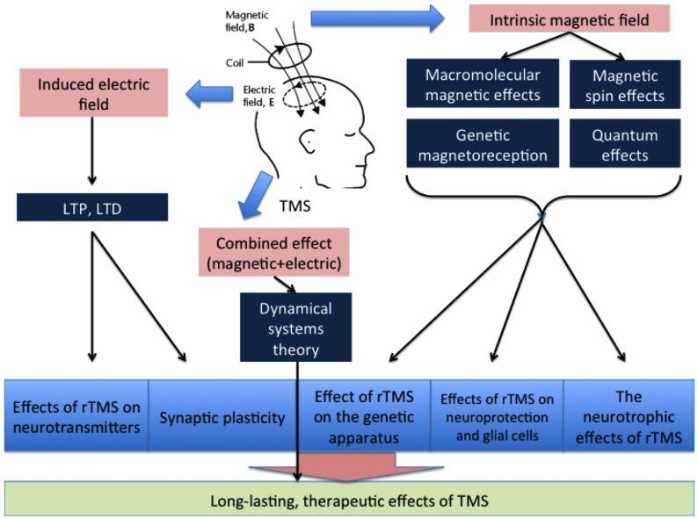

Slide 18
Evidence
Case reports 1995
Pilot controlled clinical trials 1996
Larger scale multi-site clinical trials 2000s
Meta-analyses from 2001 onwards
Sham-TMS allows double blinding

Slide 19
Evidence
Sackeim et al. 2020
5010 patients, 103 practices
Includes intention-to-treat basis and treatment completers (at least 20 sessions)
Response rates: 83% for 20+ sessions group, 58% for ITI group
Remission rates: 62% for 20+ sessions group, 28% for ITI group

Slide 20
Evidence
Meta-analysis shows moderate to large effect size
Slotema et al. 2010:
34 trials (7 antidepressant free, 17 stable on Rx, 5 simultaneously commenced Rx and TMS), 1383 patients, active vs sham TMS
Effect size 0.55 (p<0.001)
Fail-safe number of 18462 studies
Kedzior et al. 2014:
increase in effect size in newer studies
18 trials from 2010-2013: effect size 0.8
40 trials from 1997-2008: effect size 0.54

Slide 21
Combined treatment with psychotherapy (Donse 2018)
Combined rTMS and PT:
66% response rate
56% remission rate
60% sustained remission on follow-up
Early symptom improvement highly predictive of response

Slide 22
Compared to medications
STAR*D 2006
Level 1: response rate 47%, remission rate 27-33%
Level 2: remission rate (switch) 18-27%, (augmentation) 17-39%
Level 3: remission rate (switch) 8-20%, (augmentation) 13-25%
Level 4: response rate 12-24%, remission rate 7-16%
Fitzgerald et al 2016
1100 patients
45% response rate in group of patients who averaged more than 5.5 failed medication trials

Slide 23
Conclusion on evidence
Australia:
Recommended for public funding through Medical Services Advisory Committee, based on formal application supported by RANZCP
Funding approved by Australian Federal Government 2021
Canada:
Ontario Health Technology Assessment Group 2021
“Most rTMS modalities are likely more effective than sham rTMS on all outcomes.”
“All rTMS modalities are similar to ECT and to one another in response and remission rates.”
“rTMS was cost-effective compared to pharmacotherapy, at a willingness to pay of $50,000 per quality-adjusted life year.”

Slide 24
Availability
Canada: approval of TMS 1997
US: FDA approval 2008 (also approved for OCD)
AU: covered by Medicare Benefits Schedule from 2021
NZ: in Auckland, Tauranga, Rotorua, now Dunedin (Wellington soon)

Slide 25
What does rTMS treatment for MDD look like?
Multiple protocols exists
Amplitude of stimulation depends on individual Resting Motor Threshold
Standard: 30 sessions of treatment, usually daily over 6 weeks
Early responders may see improvement at 10 sessions
Most would see improvement by 15-25 sessions
If responded, wean off sessions over 3-4 weeks may be recommended

Slide 26
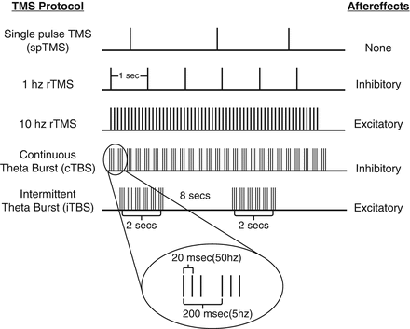
Protocols
Original: 37.5 minutes, 10Hz, L DLPFC (3000 pulses)
19 minutes, 10Hz, L DLPFC (3000 pulses)
Bilateral:
10Hz to L DLPFC
1Hz to R DLPFC
iTBS (intermittent theta burst stimulation)
Trains of 5x 20ms of 50Hz, 200ms apart
8s in between trains
3 minutes in total

Slide 27
Contraindications
Absolute:
Ferromagnetic objects in head/neck area
Relative:
History of seizures/epilepsy
History of major head trauma
History of stroke
History of neurosurgery
Caution with pregnancy - not yet well studied

Slide 28
Tolerability and side effects
Seizures (<1:30000 treatment)
Headache (20%)
Scalp discomfort (5%)
Neck pain
Muscle twitching
Jaw clenching
Fatigue
Dizziness
Tinnitus
Discontinuation rates of rTMS 2.7% (Zis et al., 2020)
Numerically but not statistically lower than sham-treated patients

Slide 29
No evidence of long term adverse consequences:
Cognition
Perceptual abilities
Motor functions
Permanent hearing loss

Slide 30
Concurrent medication use (Hunter et al. 2019)
Benzodiazepine:
Less improvement at 2 weeks
Stimulants:
Greater improvement at 2 weeks, and across 6 weeks
SSRI, SNRI, TCA, MAOI, antipsychotics, anti-epileptics, lithium
No statistically significant difference

Slide 31
Access and cost
Not currently publicly funded, available privately
Referral by GP, psychiatrist or clinical psychologist
Cost $4500nzd at Ashburn Clinic
Includes pre-assessment interview
Measuring of RMT
30 sessions of treatment
Monitoring of progress at sessions 10, 20 and 30
Wean off sessions at additional cost

Slide 32
Thank you

